Slide 1
South East ICB teams
November 2022

Slide 2
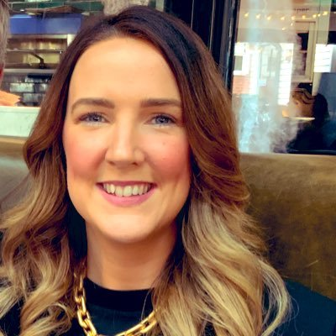
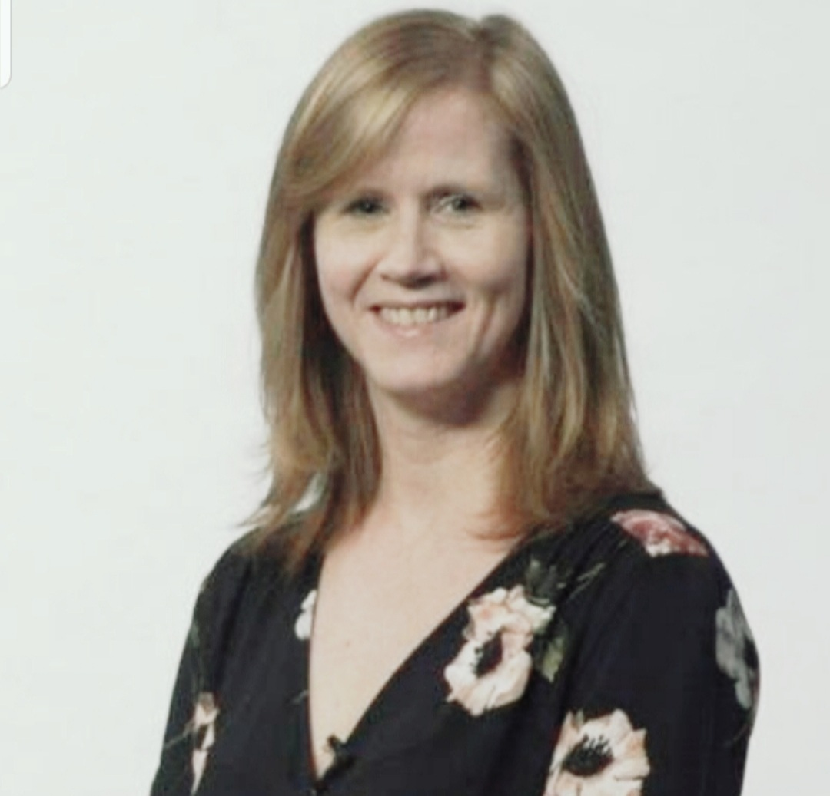
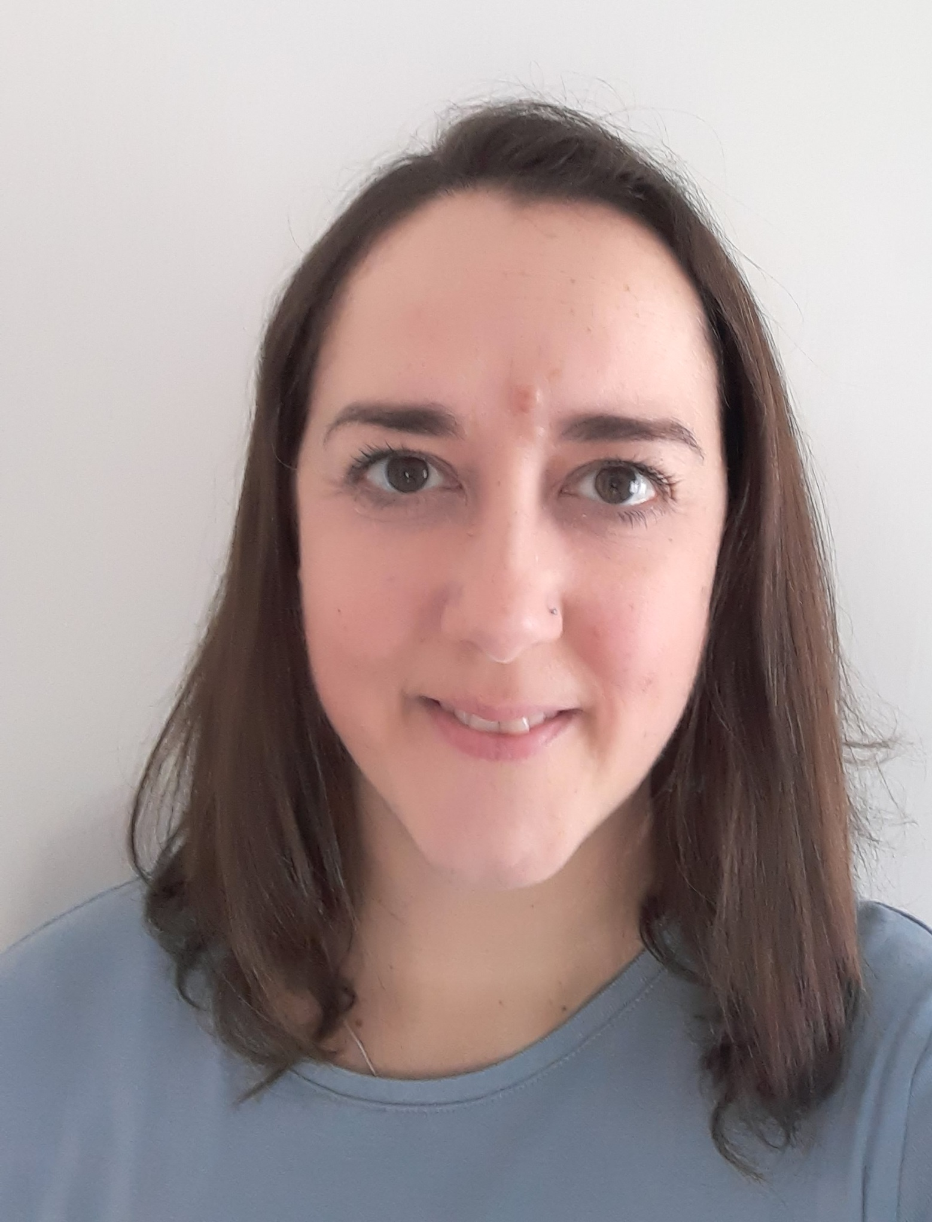
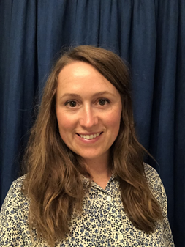
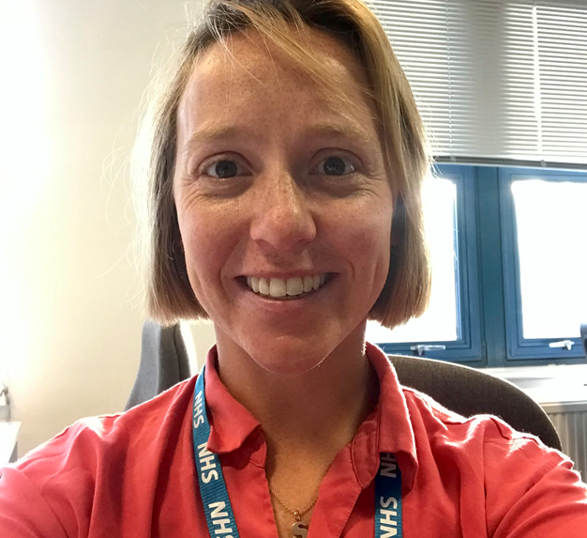
Emma Buckwell
Placement Expansion Facilitator
Team email: kmicb.cpep@nhs.net
Emer Keating
System Head of Placements (Non-Medical)
Katy Osbaldeston, AHP Placement Lead
Alison Smith-Robbie
Placement Lead – Nursing & Midwifery.
Alice Walker, AHP Placement Lead
Teresa Buchan ICS Allied Health Professions Placement Lead (Programme Manager)
Sophia Hicks
Placement Lead Nursing and Midwifery
sxicb.clinicalplacementsteam@nhs.net

Slide 3
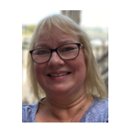
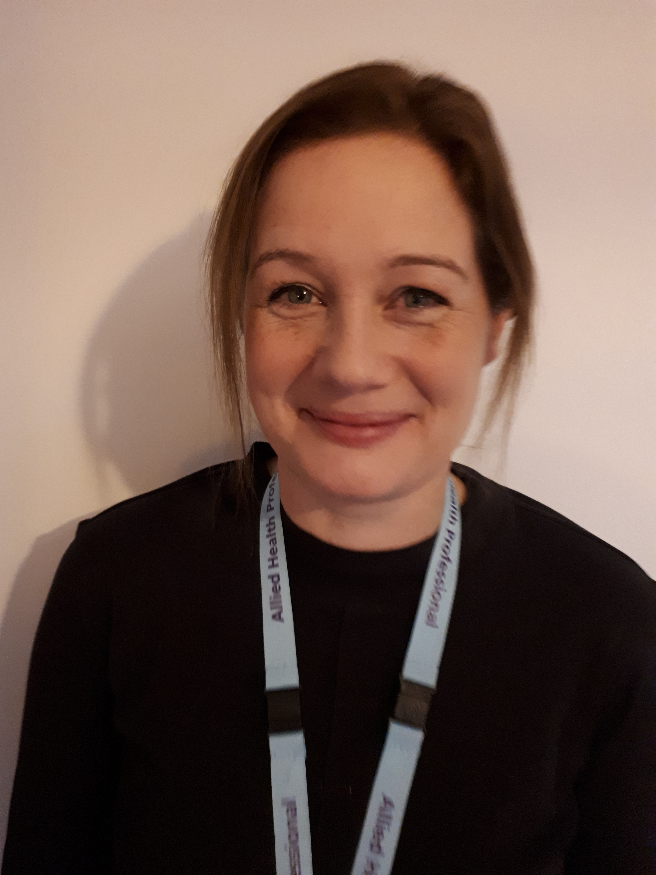
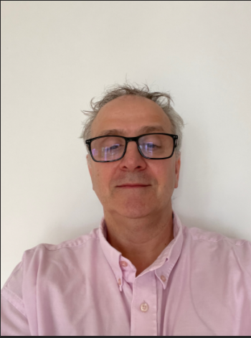
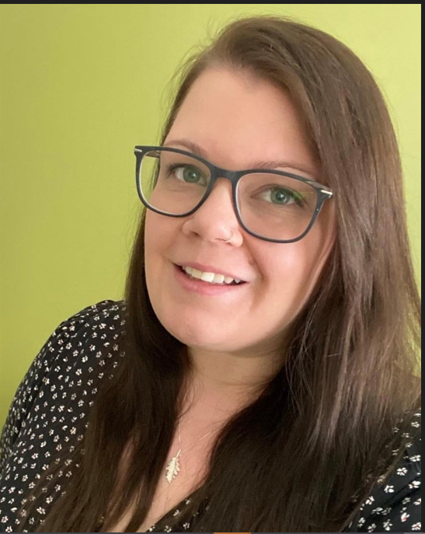
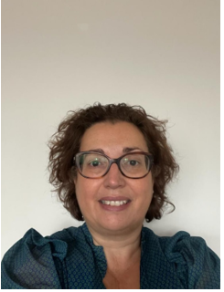
Cath Grant
AHP Strategic Clinical Placement Lead
Cath.grant3@nhs..net
Sharon Goodchild
Non NHS Placements Manager
sharon.goodchild@hhft.nhs.uk
Project Implementation Manager
sapphire.loveday@hhft.nhs.uk
Nichola Martin Strategic Clinical Placement Manager – Nursing and Midwifery
Nichola.Martin@hhft.nhs.uk

