Slide 1

Research Pillar
Róisín Fallen-Bailey, Physiotherapist & HEE/NIHR Pre-doctoral clinical academic fellow.
Twitter @DaraRoisin

Slide 2
Overview
Research pillar
Research opportunities available
Accessibility of research at all levels
Example of work

Slide 3

Research Pillar
Not just about research
Includes:
  Critical appraisal and the use of research in your service
  Evaluation of practice and service delivery
  Monitoring impact locally, regionally, nationally, internationally
Notes:
Chat about research is.
Define impact what impact is
Define audit

Slide 4

Definitions
Research = finding out new knowledge that lead to changes
Audit = compare care to an agreed standard
Evaluation = a measure of how well a treatment or project is being carried out (continuous or at the end)
Impact = the contribution, effect or benefit research makes to health, care, policy, culture, society, economy
Notes:
Research = The term research means different things to different people but is essentially about finding out new knowledge that could lead to changes to treatments, policies or care. The definition used by the Department of Health is: “The attempt to derive generalisable new knowledge by addressing clearly defined questions with systematic and rigorous methods.”
An audit of health or social care involves carrying out a systematic assessment of how well that care is being delivered. Current policy and practice is compared with an agreed standard, so that any problem areas can be identified and improved. Later, the audit can be carried out again to check that the changes made have actually made a difference
This involves assessing whether an intervention (for example a treatment, service, project, or programme) is achieving its aims. A project can be evaluated as it goes along or right at the end. An evaluation can measure how well the project is being carried out as well as its impact. The results of evaluations can help with decision-making and planning.
What is not impact = patent, media interest, presentations, public engagement activities, collaborations. Goes beyond academia

Slide 5

Research into Practice
17 years from research to practice
85% of all health research is wasted
Annual waste of $170 BILLION worldwide
No need to reinvent the wheel

Slide 6

Why bother?
Improves:
Patient care
Patient outcomes
Patient journey
quality of life
reduces waste
Save money
1x night on a general ward is approximately £318 without food per person
Reducing length of stay of up to 2 days = cost savings of £635.86 for general care ward
HDU 1x night approximately £1500
ITU 1x night approximately £2000

Slide 7

AHP Research Strategy
Capacity & engagement of the workforce to implement research into practice
Capability for AHPs to undertake and achieve excellence in research and innovation activies, roles, careers and leadership
Context for AHP’s to have equitable access to sustainable support, infrastructure and investment
Cultures for AHP perceptions and expectations of professional identities and toles that research is ‘everyone’s business’

Slide 8

Getting started on a research journey

Slide 9


1. Internship

Slide 10

1. Internships
Aim:
Introduction
Allocated a mentor
Develop research capabilities at all levels of NHS
Enhance evidence-based practice
Develop network to share learning and best practice
Support the development of clinical skills
Research leadership
Supporting others with interests
                ICA Internships are managed by local HEE teams
Notes:
Little or no research experience
Deliver a range of taught and academically supervised components that engage and expose award holders to the clinical academic environment.
Develop practical skills required to undertake a research project or develop a r=project idea

Slide 11
My NMAHP internship
Started a band 5 project looking at reasons why people declining on the ward post surgery
Application documented what area I was interested in developing and why should I get the internship
1 day a week for 6 months
Funded by The Newcastle Upon Tyne Hospitals
Complete good clinical practice training
Aim = develop skills to undertake a project

Slide 12

2. PCAF
Requirements:
At least 1 yr experience in profession
Must have a contract with a healthcare provider offering at least 50% of its services free at point of delivery
Must want a change in career trajectory to clinical academic
Cannot have a PhD in the same area as your application
Can apply twice and then need to wait 3 years to re-apply.

Slide 13
2. PCAF
Opportunity: Change in career trajectory
Develop you own training programme for 12 months/24 months:
1. Clinical development
2. Leadership development
3. Supervisor feedback & guidance
4. Training & Development
5. Public and patient involvement
Aim – build the skills I need to be able to complete a doctorate.

Slide 14
2. PCAF
Considerations:
Need to put together a suitable supervisory team – this is scrutinised
Applications can take months to complete (mine took 6 months)
Need finance involved to cost the buying out of your time from your role
May need research time to complete the applications – I applied for research capability funding from NuTH.
Need to develop a training plan – mine is a PGCert at Newcastle, Imp Sci modules etc.
Need to be published by the end of the award – output.
Notes:
Examples of my training and development

Slide 15
2. PCAF tips
Find out if you can get funding to do the application. I had 2.5 days over 3 months (Dec to Feb)
Read the PCAF application process, speak to people then decide.
You can do the application quickly but it will be stressful
Over 12 months I built upon the criteria the PCAF asks for, such as clinical development, publications, funding grants etc. Read the Chairs report 2021.
Find appropriate supervisors suited to your area of research, and who you like! Use the RDS for help.
ARC, CSP, NIHR, RDS, your trust – get networking
Budget:
Training & Development – £5000 budget
Salary funded (FT or PT)
£1000 for conferences/meetings/travel
£1000 for supervision/mentor costs
There is also the PCAF bridge

Slide 16

Every research journey is different

Slide 17

My experience
Band 5 project
Research internship
PCAF application
PCAF award
Aim for doctoral application

Slide 18
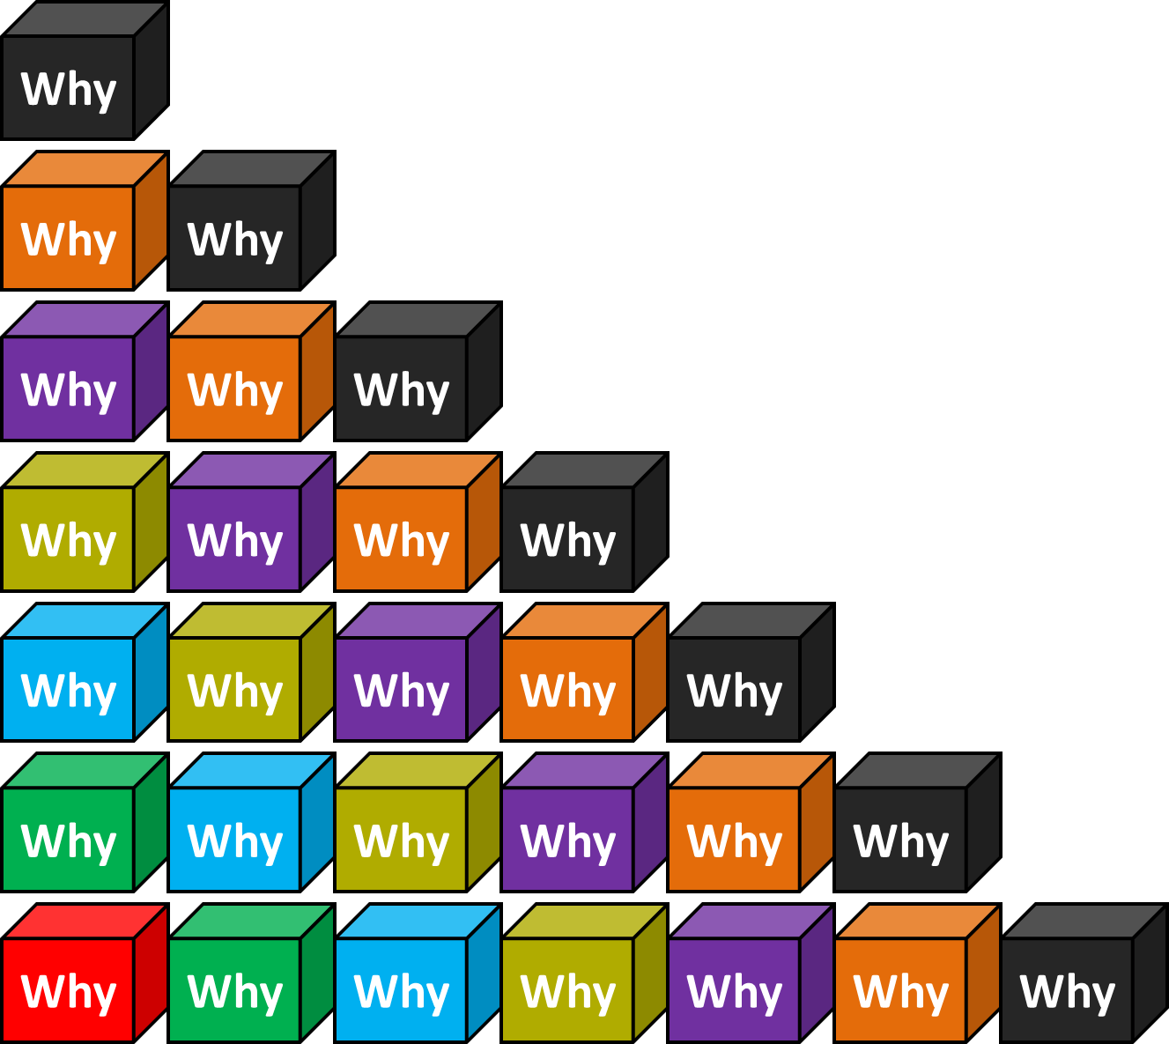
Patients are inactive in hospital
5x Whys
WHY
No
motivation?
Starting point:
Band 5 project
April 2019
WHY
No one
encouraging
patients or telling
them it’s ok/beneficial
to move?
WHY
Staff worried about safety/falls?
WHY
Falls prevention has been huge campaign across NHS
To prevent fractures, prevent longer stays in hospital, harm to patients
WHY
Notes:
Or root cause analysis

Slide 19

What’s the problem?
Older adults (>65years) are vulnerable to functional decline in hospital.
Literature
10 days in hospital = 10 years of physical ageing
12% in
the chair
83% of
hospital stay
in bed
(Falvey et al, 2015, NAO, 2016)

Slide 20
Where to influence
Admission to hospital
Inactive +/- falls
Inactive e.g. given urine bottle instead of mobilising to toilet
Discharge with carers, WZF, frail and inactive
Not encouraged to mobilise to reduce risk of falls
Deconditioned, fear of falling,
risk of falling
Target ward patients to
Encourage mobility
Inactive

Slide 21
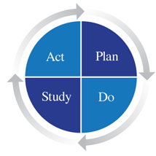
Plan, do, study, act….
Always evaluate before implementing so you can measure a difference
Plan the implementation of the activity tracker within the PDSA model.
Collect your data
Make a decision to continue or adapt the intervention.
Return to the cycle

Slide 22
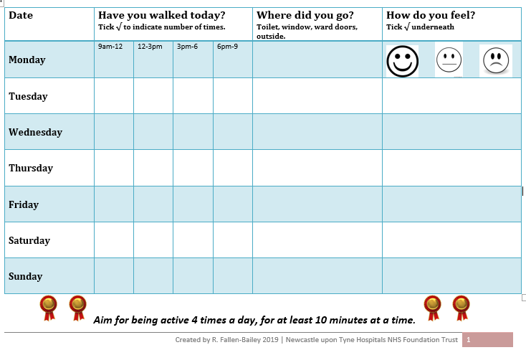

Slide 23
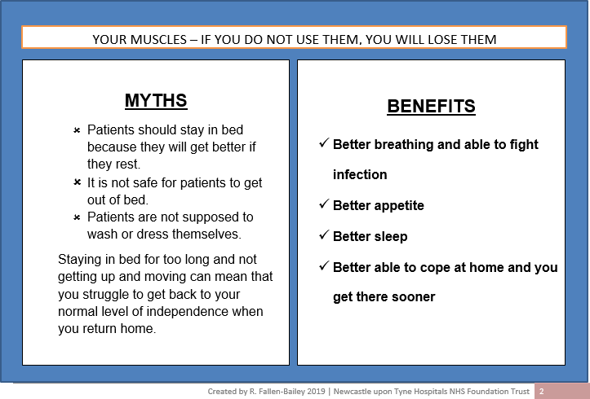

Slide 24
Result = not encouraged by staff
Admission to hospital
Inactive +/- falls
Inactive e.g. given urine bottle instead of mobilising to toilet
Next = survey to find barriers
Discharge with carers, WZF, frail and inactive
Not encouraged to mobilise to reduce risk of falls
Deconditioned, fear of falling,
risk of falling
inactive

Slide 25

Staff survey - Internship
Pilot
Survey Monkey
Band 5 nurses, physios, OT’s, therapy assistants, technical instructors and healthcare assistants
Sent to approx. 750 people
n=118
6 closed, 6 open questions
Open for 6 weeks
Notes:
Developed this plan with Dr Lisa Robinson
Guided me through the process
Gave me time to look at the literature

Slide 26
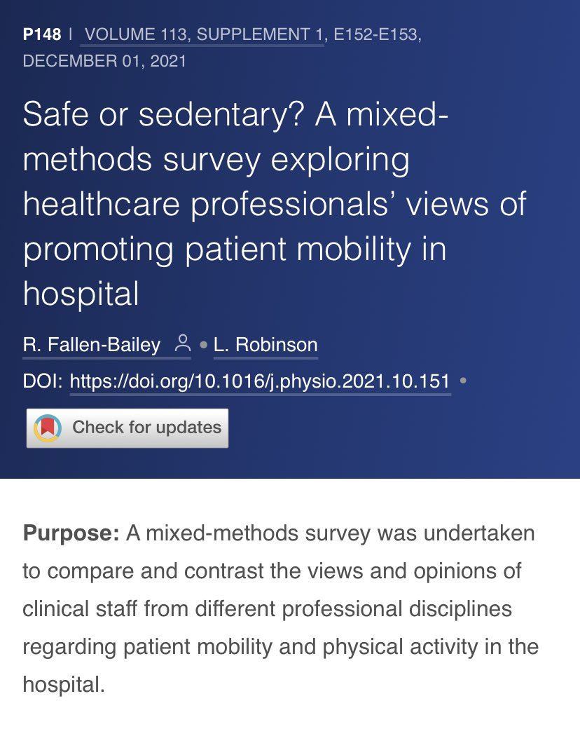
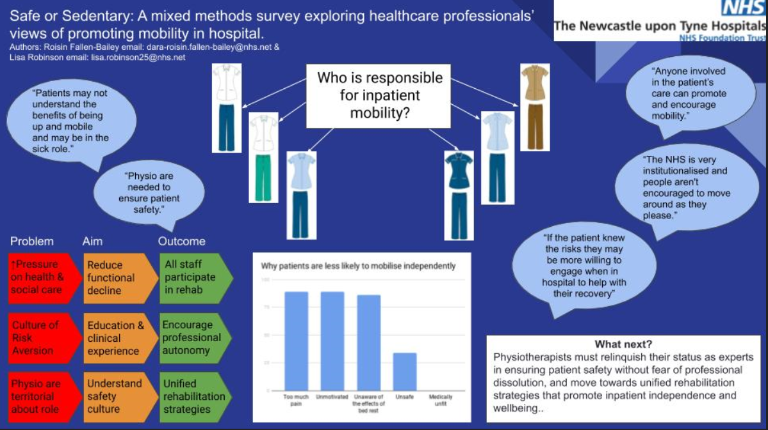
Internship outputs
Presented at Physiotherapy UK 2020 &
The World Physiotherapy Congress 2021

Slide 27
What next = Education
Admission to hospital
ED staff
Inactive +/- falls
Inactive e.g. given urine bottle instead of mobilising to toilet
Ward staff
Discharge with carers, WZF, frail and inactive
Not encouraged to mobilise to reduce risk of falls
Internship finished.
Funding???
Deconditioned, fear of falling,
risk of falling
inactive
AHP’s

Slide 28



                £1000 from CAHPR small grant scheme
                MDT focus
Co-design and preliminary evaluation of a digital training resource to promote inpatient activity and reduce hospital-associated deconditioning.
Co-applicant, OT Catherine Thomas
Funding application

Slide 29
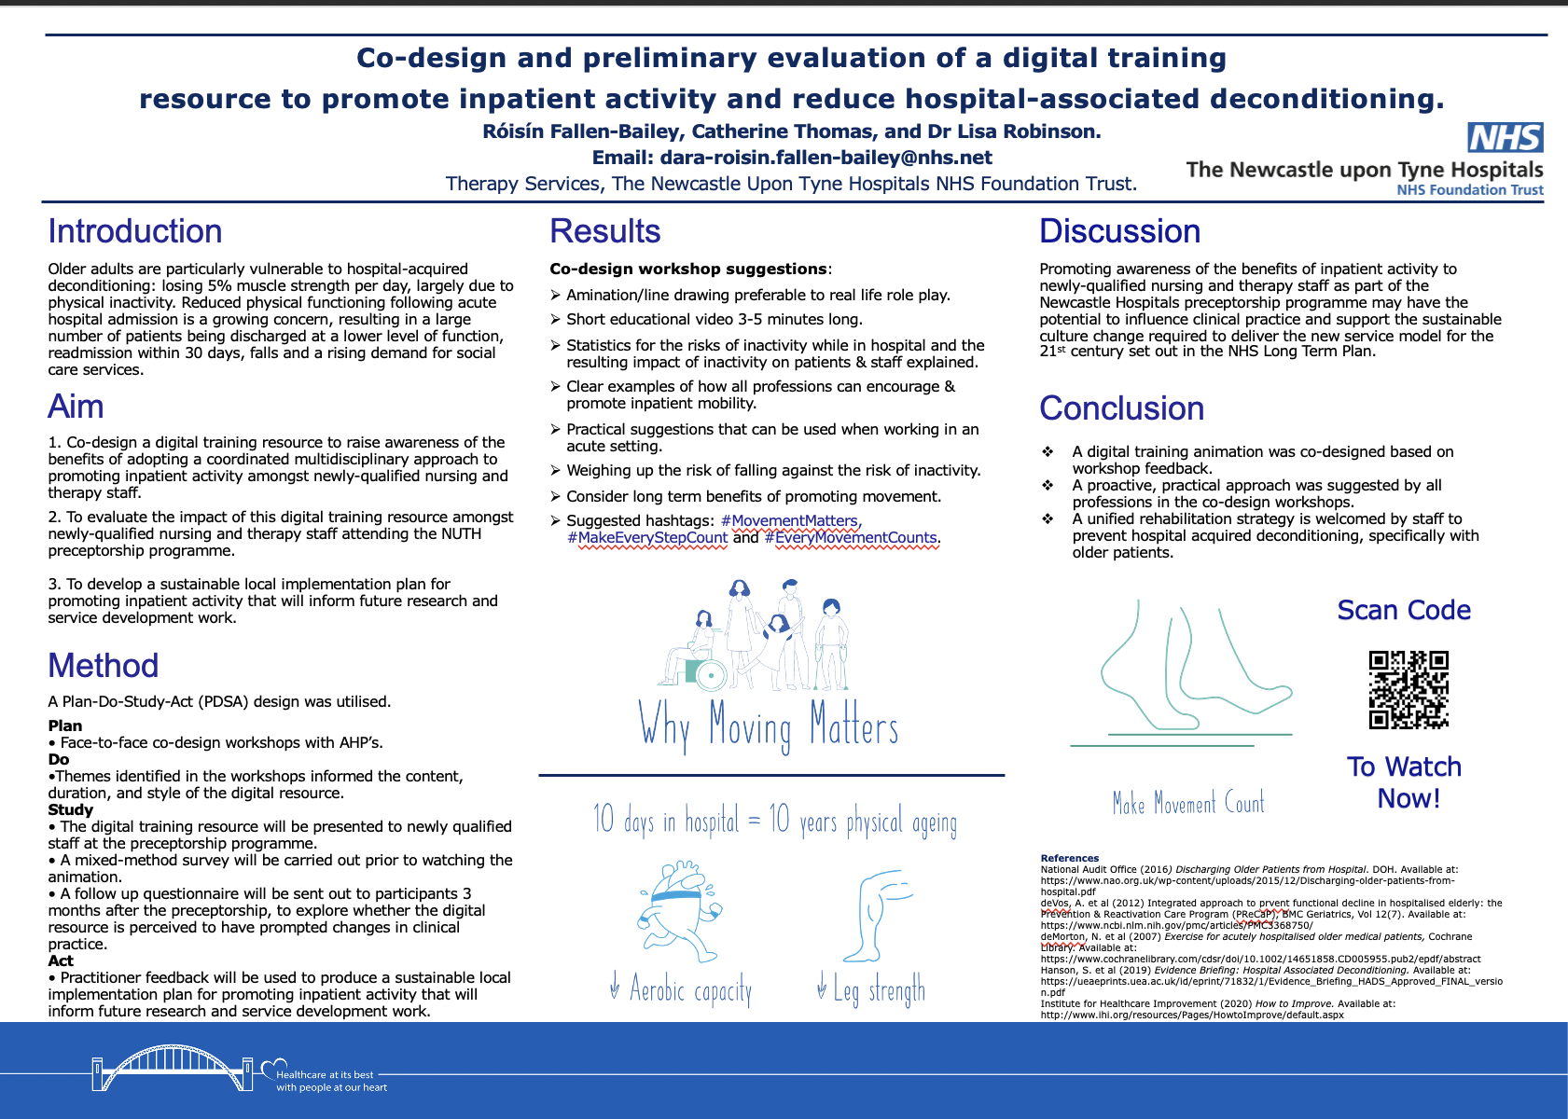
CAHPR Outputs
Poster accepted and presented at the Institute of Healthcare Improvement conference 2021.
Video shared widely across UK.
Prof Brian Dolan’s and Dr Amit Arora’s approval - EndPJParalysis
Used by 2 hospital’s induction programme.
Fully implemented into NuTH’s induction programme for all new starters, the healthcare academy training and volunteers training.
Notes:
IHI submission
- Video has been well received nationally and by Prof Brian Dolan and Amit Arora (creators of end PJ Paralysis and the get up get dressed get moving campaign)
Active Hospitals project manager is very keen to use the video and share ideas
Deconditioning games
Another trust wanting to use it for their induction which will help with the evaluation
Now currently part of our induction programme, healthcare academy and volunteer training and suitable for students
‘[I]n the face of a pandemic the search for perfect evidence may be the enemy of good policy’ (Greenhalgh et al., 2020) – if we wait for more evidence we risk being wrong – impacting a huge impact of people

Slide 30
https://www.youtube.com/watch?v=MsZrhNsmLEQ

Slide 31

Next steps….
Complete the PCAF in September 2022
Evaluate the impact of the CAHPR video
Write up the results for publication
Application for Clinical Doctoral Research Fellowship (CDRF)
Continue to disseminate the research and use what we already know rather than re-inventing the wheel
Notes:
3 month follow up

Slide 32
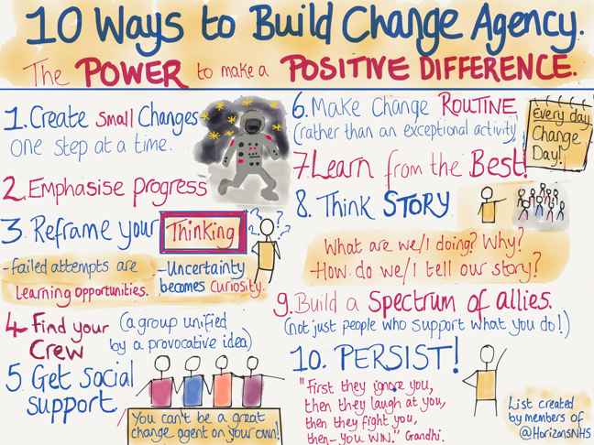
Tips:
1. If unsure about research: Future Learn Course – Agents of Change To do - The School for Change Agents - NHS Leadership Academy (futurelearn.com)
2. Remember you are not just a band 5 or band 6 or ‘just’ a physiotherapist.
3. Get in touch with the Research Design Service to discuss your idea. nrdsned@newcastle.ac.uk
4. Join twitter and contribute to the conversation. Start building a network.
Why I do it? …..

