Slide 1
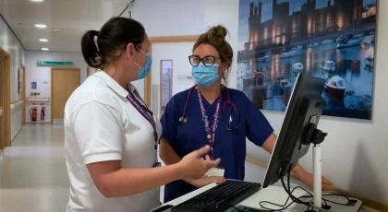
Paula Wheeler Band 5 Neuro/complex rehabilitation technical instructor CSP associate member CSP H&S representative Specialist tertiary cardiothoracic centre covering the whole of the northwest, IOM, north wales and beyond. 25 years as a physiotherapy support worker in the cardiothoracic setting. Small team of 3 ( band 7, band 3 and myself band 5) and care for those with neurological events pre / post op cardiothoracic surgery or procedures, including SCI, HBI and stroke. Over the 25 years in post my role has evolved as a requirement for the service to function.

Slide 2
What makes my role Band 5? Academic level 6 (SCQF level 10) education within the speciality which enables: Work to be managed through a governance process with a higher level of autonomy in the role Provision of episodes of care for a complex caseload within a niche speciality Leading a portfolio of other responsibilities including line management and training and development of staff

Slide 3
My professional development journey A willingness to undertake additional experiences and learning and development activity CSP voluntary roles – leadership knowledge and skills Level 6 (SCQF 10) clinical module Level 4 (SCQF 8) safer handling – responsibility for AHP manual handling training Practice educator training

