Slide 1



Working with students
The support workforce’s role and value in supporting the next generation
^{Claire Fordham}
CSP Professional Adviser - Workforce and Education
^{@ClaireFordham5}
^{What did you sense?}

Slide 2
Learning Outcomes
define what and how support staff can contribute to student placements within their scope of practice
determine what actions to take to fully engage as a support worker in student placements /engage support staff in student placements

Slide 3

The position of the HCPC
A named practice educator on an appropriate register
A variety of staff with the appropriate qualifications, skills and experience can contribute
Staff who are contributing must be competent to support practice education

Slide 4



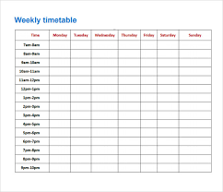

A team based approach

Slide 5

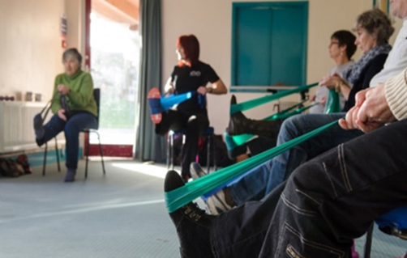

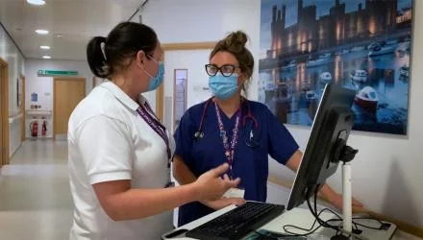
Why wouldn’t you?
technical competence in the tasks and activities they undertake in their roles
communication skills
cultural competence
experience in personalised care
knowledge of local systems and processes
an abundance of noticing, coaching and caring talents
years of clinical and life experience

Slide 6
Everyone’s responsibility
tasks and responsibilities that are in the support worker’s scope of practice
undertaken as a delegated activity
local job descriptions, local delegation policies, the level of competence of a support worker in their role, and their competence to support pre-registration students in practice

Slide 7
What does that look like?
entry level band
induct students to a work area
educate students about the role and responsibilities
demonstrate the tasks and activities undertaken as part of the role
support students pastorally as part of a compassionate and supportive team culture

Slide 8

What does that look like?
higher bands
induct students to the clinical area
educate students about the role and responsibilities
train students to undertake the tasks and activities that are common to the role
work alongside a student, enabling them to take the lead in a task or activity that is common to the role and in which the student has been trained
feedback to a student on their performance; supporting them to reflect; identify further learning needs and ways in which these might be met
contribute to team discussions regarding a student’s performance and placement assessment
support students pastorally as part of a compassionate and supportive team culture

Slide 9

Countersigning records…….
permissible if local policies allow
support worker is deemed to be competent (i.e. they have received training and development in practice education)
delegated activity – responsibility for care remains with the registered practitioner
develop a local SOP

Slide 10
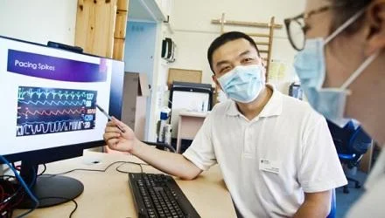
Educating, training and supporting students on placement is a skill
You already have many of these skills!
investment in learning and development
HCPC requirement that staff are competent
training in supporting students who need adjustments
principles of equity, diversity and belonging

Slide 11

talk about it
update support workers’ job descriptions, job plans and annual objectives to include involvement in practice based learning
competence and confidence – gaps and PDP, appraisal and objectives
inform students
create regular and timetabled periods
involve support workers in discussions regarding feedback on a student’s performance and placement assessment

Slide 12


