Slide 1

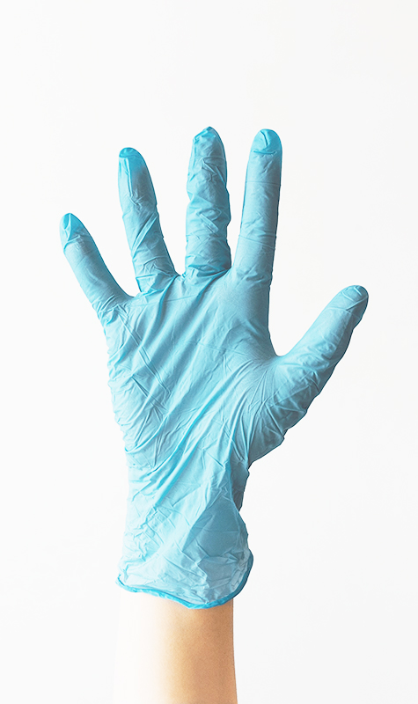
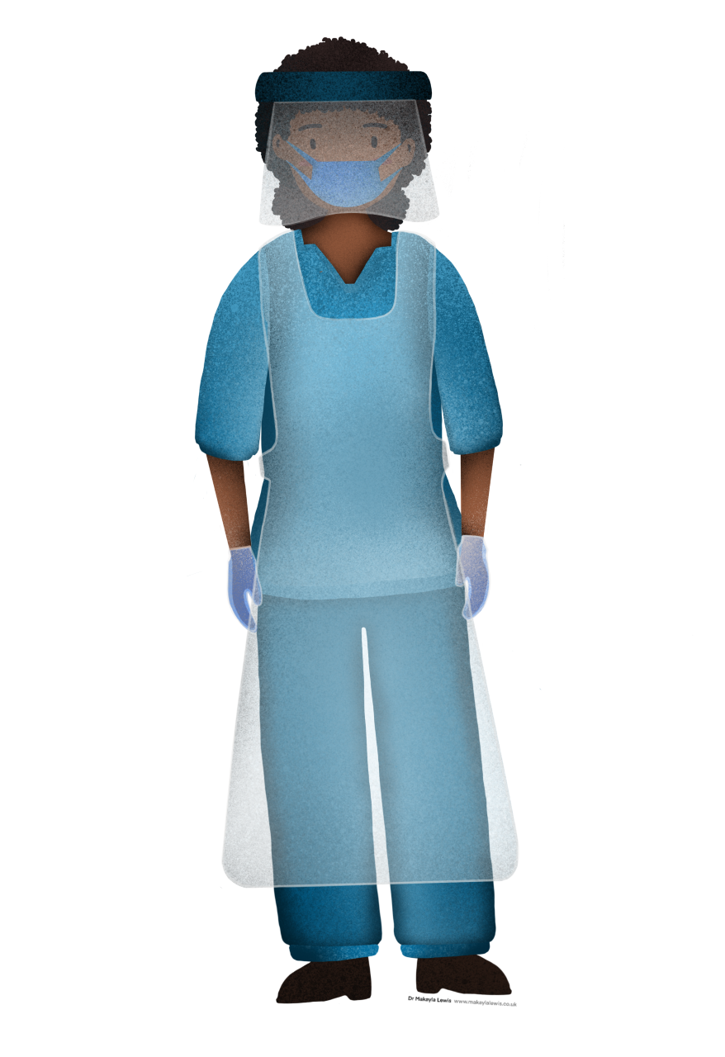
Slide glove = enotions
Let’s zoom out now
Take a moment to reflect on where you are tonight?
What Events experiences generate these emotions?
Where would you ike to be?
We are all unique with our our wiring and have individual preferences What strategies activities generate
Slide grid
acceptance?
In
Slide offering download
EMOTIONS

Slide 2
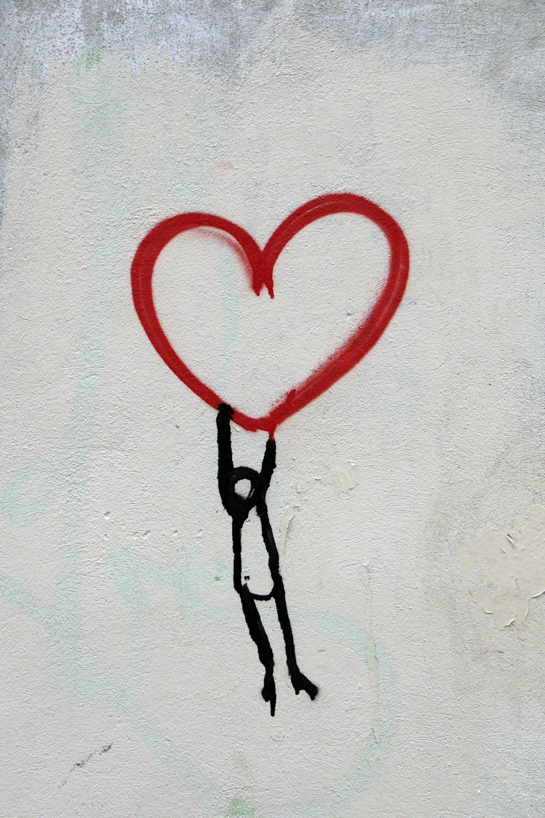
Emotions
(McCraty & Zayas, 2014)

Slide 3
Emotions
Historically generally perceived unpleasant/“Negative” emotions | Historically generally perceived pleasant/“Positive” emotions

Slide 4
Emotions
Historically generally perceived “Negative” emotions | Historically generally perceived “Positive” emotions
Frustration/irritability | Joy/happiness
Anger | Courage
Hatred | Passion
Fear | Love
Nervous/Anxiety,/Impatience | Excitement/Enthusiasm
Depression/apathy/withdrawn | Peace/serenity/contentment
Shame | Appreciation/gratitude
Resentment | Compassion/kindness
Guilt | Acceptance
Disgust | Trust
Pain | Curiosity/Awe

Slide 5
Emotions
High heart rate
Anger
“Negative” emotions
“Positive” emotions
Relaxed
Low heart rate

Slide 6
Emotions
Sympathetic branch of ANS
Fight, flight, freeze
high heart rate
Upset/Anger/Rage
Frustration
Anxiety/Panic/Fear/Scared
Tension/Worry
Joy/Excitement/Surprise
Enthusiasm
Courage
Passion
Happiness
Love (honeymoon phase)
nervous system
Cortisol, Noradrenaline, Serotonin
Dopamine, DHEA
Hormonal system
Contentment/Peace
Appreciation/Gratitude
Love/Compassion,/Kindness
Acceptance
Trust/hope
Sadness
Shame
Guilt
Withdrawn/depressed/apathy
Resentment
low heart rate
Parasympathetic branch of ANS
Rest and digest
(Wang et al, 2020; Russell et al., 1989)

Slide 7
Emotions
Sympathetic branch of ANS
Fight, flight, freeze
Depleting emotions
high heart rate
Restorative emotions
Anger/Rage
Frustration
Anxiety/Panic
Tension
Joy/Excitement/Surprise
Enthusiasm
Courage
Passion/Happiness
Love
S T R E S S
nervous system
Cortisol, Serotonin, Noradrenaline
Dopamine, DHEA
Hormonal system
Contentment
Appreciation
Dignity
Peace
Love Compassion, reciprocity
Kindness
Acceptance
Impatience
Withdrawn
Resentment
Apathy
Depression
S A F E
BURNOUT
low heart rate
Parasympathetic branch of ANS
Rest and digest

Slide 8
Six Steps for Self Care & Shifting Stress
1. Self awareness
2. Seek support
(Southwick et al., 2016)
3. Sustain microbiome
(Wallace and Milev, 2016; Zhang et el. 2019)
4. Sleep
(Walker 2017; van Dalfsen & Markus, 2019)
5. Stimulate your Vagus nerve
(Moraes et al. 2018; Porges 2009)
6. Save into your emotional bank account
2
3
4
5
1
6

Slide 9
How to use emotions to develop resilience
3-2-1 game
3: Three for thanks
    – what 3 things am I grateful for today?
2: Two for do
  - what 2 things did I do well today?
1: One for you
  what 1 thing do you think I did well today?

Slide 10
Resources
Free downloads:
  Reference list of journal articles and books
  3-2-1 worksheet
  Slides code: EMOTIONS
  Website: https://www.thelifearchitect.co.uk/shop
I would like to support you, so for attendees of this webinar, I am giving 25% off your first remote coaching session with myself
  Send me an e-mail at sudhir@thelifearchitect.co.uk
  Discount code: CSPSW
  Expires on 11 December 2020*
Face to face emotional stress HRV assessment 25% off
  Send me an e-mail sudhir@thelifearchitect.co.uk
  Discount code: CSPHRV
  Expires on 11 December 2020 *
*you don’t have to have your session by this date, just be booked in my diary

Slide 11






Questions and stay in touch
www.thelifearchitect.co.uk
Sudhir@thelifearchitect.co.uk
https://www.linkedin.com/in/sudhirdaya/
Facebook @sudhirdayathelifearchitect
Instagram @sudhirdaya.thelifearchitect
Twitter @sudhir_daya
Want to explore more?
Get in touch to arrange a bespoke training event like a workshop or seminar.

