Slide 1
ESCAPE Pain
The Northumbria Challenge
Angela Larkin
Acting Physiotherapy Clinical Manager
Northumbria Healthcare

Slide 2
N Tyneside Practice Population 215,000
Contracting started January 2018
Staff training commenced February 2018
Projected plan for start was March 2018
BUT

Slide 3


ESCAPE Pain in North Tyneside
Commenced 1st September with Sport England funding

Slide 4
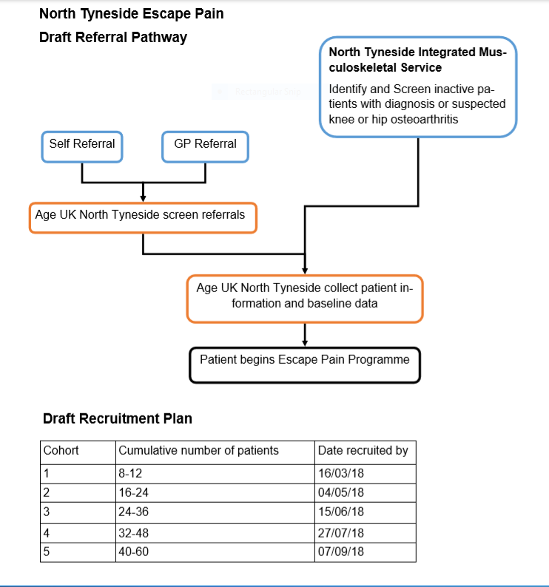

Slide 5
Location of Programme: Various locations throughout North Tyneside assessed as being appropriate by AGE UK. All cohorts were based at Linskill Centre North Shields.
Facilitators
Physiotherapy Technical Instructors from Northumbria Healthcare
Warren Johnson
Chris Lamb

Slide 6
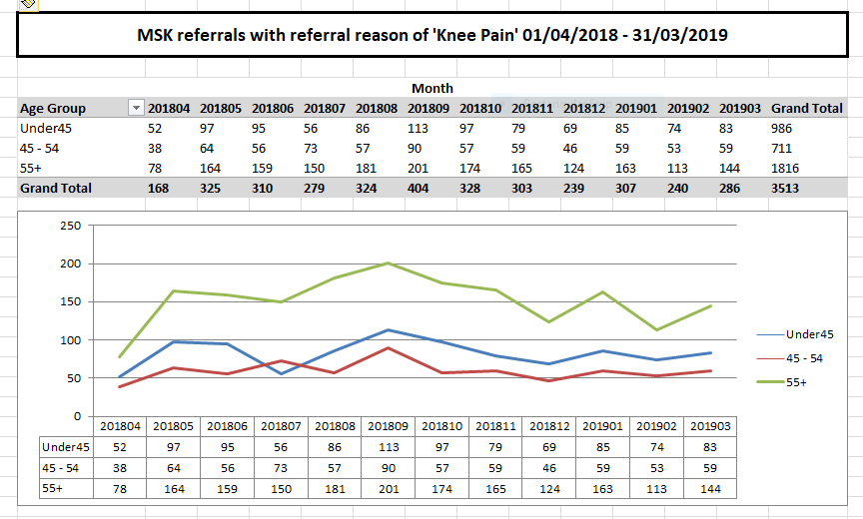

Slide 8
Approaches to patient recruitment
Departmental Briefings
Communications Department – GP Teamnet
GP Education Event
Delivered at Practice Managers Forum

Slide 9
Participants are suitable to participate in the programme if they meet the following criteria:
• Over 45 years of age
• Knee and/or hip OA or
• Chronic knee and/or hip pain for ≥3 months
• Needing a supervised exercise programme in order to: gain confidence and motivate themselves or
get them started on a self-management programme
• Independently mobile
• Able to communicate well enough to participate in a group setting
Able to attend twice per week for 6 weeks

Slide 10
Exclusion Criteria Unstable angina Systolic blood pressure >180 and/or diastolic blood pressure >100 BP drop >20mm Hg demonstrated during ETT Resting tachycardia >100bpm Uncontrolled atrial or ventricular arrhythmias Unstable or acute heart failure Unstable diabetes Febrile illness

Slide 11
 | ESCAPE Pain Referals
 |  | Number started |  | Number completed
Start Date: 01/09/2018 | Cohort 1 | 4 |  | 1
Start Date: 08/01/2019 | Cohort 2 | 9 |  | 8
Start Date: 03/2019 | Cohort 3 | 8 |  | 6
Total referrals in 26 |  | 21 |  | 18

Slide 12
Top tips for optimising referrals, uptake and retention:
• Ensure that you have dedicated time to set-up the programme (i.e. it is not in addition to your normal workload)
√
• Secure senior support for the set-up – this helps to send a message across the department that the programme is considered important and senior manager can help with any issues that might come up in setting up and running ESCAPE-pain
√

Slide 13
• Fully integrate the programme into local systems and processes (rather than simply bolting it on) o Ensure all colleagues understand what ESCAPE-pain is, the evidence behind it, and how to refer in (e.g. use team meetings, in-service, email, invite colleagues to observe sessions)
√
● Make referral forms and processes quick and easy to complete (e.g. ask colleagues what would work best)
√
● Consider if some patients can be referred directly in at triage, in order to reduce 1:1 assessments and increase efficiency
X

Slide 14
• Engage with the referrers into your service and promote the evidence-based benefits of the programme
√
• Timings – consider what days and times work best for your participants (rather than best for you)
X
• A short wait between referral and starting capitalises on people’s motivation
X

Slide 15
• Participant opt in – ask them to think about it and then sign-up later. This helps to ensure that people are motivated to take part and can improve retention
√
• Overbook each group – there will often be DNAs from the start
X

Slide 16
• Make the group fun, interactive and sociable so that people want to come back – this sounds obvious but does not always happen
√
Retrospective feedback:
I have recently completed a programme of twelve sessions at Linskill Centre over a six week period and found it to have been most beneficial.
Both instructors were excellent and delivered the programme in a personal manner. They were considerate, observant and caring, always ready to provide advice and assistance. I shall continue with the exercises at home which should be a boon for me in continuing to live independently. Especially for me was the commitment to attend and the opportunity to be with others who were in circumstances similar but not necessarily the same as mine.

Slide 17

Thank you

