Slide 1

A Virtual Fracture Clinic –
4 years on
Victoria Lyle
Advanced Physiotherapy Practitioner

Slide 2
My background
Bolton MSK CATS 2007 to 2014 – band 8a
Bolton Fracture clinics -2011 to 2014
Started SRFT Sept 2014 to start VFC
Work in 4 # clinics per week.
Service development
ED weekend rota

Slide 3
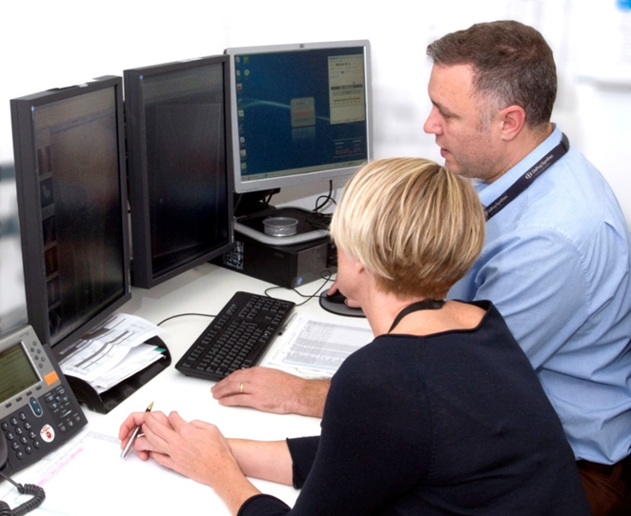
Aims of presentation
Overview of VFC
Results
Challenges
Successes
Future recommendations.

Slide 4
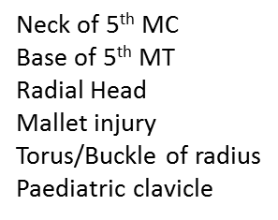
The Virtual Fracture Clinic Model
ED
Non
admitted
DISCHARGE
The 6
fractures/STIs
Exceptions:
Non English speaking
Deafness
Vulnerable patients
Phoneless
2% Re-attendance
3 times per week
VFC
Consultant
Discharge
Speciality/
general # clinic
Advanced Physio
phone call with AP
led clinic

Slide 5
VFC overview
Patient centred
A decision making centre for non-admitted fractures
Reduces physical attendances at the Fracture Clinic
Simple, stable injuries are managed quickly and efficiently
Consultant/AP physio led
Face-to-face review is timely, by the correct team: no wasted encounters
Meets BOAST standards for fracture care
Consistent patient care
High levels of patient satisfaction
Training and support of junior medical staff is enhanced

Slide 6
The VFC discharge process
A discharge letter is dictated by consultant
AP calls patient – experience important.
Any concerns a face to face # clinic appt is made
Pt always gets opportunity to ask questions
Pt always has ‘hotline’ number to call/opt in
‘Shift the locus of control’

Slide 7

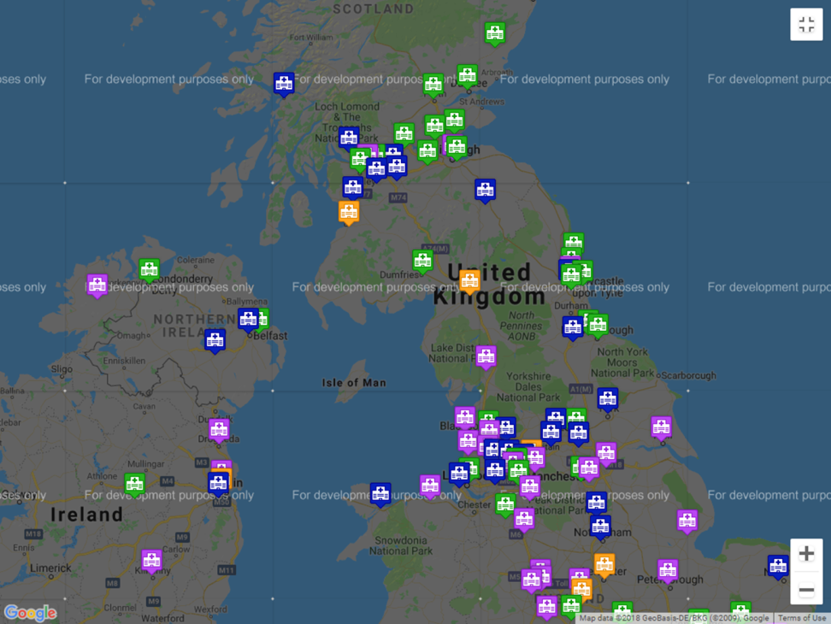
Sharing Best Practice – a Glasgow model
A number of trusts around the UK have implemented the new model in some form:
Fully implemented the principles of Fracture Clinic Redesign
Introduced the leaflets in the ED
Other units are planning a redesign
Initial Enquiries
Enquiries and visits to SRFT include: Pennine, Derby, Liverpool, Thameside, Whiston, Central Manchester, Wigan, Shrewsbury, Bolton, St.Helens, Mid-Yorks, Cardiff, Brighton,
Patient and Customer Focus, Accountability, Continuous Improvement, Respect

Slide 8
Oct 2014 to Oct 2018
Total NP = 20,496
Total Discharged = 7,074
Overall average discharge rate = 35%
Average face to face slots saved pcm = 150
Notes:
There has been a marked drop in discharge rates

Slide 9
Face to face appointments pcm

Slide 10
Challenges
Rising ED attendances year on year
More complex patients
Resistance to change
Variation in practice
Agreeing a tariff
High staff turnover in ED/rotational medics
  Training
  Feedback
  Continuity
Devil is in the detail

Slide 11
Variation

Slide 12
Successes
Reliable SOS service
Fewer wasted slots
Fewer DNAs
Quicker waiting times
Less crowded clinics
More time for complex patients
Time given for audit/evaluation
No formal complaints
Patients like it
Closer working with ED
More simple injuries discharged from ED

Slide 13
Re-attendance

Slide 14
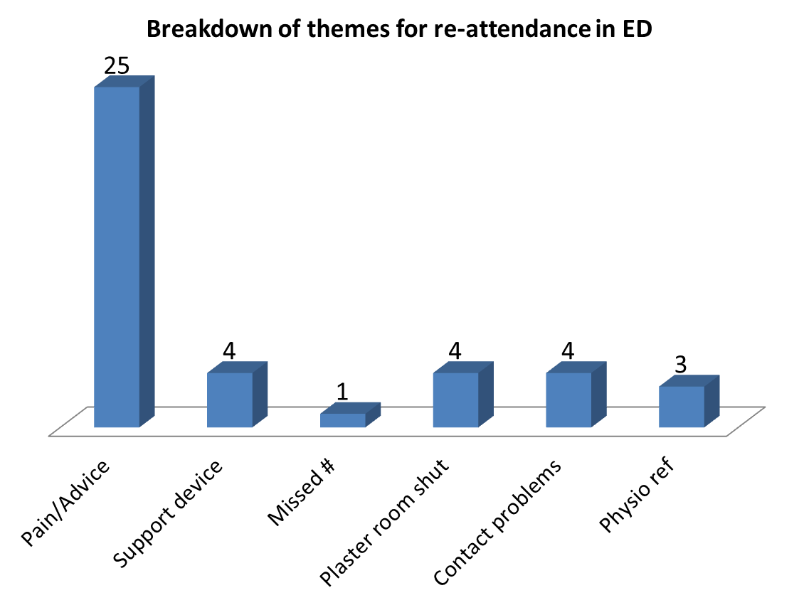
Themes Oct 14-Aug 16

Slide 15
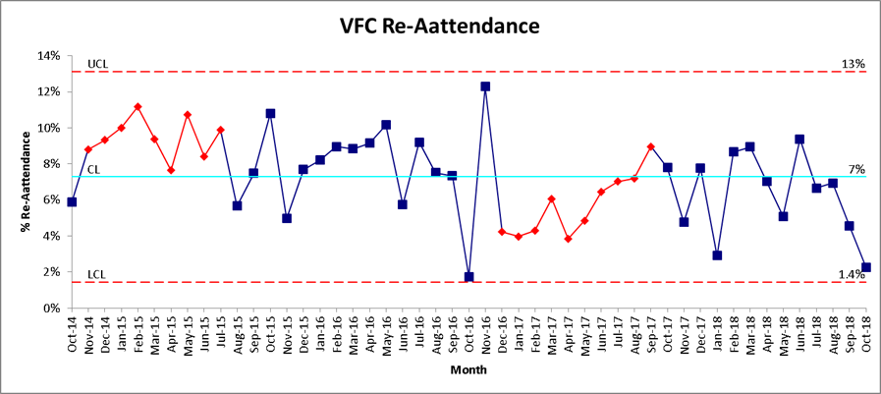
Re-attendance rates

Slide 16
Patient satisfaction survey
Notes:
All self care patients were called in 2015 after 6 months VFC. A random selection of a further 60 patients were also contacted. N=120

Slide 17
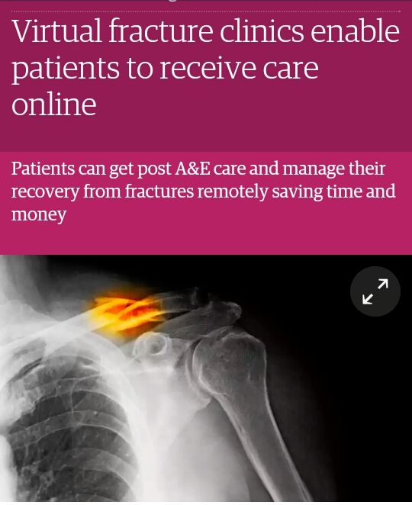
Growing body of evidence
NICE/BOA starting to recognise virtual clinics
Holgate J, Kirmani S, Anand B. Virtual fracture clinic delivers British Orthopaedic Association compliance. AnnR Coll Surg Engl. 2017
http://www.fractureclinicredesign.org/ed-direct-discharge/#
White, T et al. The evolution of fracture clinic design. The Bone & Joint J 2017;99:503-7
Chesser T & Vetharajan N. Standardised virtual fracture clinic management of radiographically stable Weber B ankle fractures is safe, cost effective and reproducible. 2017, Oct(10) 2372-73.
Jayaram PR et al 2014. A new “virtual” patient pathway for the management of radial head and neck fractures. Jounral of Shoulder and Elbow surgery. Mar 23 (3): 297-301.
Brogan K, et al Virtual fracture clinic management of fifth metatarsal, including Jones', fractures is safe and cost-effective Injury. 2017 Apr;48(4):966-970.
Bellringer SF et al Standardised virtual fracture clinic management of radiographically stable Weber B ankle fractures is safe, cost effective and reproducible. Injury. 2017 Jul;48(7):1670-1673
Bhattacharyya R, et al The virtual fracture clinic: Reducing unnecessary review of clavicle fractures. Injury. 2017 Mar;48(3):720-723
McKirdy A, Imbuldeniya AM. The clinical and cost effectiveness of a virtual fracture clinic service: An interrupted time series analysis and before-and-after comparison. Bone Joint Res. 2017 May;6(5):259-269
McAuliffe O, Lami M, Lami T. The impact of virtual fracture clinics on medical education - a medical student perspective. Med Educ Online. 2016 Mar 15;21

Slide 18
Recommendations
Physiotherapists with # experience
Give time for audit/evaluation and training
Standardised templates
Regional NW forum - data collection
National tariff?
NICE guidance – more pathways for simple fracture management
Centralised information leaflets/rehab advice
Digital solutions

Slide 19
Thank you
Any questions?

