Slide 1
Using Patient Reported Outcome Measure Data to Shape Patient Care
Serena Hartley
Specialist Neuro-oncology Physiotherapist, MSc

Slide 2
Aim of Presentation
Re-configuration of an existing service to improve patient care for patients with a meningioma – Primary brain tumour
The importance of using patient reported outcome data to shape patient care
Digital technology used to analyse patient reported outcome data in my MSc research to support the need for this service and to assist in determining patient’s needs
Future plans to use digital technologies to support this service

Slide 3
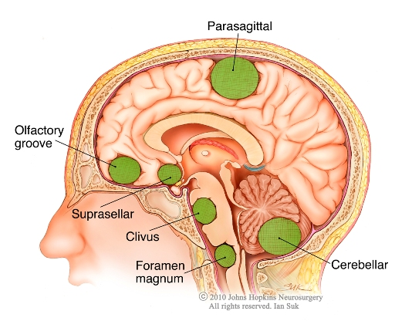
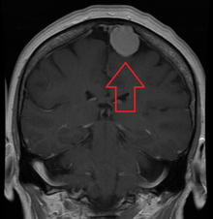
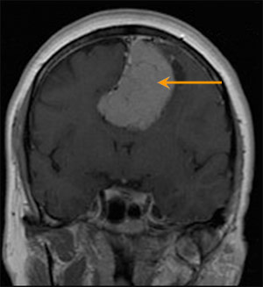
Meningioma Brain Tumour (90% are benign)
Notes:
Main treatment is surgery. Slow growing many watch and wait
May present with significant physical and psychosocial deficits following surgery (van Alkemade et al, 2012)
Associated morbidities occur with increased survivorship
Survival rates of meningioma patients are increasing with improved medical management, with 80% of patients having a 10 year survival following treatments as seen in Figure 1.1 (Van Alkemade et al., 2012)
Therefore, health care professionals developing a further understanding of their HRQOL is vital to guide supportive care and therapeutic interventions and to ensure adequate services are available to facilitate recovery and optimise HRQOL (Cornwell et al., 2012; Wu et al., 2017).
Meningiomas develop in the meninges (the dural outer lining of the brain) and are one of the most common type of PBT in adults (37%). The numbers of incidental asymptomatic meningiomas being found is increasing, due to more frequent use of neuroimaging (Vernooij et al., 2007Approximately 90% are benign (WHO grade I) and are slow-growing (Kleihues et al., 2002). Although they are defined as benign and often asymptomatic, in some cases, due to progressive enlargement within the confined intracranial space, the adjacent brain tissue may be compressed resulting in significant symptoms. This may include motor, speech, visual and cognitive deficits, personality changes, headache, nausea and/or seizures (Mukand et al., 2001; Wu et al., 2017). This may limit normal daily living activities and result in participation restriction which can have detrimental effects on HRQOL.
Surgical resection is the primary treatment for meningiomas, although radiotherapy is also used in some cases, such as with incomplete excision or if histology indicates atypical cells (Whittle et al., 2004). Many meningiomas are asymptomatic and as they are slow-growing, they often only require a conservative management approach, using serial scanning to monitor for tumour growth (Yano and Kuratsu, 2006). Surgery is deemed to be curative and has been shown to improve survival and reduce neurological symptoms (Natarajan et al., 2007; Wu et al., 2017). This has often been interpreted in the literature as an improved HRQOL, however, recent studies have reported that meningioma patients can experience long-term neurological and psychological deficits which may impact on their HRQOL (van Alkemade et al., 2012; Wu et al., 2017). Meskal et al. (2016) demonstrated that although cognitive deficits improve post-surgery, they all have significantly lower cognitive functioning than healthy controls. It is well recognised that impairment in cognition can compromise independence, activities of daily living and HRQOL (Pace et al., 2012).

Slide 4
Interdisciplinary Clinic for Patients with a Meningioma
Patient
‘One Stop Shop’
Comprehensive Assessment’
Neuropsychologist
Physiotherapist
Speech and Language Therapist
Occupational Therapist
Patient
‘One Stop Shop’
Comprehensive Assessment’
Neuropsychologist
Physiotherapist
Speech and Language Therapist
Occupational Therapist
Initial assessment - Provides further information to support the surgeon’s clinical decision-making for proceeding with surgery and to plan for support before and following surgery
Six months following surgery - To provide support, advice and referral to appropriate services to optimise quality of life and support self-management
Notes:
Patients attend an appointment, where they have a multi-professional comprehensive assessment prior to their surgery, to support the surgeon’s decision-making for proceeding with surgery
Patients attend again approximately six months following surgery, to address their therapeutic and supportive care needs.
The care needs of this client group are varied due to the complex multifactorial nature of the condition and are best met by an interdisciplinary team (Gabenelli, 2005). This team comprises several disciplines, including physiotherapists, occupational therapists, neuropsychologists and speech and language therapists who can support the complex problems that may present, to maximise activity and participation (WHO, 2001).
Provides equity of access and a formalised streamlined pathway for patients with a meningioma
Held once a week
‘One stop shop’ – Reduces time and financial costs for patients. Reduces admin as only one appointment. Facilitates improved communication between professionals. Requires co-ordinated admin support.
Interdisciplinary assessment proforma forwarded to the Consultant
Peer review - Reported as an area of good practice
Promotion of self-management and facilitating prevention (five year forward view (2014)

Slide 5

Nice Guidelines
Care needs are complex and present a unique challenge
All patients with a brain tumour should be offered a neurological rehabilitation assessment of physical, cognitive, and emotional function at diagnosis and every stage of follow-up.
Access to this is not always available to patients with a meningioma (Wong, 2011).
Research has focussed on malignant brain tumours, resulting in unidentified and unmet needs
Improving Outcomes for People with Brain and Other CNS Tumours (2006)
Brain tumours (primary) and brain metastases in adults (July 2018)
Notes:
Be aware that the care needs of people with brain tumours represent a unique challenge, because (in addition to physical disability) the tumour and treatment have affects on:
behaviour
cognition
personality.
Health and social care support needs with the person with a brain tumour and their relatives and carers (as appropriate). Health and social care professionals involved in the care of people with brain tumours should address additional complex
fatigue
loss of personal identity
loss of independence
maintaining a sense of hope
potential for change in personal and sexual relationships
the challenges of living with uncertainty
the impact of brain tumour-associated epilepsy on wellbeing (see what NICE says on epilepsy).
NICE (2006) advocates that all patients with a brain tumour have access to rehabilitation and supportive care.
This can improve health and quality of life, thereby reducing the socio-economic impact on health care services (DH, 2005; BSRM, 2009).

Slide 6

Health Related Quality of Life (HRQOL)
Definition
HRQOL is a complex multi-dimensional theoretical concept of a perceived level of satisfaction and general well-being of a person, based on the interaction between their personal experiences, health condition, beliefs and values (Pace et al., 2012).
Research with patients with a meningioma undergoing surgery focussed on morbidity and mortality outcomes
Current literature advocates that integrating a subjective measure of HRQOL with the traditional assessment of mortality and morbidity will provide a more comprehensive evaluation of the outcome of interventions (Dirven et al., 2015).
Recent research has demonstrated that although HRQOL can improve, in some cases, it may be impaired post-surgery (Zamanipoor et al., 2016; Benz et al., 2017)
Notes:
HRQOL is a multidimensional concept and is one aspect of the broader concept of QOL and is defined as a patient’s overall satisfaction with life due to the impact of both disease and treatment, encompassing psychological, physical and social well-being (Mauer et al., 2008
It is thought to be best assessed by the patient themselves, as studies have shown disparity between physician and patient reported issues (Valderas et al., 2008). Providing evidence from the patient’s perspective, minimises systematic error and observer bias (Ajetunmobi, 2002).
Zamanipoor et al. (2016) concluded that the studies demonstrated poor quality reporting of PROM data and many used generic measures not disease specific validated for the brain tumour population
There is very little published data, particularly in the UK, examining the HRQOL of meningioma patients undergoing surgery and comparing it to healthy controls using a disease-specific PROM. Therefore, the nature of the HRQOL of patients with a meningioma undergoing surgery remains unclear.

Slide 7
Patient Reported Outcome Measures(PROMs) to measure HRQOL
PROMs are often used in health care to assess HRQOL
PROMs provide evidence from the patient’s perspective of their health and well-being, without influence from the clinician or others (FDA, 2009)
HRQOL is thought to be best assessed by the patient themselves (Thompson et al., 2016)
PROMs are a method of collecting standardised data of a person’s HRQOL at a single point in time, in the form of self-completed questionnaires generating an overall score of HRQOL
Notes:
Problems of using PROMS – cognitive problems, response shift

Slide 8
Patient Reported Outcome Measures (PROM)
PROMs
Are promoted in routine clinical practice as part of the government’s wider quality improvement agenda (DH, 2011; Black et al., 2013).
Facilitate better communication and decision-making between health professionals and patients (Appleby and Devlin, 2005; Chen et al., 2013).
Standardise care, with systematic and comprehensive monitoring to identify the patient’s problems (Trotti et al., 2007).
Promote person-centred therapeutic and supportive care planning care and assist in empowering the person and promote self-management( Kyte et al., 2007).

Slide 9
A Longitudinal Study to Investigate the HRQOL using PROMs of Adult Patients with a Meningioma Brain Tumour Undergoing Neurosurgery
Aim Gain further understanding of the HRQOL issues, to highlight their therapeutic and supportive care needs and support the development of the Interdisciplinary Clinic
Method
Secondary data analysis of the HRQOL outcome data collected at the interdisciplinary clinic before and six months following surgery from 30 patients with a meningioma between April 2015 and March 2018.
HRQOL PROM - The Functional Assessment Cancer Therapy – Brain (FACT-BR) - Disease-specific PROM which has high validity and reliability, supporting it’s sensitivity in assessing HRQOL in brain tumour patients (Weitzner et al., 1995).
Notes:
The main aim of this study was to investigate the HRQOL of meningioma patients undergoing surgery, adding to the understanding of the HRQOL issues that they may experience. As a physiotherapist working in the team and responsible in part for the development of the interdisciplinary assessment clinic, it was hoped that by undertaking this study, it would provide further theoretical evidence that these patients have HRQOL issues, needing to be addressed by supportive care. Thereby, supporting the development of this clinic as a best practice model, the concept of which, could then be disseminated to other similar units across the UK, who provide specialist services for brain tumour patients.
PROMs measuring HRQOL can be in the form of generic or disease-specific questionnaires (Cella and Stone, 2015). They are designed to assess the broad perception of health, including physical, mental, and social well-being and determine the impact this may have on the activities of daily living and social relationships (Muragundi et al., 2012).
Generic instruments measure general health and well-being relevant to all populations, which allows comparison across various medical conditions (Black, 2013).
Disease-specific questionnaires focus on aspects of health that are important to specific health conditions and have greater responsiveness to small changes in health (Fitzpatrick et al., 1998; Kyte et al., 2014).
Appropriate instrument selection is important to ensure it measures the health dimensions relevant to that particular set of patients (Weldring and Smith, 2013).

Slide 10
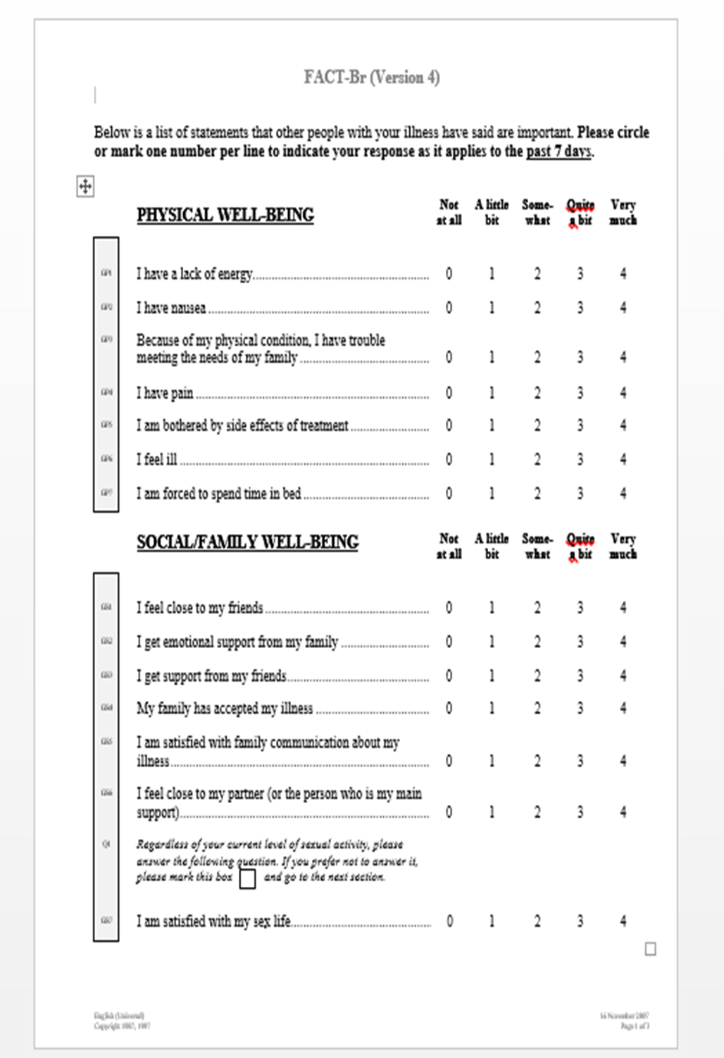
FACT- BR (Weitzner et al, 1995)

Slide 11
Digital Technologies
Identification of the research evidence to provide the basis for the research using relevant electronic databases; CINHAL, MEDLINE, Cochrane
Anonymised and non-identifiable data sets were extracted from the secondary data by a gatekeeper and inputted onto a Microsoft excel spreadsheet for storage, calculations and graphics
SPSS Statistics – software package used for complex statistical analysis. To demonstrate significant improvements and compare with normative data. Provide visual comparisons using charts/graphs
Notes:
Adherence to section 33 of the Data Protection Act (DPA) 1998 was required. This legislation governs the processing of personal data and Section 33 provides some exemptions specifically for data processing for research, to ensure patient data remains unidentifiable. The following were addressed in this study to comply with this legislation;
The Healthcare Trust where the research took place had a general agreement with patients that their clinical data may be used for research, therefore patient consent was not required.
The patients at the Healthcare Trust who had opted out of having their data used for clinical research were removed from the data-set.
Permission was gained from the Caldicott Guardian at the Healthcare Trust.
The data-set was anonymised and made non-identifiable then extracted by a gatekeeper, who was a person who had authorised access to the data-set, on behalf of the researcher.
Excel spreadsheet allows you to store , manipulate and aanalyse the data

Slide 12
Comparison of HRQOL Scores with Normative Data Before and Six Months Following Surgery
Significantly impaired HRQOL scores before(p=0.001) and six months following surgery(p=0.003) compared to the Normative Data (FACIT.org)
Notes:
The graph shown shows the change in the mean HRQOL scores following surgery from that at baseline and compares these with the normative values.
The mean of the total FACT-G and the Emotional Domain scores improve slightly following surgery but the scores pre and post-surgery are still considerably lower than the normative values.
This Emotional Domain mean score significantly increases from 12.77 to 16.47 following surgery, indicating reduced emotional issues post-surgery once the tumour is excised.
The Physical, Social and Functional Domain scores are almost the same post-surgery. However, again they are significantly lower than the normative values
The mean total HRQOL scores of the meningioma patients in this study before and after surgery was significantly lower than the normal population values.
The Social Domain of the FACT-BR was also significantly higher than that of the Normative Data both before and following surgery. This may be due to increased friend and family support networks as a result of having a serious health condition. Further analysis to determine differences in the HRQOL scores of patients with differing social support networks would be of interest, however, this was not possible as the sample size needs to be large enough for comparisons of sub-groups (Ajetunmobi, 2002).

Slide 13
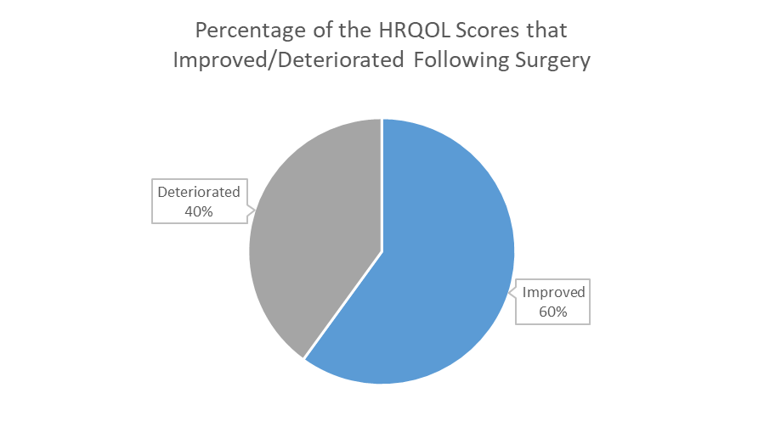
Comparison of HRQOL Scores Six Months Following Surgery with that Before Surgery
Notes:
The findings indicated that there was no significant difference between the self-reported HRQOL scores before and after surgery apart from the Emotional Domain. Suggesting, that surgery has no negative or positive impact on HRQOL six months after surgery apart from the emotional status of the patients which significantly improved following surgery.
However, the small sample size may have resulted in the study being under-powered, resulting in a Type II error, in that a significant difference was not found when one actually exists.
Another important consideration, is that the benefits of surgery may be underestimated in these studies, as the patients HRQOL may have deteriorated due to tumour growth if they had not had the surgery.

Slide 14
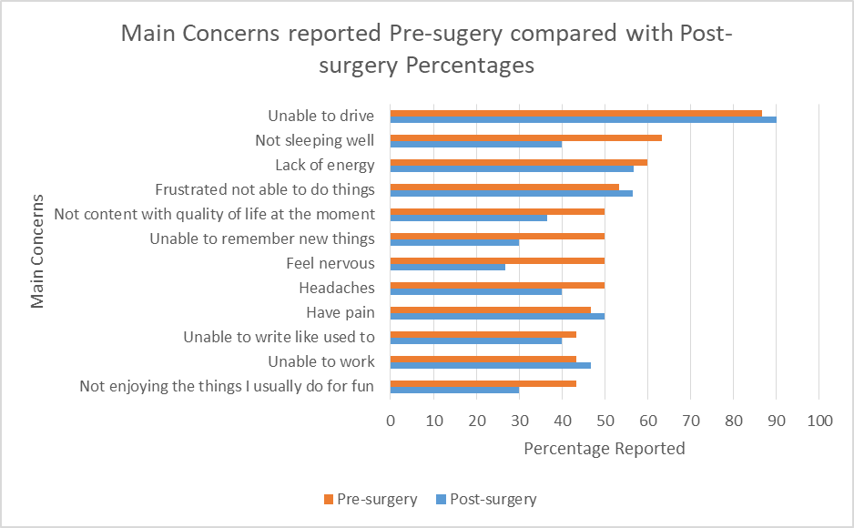
Main Concerns Identified before Surgery
Notes:
This data was further analysed to give more specific information of the main concerns that were experienced by the meningioma patients in the study, both pre and post–surgery.
These were identified by extracting from the completed FACT-BR questionnaires, those scoring ‘quite a bit’ and ‘very much’ for the negative questions and ‘not at all’ and ‘a little bit’ for the positive questions on the Likert scale.
The main issues identified pre-operatively were; being unable to drive(86.7%), difficulty sleeping(63.3%), lacking energy(60%), frustrated that unable to do the things they used to(53.4%), headaches(50%) and feeling nervous(50%) and the symptoms such as headaches(40%), not sleeping well(40%) and feeling nervous(26.7%) all reduced post-operatively.
It was anticipated that headaches (50%) would be a highly reported issue, as this is a common symptom in meningioma patients caused by raised intracranial pressure, often relieved by surgery (Wu et al.,2017). However, 40% of patients still reported this as a significant problem following surgery.
The low emotional status of the patients before surgery is of interest, in terms of the main issues reported of not being able to sleep, feeling nervous and being unable to remember new things and could be attributed to the fact that patients may be apprehensive as a result of having a diagnosis of a meningioma brain tumour and due to the impending surgery. These symptoms of high symptom distress preoperatively have also been reported in other studies (Tsay et al., 2010). Interestingly, in this study and also reported by Jakola et al. (2012), the issues related to pain and anxiety reduced following surgery, indicating the importance of the provision of emotional support before surgery.

Slide 15
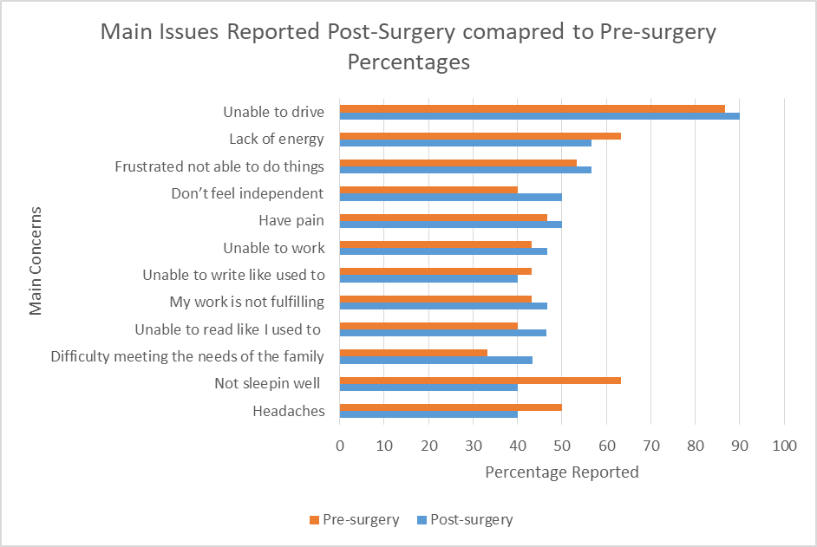
Main Concerns Post-surgery
Notes:
The main issues identified post-operatively were; being unable to drive(90%), lacking energy(56.7%), frustrated not being able to do the things they used to(56.6%), pain(50%), not feeling independent(50%) and being unable to work(46.7%).
At the subsequent assessment following surgery, reduced energy levels were still being reported at the same frequency (56.7%) as pre-surgery (60%). ‘Lacking energy’ is a significant problem identified both before and after surgery.
The symptoms being reported of not feeling independent and difficulty meeting the needs of the family increased post-operatively. All these issues have the potential to significantly impact on HRQOL.
Fatigue is a commonly reported issue (Mohsenipoor et al., 2001; Zamanipoor et al., 2017). It has been identified as the leading factor diminishing HRQOL in glioma patients (Taphoorn et al, 2010).
Being unable to drive as a result of having their licence revoked due to the surgery has a significant impact on HRQOL, which may improve if reinstated. This may contribute to the improved HRQOL in the longer term
Fatigue, cognitive deficits and physical impairments all of which are reported and may impact on HRQOL issues, can be targeted by therapeutic and supportive care interventions.

Slide 16
Discussion Points
The results of this study suggests that patients with a meningioma may experience HRQOL issues and have therapeutic and supportive care needs in the year following surgery, supporting the development of an interdisciplinary assessment clinic to address these needs
Fatigue is a significant issue pre and post-surgery
PROMs measuring HRQOL such as the FACT-BR provide structure for improved identification of patients’ issues
The potential negative impact on HRQOL raises the importance of careful consideration of the risks/benefits when proceeding with surgery, which must be weighed against the potentially slow progression of the condition
Notes:
Limitations – Extraneous variables such as age co-morbidities could not be controlled. Small sample size governed by timescales may affect the external validity and generalisation to the wider population. Surgical approaches and therapeutic and supportive care mechanisms may be different to other specialist units and therefore the sample may not reflect the variation of different approaches across the country. It is acknowledged that the interdisciplinary clinic itself and seeing patients pre-op may have influenced HRQL
Integrating a HRQOL PROM, such as the FACT-BR into clinical practice, is useful in determining the effectiveness of interventions and to provide structure for improved identification of patient’s issues(Appleby and Devlin, 2005; Valderas et al.,2008; Brown, 2010; Chen et al., 2013).
A further prospective multi-site study with larger sample sizes, to facilitate the analysis of prognostic factors and therapeutic interventions which may influence HRQOL would be useful. This information has significant clinical relevance as understanding the issues at different stages in the disease trajectory assists in the selection and of appropriate therapeutic and support mechanisms to address the patients’ needs
This study also aimed to provide further evidence of the impact of surgery on HRQOL, to support the surgeons’ clinical decision-making for proceeding with surgery. There is increasing recognition that HRQOL assessment is important in determining the efficacy of surgical interventions to support clinical decision-making (Dirven et al., 2015). This has become more important in recent times as the incidental detection of asymptomatic meningiomas has increased due to more frequent use of diagnostic neuroimaging (Vernooij et al., 2007). If the tumour-related symptoms are more subtle, the decision-making process for the surgeons in terms of risk/benefit analysis may be more difficult (Whittle et al., 2004). A balance must be struck in terms of deciding if surgery will alleviate symptoms, prevent tumour progression and prolong survival but also maintain HRQOL and this must be weighed against the natural progression of the condition which may be benign and slow (Schiestel and Ryan, 2009; Dirven et al., 2014). Further understanding of HRQOL issues following surgery would provide more information to support these difficult decisions.

Slide 17
Developments
Addition of low grade and other benign tumours
OT clinic developed to support patients with identified issues at the six month assessment
Longer Term assessment of patients with a meningioma following surgery and assessment of the QOL of the carers
Macmillan Co-ordinator funding which supports the clinic and provides further support to patients
Seeking funding for IPADs/tablets for collecting, storing and analysing the outcome data and to facilitate self-management; Information resources, forums and Apps
Notes:
Other studies have demonstrated further improvement in HRQOL in the longer term (Santos et al., 2011). Longer term improvement in HRQOL may also be due to being ble to drive rather than reduction in symptoms

Slide 18
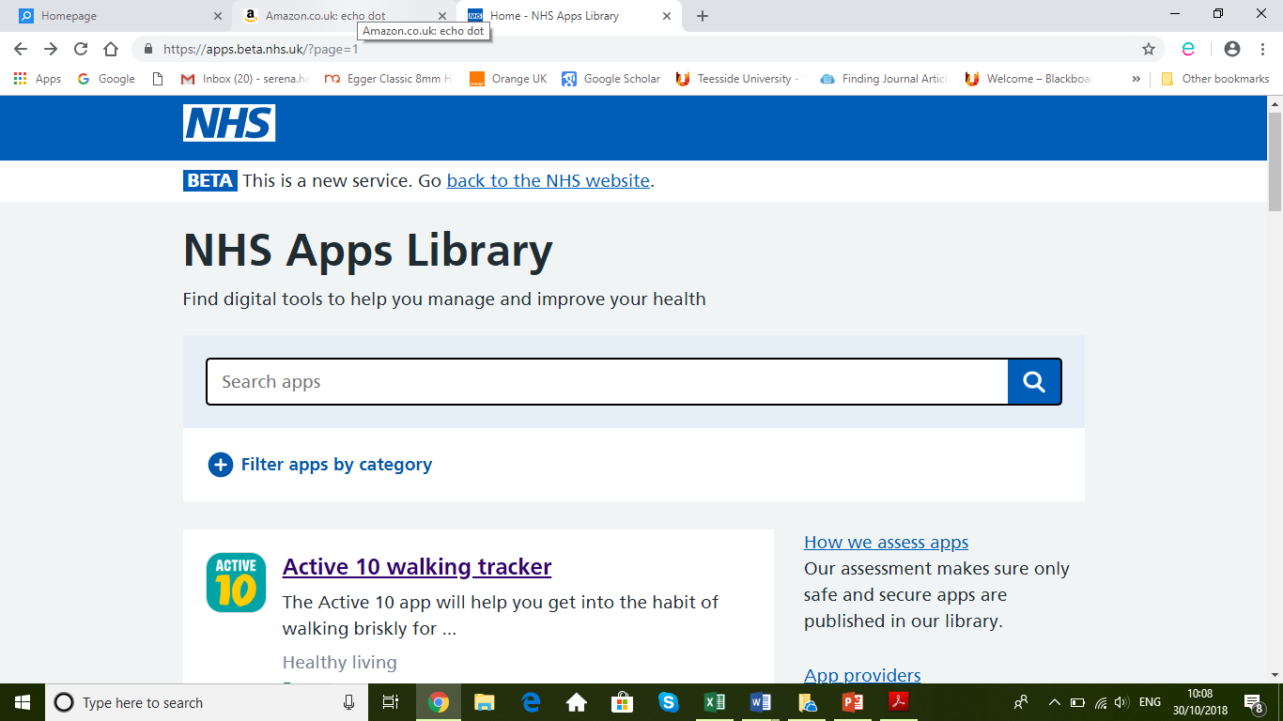
NHS Digital Apps Library

Slide 19
Acknowledgements
Professor P Kane – Consultant Neurosurgeon
Mr A Varma – Consultant Neurosurgeon
Dr Don Brechin - Clinical Director of the Medical Psychology Service and the Adult Neuropsychology Department
Caroline Barber Miller - Advanced Practitioner Neuro-Oncology Occupational Therapist
Jenny Collins - Specialist Neuro-Oncology Physiotherapist
Kathryn Dawson - Highly Specialised Neuro-Oncology Speech and Language Therapist
Karen Baldwin - Highly Specialised Neuro-Oncology Speech and Language Therapist
Kate Helstrip – Secretary to Consultant Neurosurgeons
Emma Sheehan – Secretary to Medical Psychology and Neuropsychology Dept.
Contact details serena.hartley1@nhs.net

Slide 20
References
NICE (2006) Improving Outcomes for people with Brain and other Central Nervous System Tumours. National Institute of Clinical for Clinical Excellence.
NICE (2018) Brain tumours (primary) and brain metastases in adults
Wong, J. et al. (2011; 2010) 'A qualitative assessment of the supportive care and resource needs of patients undergoing craniotomy for benign brain tumours', Supportive Care in Cancer, 19(11), pp. 1841-1848.
Pace, A. et al. (2012) 'Quality of life of brain tumour patients', European Association of NeuroOncology Magazine, 2(3), pp. 118-122.
Black, N. (2013) 'Patient reported outcome measures could help transform healthcare', BMJ (Clinical Research Ed.), 346(1), pp. 167.
Devlin, N.J. and Appleby, J. (2010) 'Getting the most out of PROMS', Putting Health Outcomes at the Heart of NHS Decision Making. London: King’s Fund. Available at: https://www.kingsfund.org.uk/sites/default/files/Getting-the-most-out-of-PROMs-Nancy-Devlin-John-Appleby-Kings-Fund-March-2010.pdf
Benz, L.S. et al. (2018) 'Quality of life after surgery for intracranial meningioma', Cancer Cytopathology, 124(1), pp. 161-166.
Weitzner, M.A. et al. (1995) 'The Functional Assessment of Cancer Therapy (FACT) scale. Development of a brain subscale and revalidation of the general version (FACT-G) in patients with primary brain tumors', Cancer, 75(5), pp. 1151-1161.
Zamanipoor Najafabadi, A.H. et al. (2016) 'Impaired health-related quality of life in meningioma patients-a systematic review', Neuro-Oncology, 19(7), pp.897-907.
FACIT.org (2010) Questionnaires. Available at: http://www.facit.org/FACITOrg/Questionnaires

