Slide 1
Getting It Right First Time
Clinically-led programme, reducing variation and improving outcomes
Liz Lingard, GIRFT Hub Director
North East, North Cumbria and Yorkshire

Slide 2
Introducing GIRFT
Review of 39 clinical specialties leading to national reports for each.
Led by frontline clinicians who are expert in the areas they are reviewing.
Peer to peer engagement helping clinicians to identify changes that will improve care and deliver efficiencies, and to design plans to implement those changes.
Support across all trusts and STPs to drive locally designed improvements and to share best practice across the country.
Agreed efficiency savings: c.£1.4bn per year by 2020-21, starting with between £240m and £420m in 2017-18.
Tackling unwarranted variation to improve quality of patient care while also identifying significant savings.

Slide 3
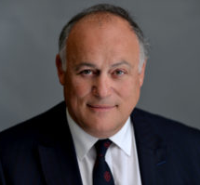
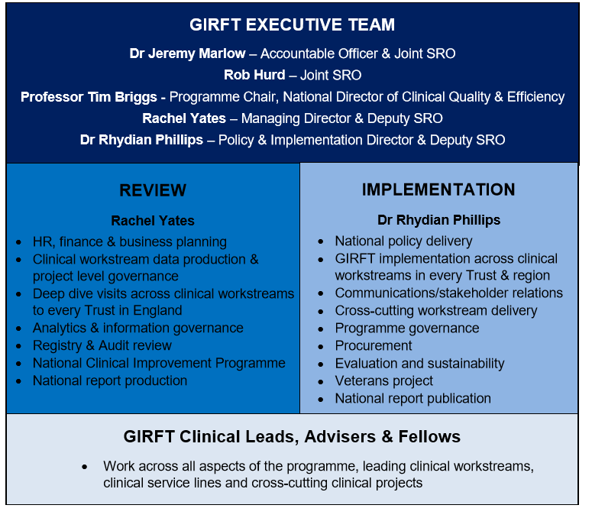
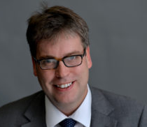

GIRFT Structure

Slide 4
GIRFT clinical workstream schedule
34
17
1300
5
Clinical work streams are already underway
Clinical workstreams visiting trusts
Clinical Lead visits already completed
Workstreams yet to start

Slide 5


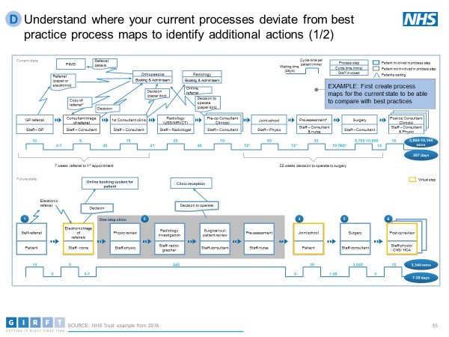
Additional support offers
Trusts can benefit from support by GIRFT regional teams in a number of cross-cutting areas, including:
Nursing
AHPs
Good Practice
Guide
Clinical Service Redesign
Governance
Theatres utilisation
Patient Flow
Good practice
Good practice examples are being captured locally and circulated nationally so that all trusts to benefit e.g. the Aug 2018 Getting It Right in Emergency Care Guide.
Nursing
Strategic barriers or issues
Strategic barriers/issues to implementation of GIRFT recommendations are raised with regional hub directors. The regional hub and GIRFT national team assist in work to mitigate these barriers.

Slide 6
GIRFT National Reports Schedule
National Report | Stakeholder circulation | General Publication
Oral and Maxillofacial | 08/10/2018 | 22/10/2018
Spinal Surgery | 26/11/2018 | 10/12/2018
ENT | 07/01/2019 | 21/01/2019
Ophthalmology | 07/01/2019 | 21/01/2019
Paediatric Surgery | 04/02/2019 | 18/02/2019
Obstetrics and Gynaecology | 04/02/2019 | 18/02/2019
Emergency medicine | 10/06/2019 | 24/06/2019
Breast Surgery | 04/05/2019 | 18/05/2019
Endocrinology | 13/05/2019 | 27/05/2019
Dentistry | 03/06/2019 | 17/06/2019
Diabetes | 24/06/2019 | 08/07/2019
Intensive Critical Care | 15/07/2019 | 29/07/2019
Anaesthetics / POM | 05/08/2019 | 19/08/2019
Radiology | 26/08/2019 | 09/09/2019
Renal | 16/09/2019 | 30/09/2019
Cardiology | 07/10/2019 | 21/10/2019
AGM | 28/10/2019 | 11/11/2019
Stroke | 18/11/2019 | 02/12/2019
Geriatric | 09/12/2019 | 23/12/2019
Neurology | 30/12/2019 | 13/01/2020
Respiratory | 20/01/2020 | 03/02/2020
Dermatology | 10/02/2020 | 24/02/2020
Rheumatology | 02/03/2020 | 16/03/2020
Outpatients | 23/03/2020 | 06/04/2020
Gastroenterology | 13/04/2020 | 27/04/2020
Pathology | 04/05/2020 | 18/05/2020
Plastic Surgery & Burns | 25/05/2020 | 08/06/2020
Trauma (Adult and Pads) | 15/06/2020 | 29/06/2020
Mental Health CAMHS | 06/07/2020 | 20/07/2020
Mental Health Acute Adults | 06/07/2020 | 20/07/2020
Mental Health Complex / rehab | 06/07/2020 | 20/07/2020
Already published:
Orthopaedics
General surgery
Vascular surgery
Cardiothoracic surgery
Cranial neurosurgery
Urology
6 further reports scheduled for stakeholder circulation by April 2019.
Significant stakeholder consultation in drafting phase.
Implementation driven nationally (by GIRFT national team) and locally (via GIRFT Hubs) working with NHS regional teams & Spec Com.
Work includes support for trusts to remove local barriers to delivery and realign resources where necessary.

Slide 7
GIRFT Deep Dive Visits
Data helps to identify where there is variation
Data can measure the:
  structure of a service (e.g. facilities and number of staff available etc.)
  processes (e.g. clinical pathways, waiting times, length of stay etc.)
  outcomes (e.g. complications, mortality, patient-reported outcomes etc.)
Deep dive clinical visits – peer to peer conversation with the Trust clinical teams (multi-disciplinary) as well as coding, management & finance teams with the senior exec team (CEO and Medical Director)
Intelligence is narrative around the data that allows the GIRFT Clinical Lead and the Trust to understand where variation is warranted and where variation is unwarranted and clinical care and patient outcomes can be improved.

Slide 8
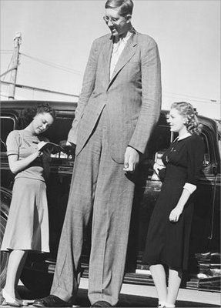
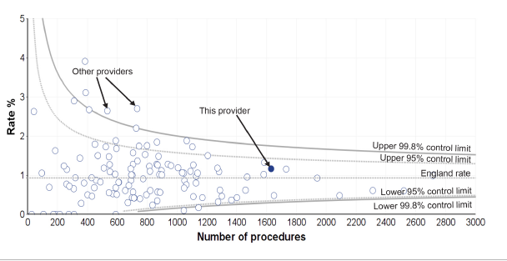
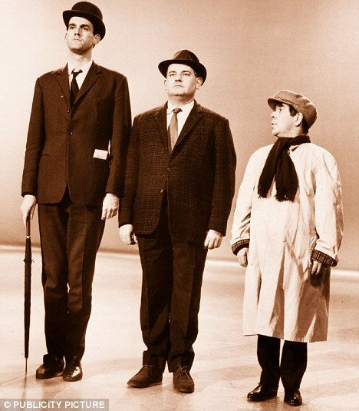
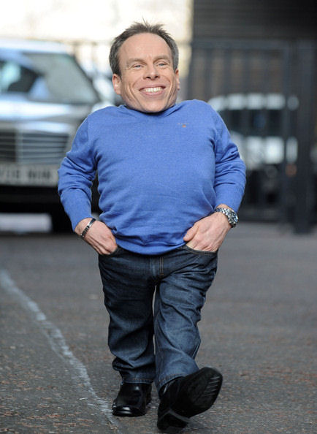
Funnel Plots:
Statistical Control Plots (SPC)
Special cause variation: not random variation

Slide 9
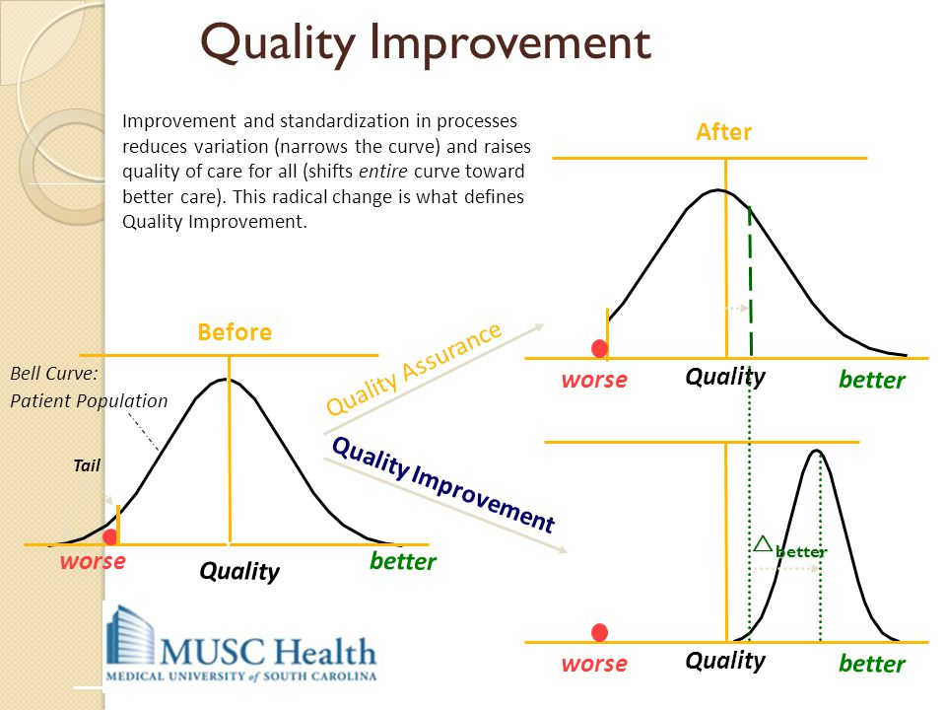

Slide 11
Facet Joint Injections by GIRFT Spinal Surgery Visit Sites: NHS Providers
Source & Year: HES April 2013 to March 2018

Slide 12
Facet Joint Injections by Yorkshire & Humber Independent Providers (NHS)
Source & Year: HES April 2013 to March 2018

Slide 13
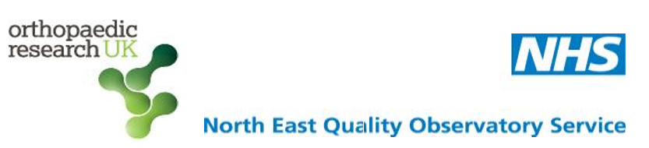
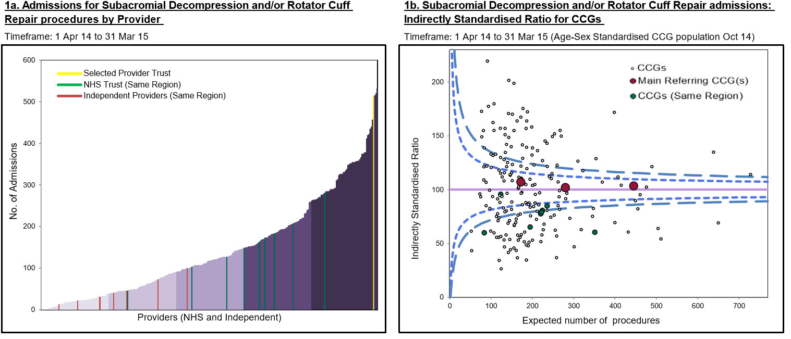
Sub-acromial Decompression / Rotator Cuff Repairs

Slide 14
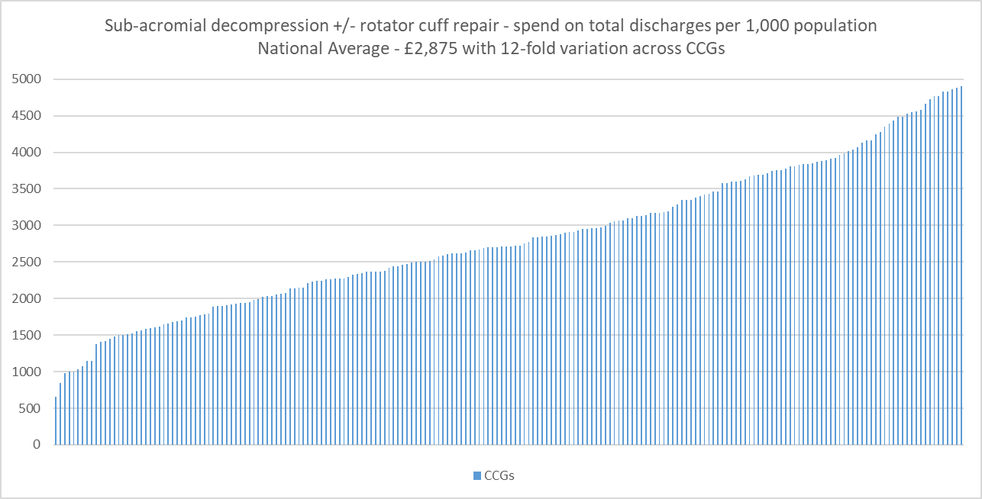
Sub-acromial Decompression / Rotator Cuff Repairs
Data provided by NHS RightCare
These indicators have been indirectly age-sex standardised.
CCGs with low volumes (under 6) have had their data suppressed.

Slide 15
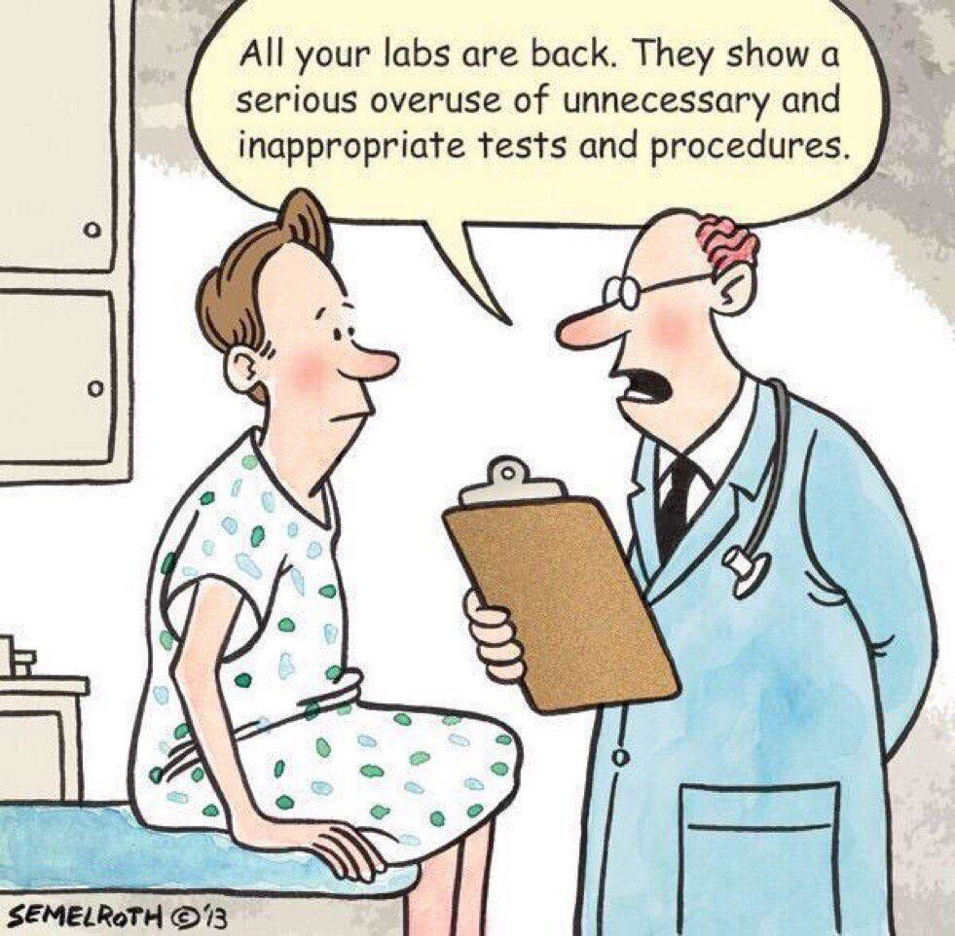
Unwarranted Variation
Getting It Right First Time
Tackling unwarranted variation to improve quality of patient care while also identifying significant savings.
Requires clinical teams in Trusts as well as commissioners to understand what good evidence based care looks like and work together across the local health economy to deliver the change.

Slide 16
GIRFT Implementation
The responsibility for designing and implementing any changes derived from GIRFT recommendations lies with trusts and their partners in each local health economy.
Each trust has a board-level GIRFT clinical champion (normally Medical Director), and each clinical workstream will have a designated GIRFT lead.
Over 80% of GIRFT staff are trust facing. Nearly 40% are clinicians. They support each trust and their local partners to improve clinical outcomes.
Clinical Leads, as national leaders in their field, advise trusts on how to reduce any unwarranted variations seen in their GIRFT data packs and help to benchmark their performance against their peers.
Clinical Leads drive improvement nationally by writing a GIRFT National Report on their specialty, through working closely with NHSE Clinical Directors, and by feeding into wider national improvement initiatives.

Slide 17
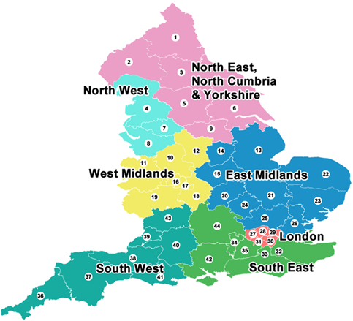
GIRFT local support
GIRFT Regional Hubs support trusts in delivering the Clinical Leads’ recommendations by:
Helping them to assess and overcome the local and national barriers to delivery.
Working closely with NHSI regions to ensure prioritisation of GIRFT delivery takes account of the wider context within each trust and is joined up with local and regional improvement initiatives.
Joining up with NHSE / RightCare to ensure integrated support for STP level improvements.
Producing good practice manuals of case studies and best practice guidance that trusts can use to implement change locally.
Supporting mentoring networks across trusts.

Slide 18
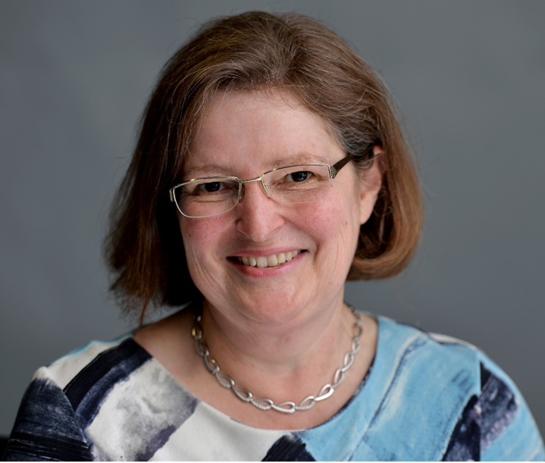

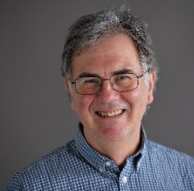
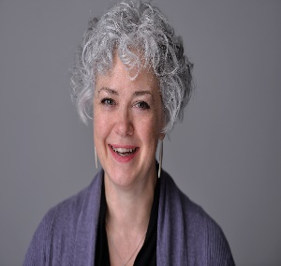
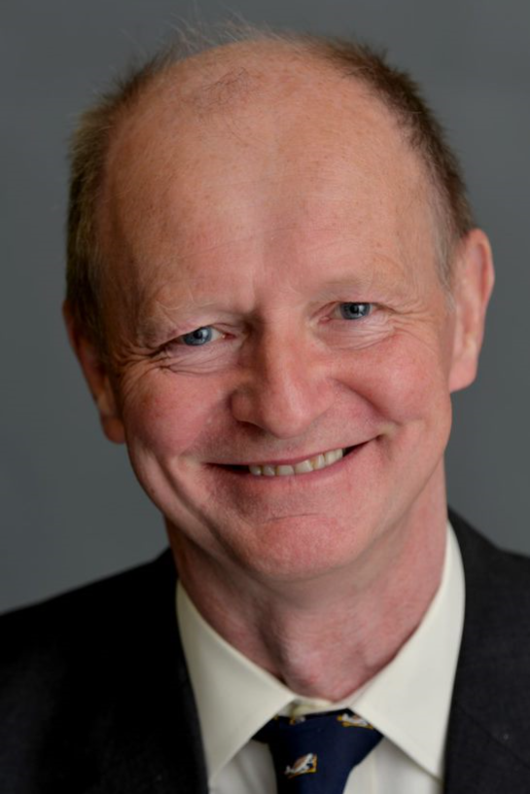
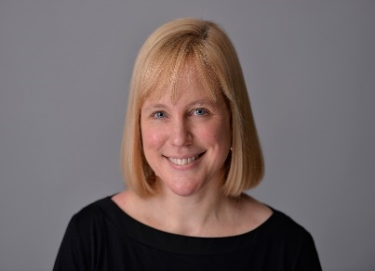
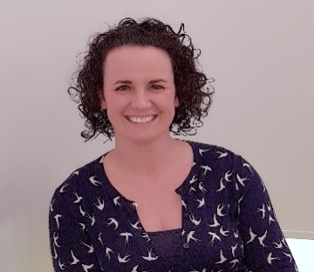
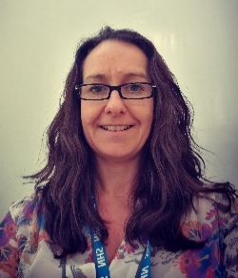
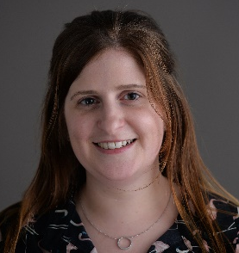
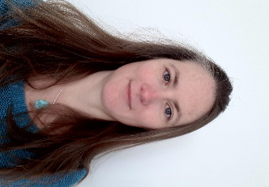
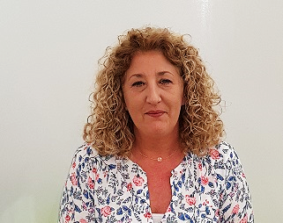
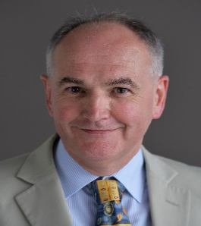
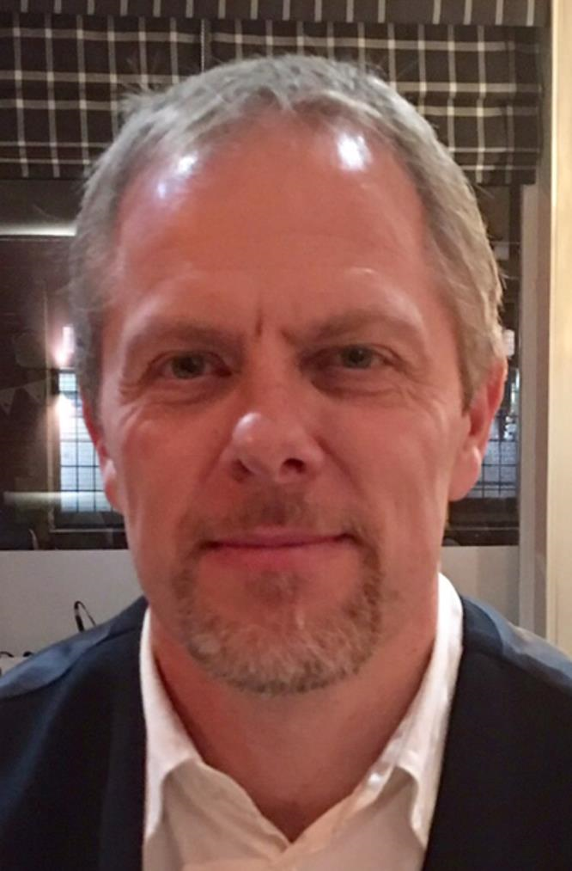
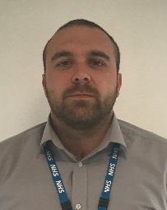
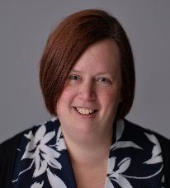
North East, North Cumbria & Yorkshire Hub
Implementation Team
Joint Hub Directors
Clinical Ambassadors
Liz Lingard
Ann Wright
Mark Lansdown (88 days)
Jean MacLeod (88 days)
Nick Phillips (24 days)
Implementation Managers
Jennifer Wilkie
Aimee Robson
Terry Phillips
Helen Biggs
Jacqueline Claydon
Helen Ridley
Michael Lydon
22 Acute Trusts
9 Mental Health Trusts
1 Speciality Trust
6 Integrated Care Systems
Business Information Manager
Stephen Hoy
Comms Lead for the North
David Tate
Hub Administrator Paula Kew

Slide 19
National Partner Collaboration
The full potential of GIRFT can only be realised if the programme works in close partnership with a wide range of partners:
GIRFT and NHSI Operational Productivity deliver joint objectives.
GIRFT is working closely with NHSI central teams including Medical, Nursing, Regulation, Strategy, Comms, Finance, Pricing and Patient Safety.
GIRFT has agreed a joint operating model with the NHSI Regional network and GIRFT clinical ambassadors work closely with NHSI Regional medical directors and senior nurses.
GIRFT has MOUs with NHS England programmes including RightCare, Elective Care Transformation Programme and Specialised Commissioning to offer a joined up approach to STP level improvements
GIRFT-NICE collaboration
GIRFT works closely with Royal Colleges & national professional associations such as the CSP on national reports, best practice guidance etc.

Slide 20

“Logic clearly dictates that the needs of the many outweigh the needs of the few.”
“Or the one.”
Wrath of Khan (1982), Spock & Kirk
Through all our efforts, local or national, we will strive to embody the ‘shoulder to shoulder’ ethos which has become GIRFT’s hallmark as we support clinicians nationwide to deliver continuous quality improvement for the benefit of their patients.
Contact details - Liz Lingard, Hub Director Liz.Lingard@nhs.net

