Slide 1
Data
CSP meeting 14th November 2018
Dr Graeme Wilkes Sport & Exercise Medicine Consultant
Medical Director Connect Health

Slide 2
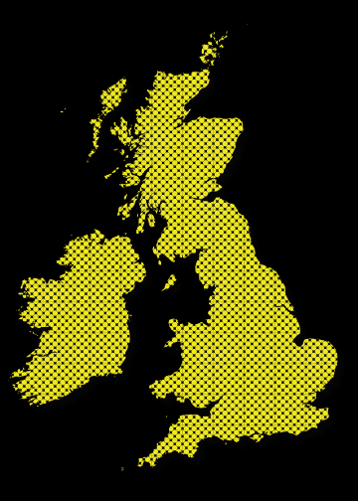
Connect Health 1993-2018
NHS Community MSK, Pain, Rheumatology
20 CCG contracts with 19 NHS Organisations
~400 clinical staff (137 TUPE’d from other organisations)
350,000 NHS referrals per year
Northumberland CCG South Tyneside CCG
Darlington CCG North Kirklees CCG
Wakefield CCG Nottingham North & East CCG
Nottingham West CCG Wolverhampton CCG
Herts Valleys CCG Milton Keynes CCG
Harrow CCG Hammersmith & Fulham CCG
Merton CCG Camden CCG
Thurrock CCG Basildon & Brentwood CCG
Croydon CCG Brent CCG
Lincolnshire CCG

Slide 3

William Edwards Deming 1950
"In God we trust, all others bring data."

Slide 4

Notes:
CEO Hewett Packard

Slide 5

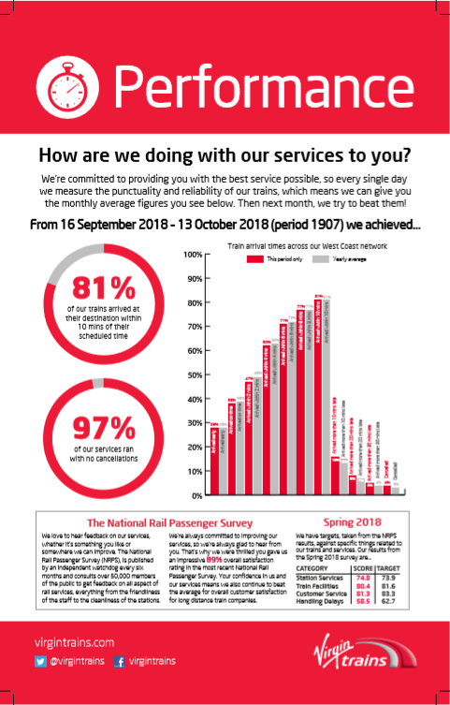
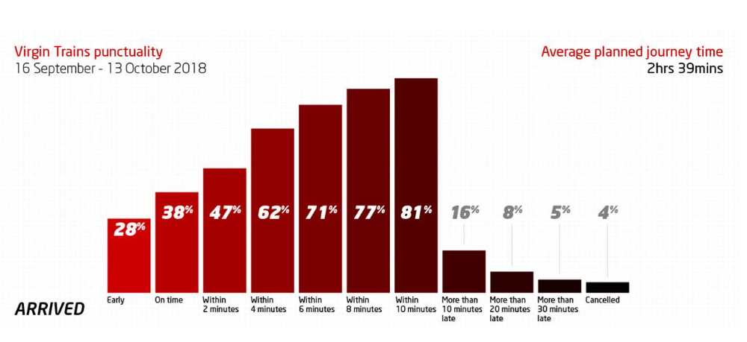

Slide 6
NHS Digital
Health Economy Performance
Medicines use (Pregabalin, EPS%, etc)
PROMs data
RTT
Deprivation rates (access and equity)
A&E waits
Patient experience data- GP, hospital, etc
RightCare
National
Joint
Registry
QOF
STP dashboard

Slide 7

Notes:
Opportunity Orthopaedic balance moving

Slide 8
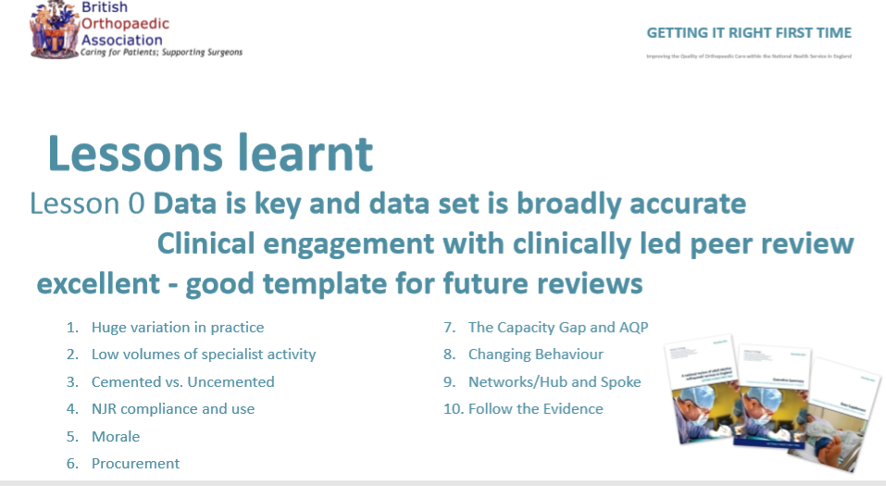

Slide 9
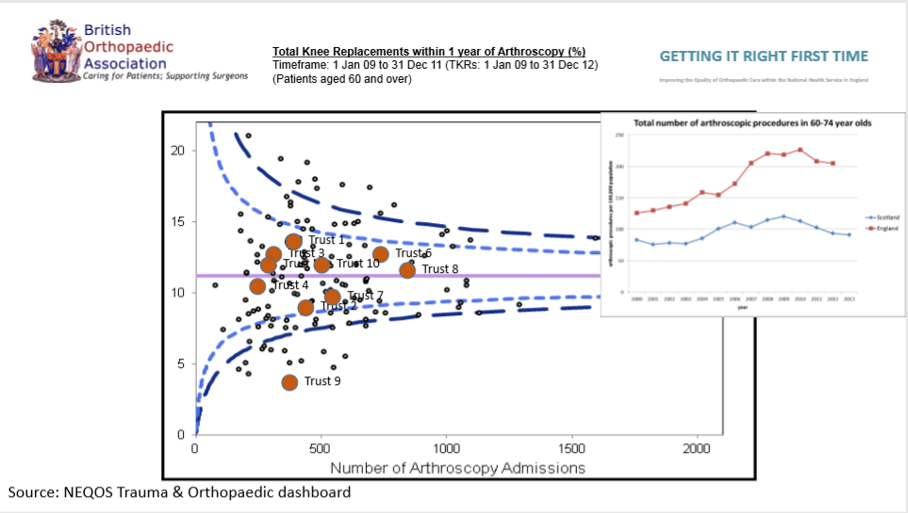
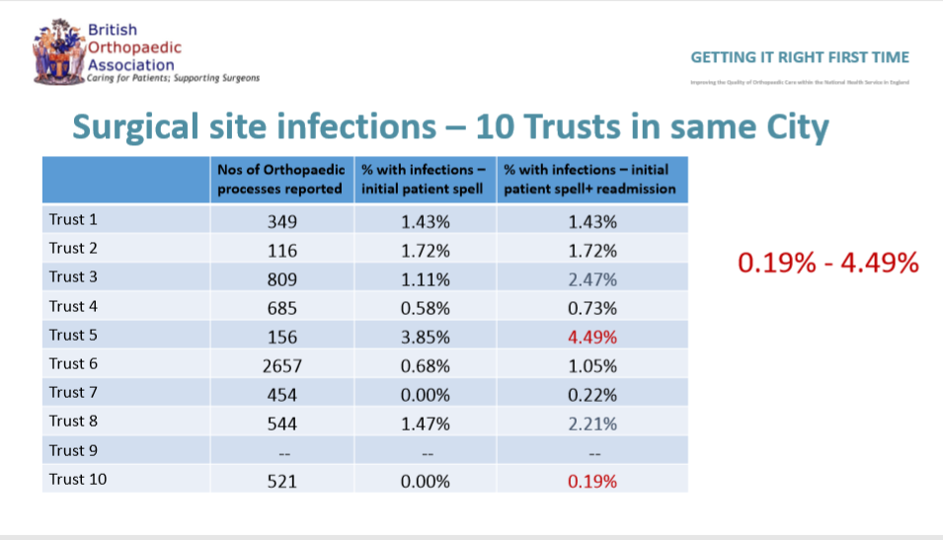

Slide 10
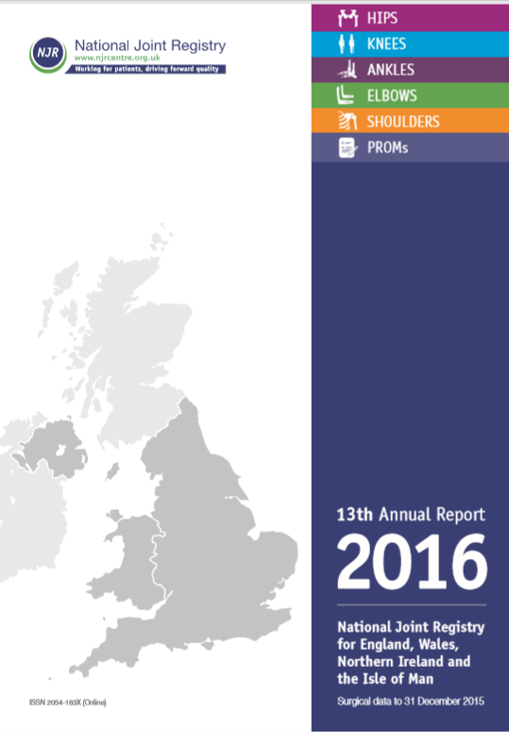
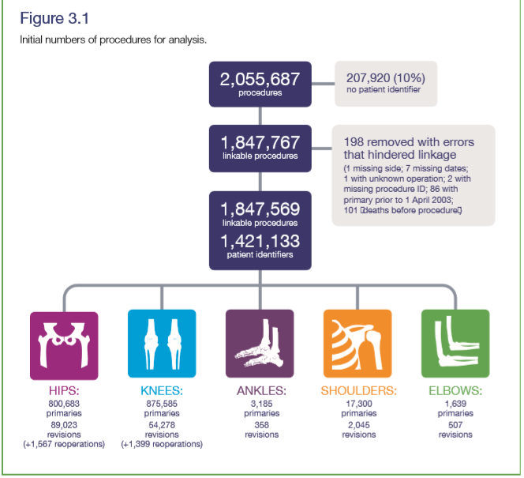

The collection of Patient Reported Outcome Measures (PROMs) remains a priority for the NJR. This year we commenced the regular six-month follow-up of shoulder joint replacement procedures for patients who had undergone surgery after 1 October 2016. Three- year follow-up will begin in 2019. Work is ongoing to finalise outcomes from the five-year follow-up of hip and knee PROMs and a newly convened working group will consider the future strategy for NJR PROMs.

Slide 11
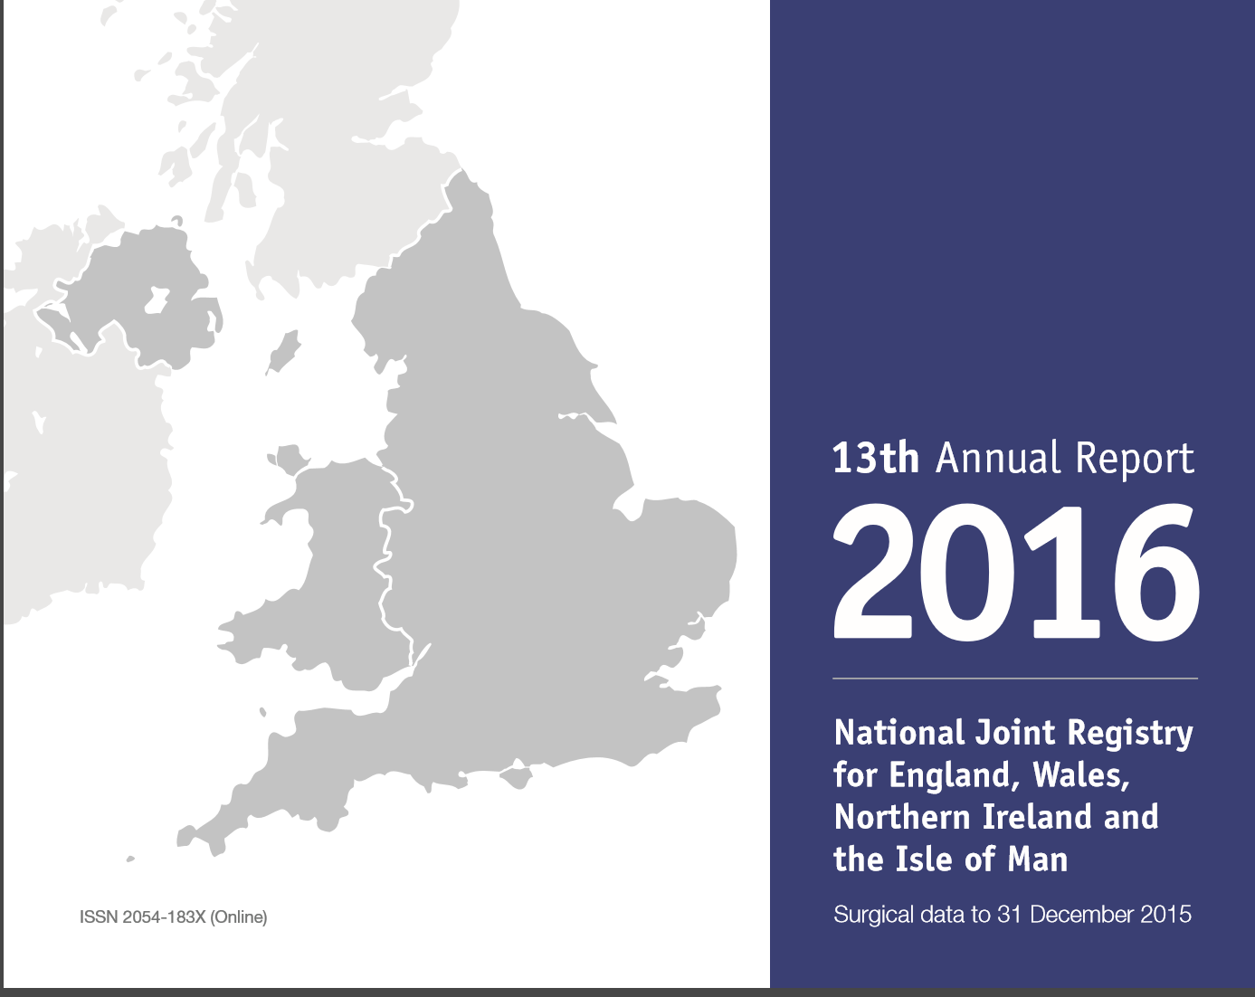
EQ5D - National Joint Registry 2015
Knee Arthroplasty EQ5D + 0.34
Hip Arthroplasty EQ5D + 0.44
Notes:
SHARED DECISION MAKING

Slide 12
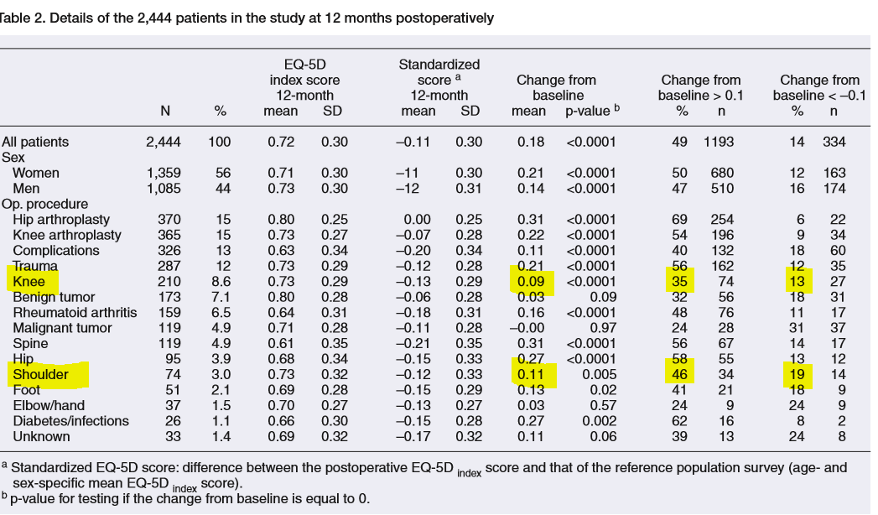
EQ5D Orthopaedic study Stockholm
Jansson KA, Granath F. Health-related quality of life (EQ-5D) before and after orthopedic surgery. Acta Orthop. 2011;82:82–9.
Notes:
This is just ONE measure, may not be sensitive, specific etc

Slide 13
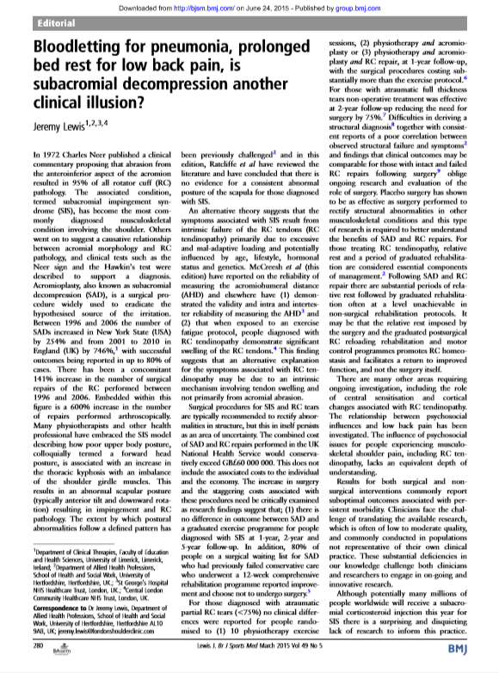
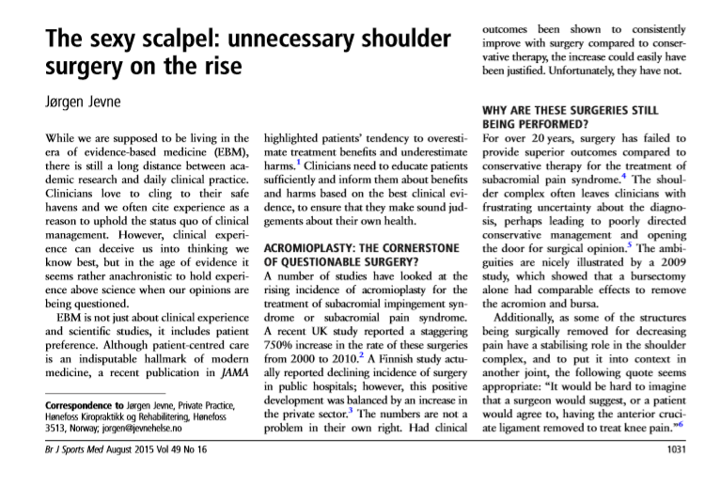
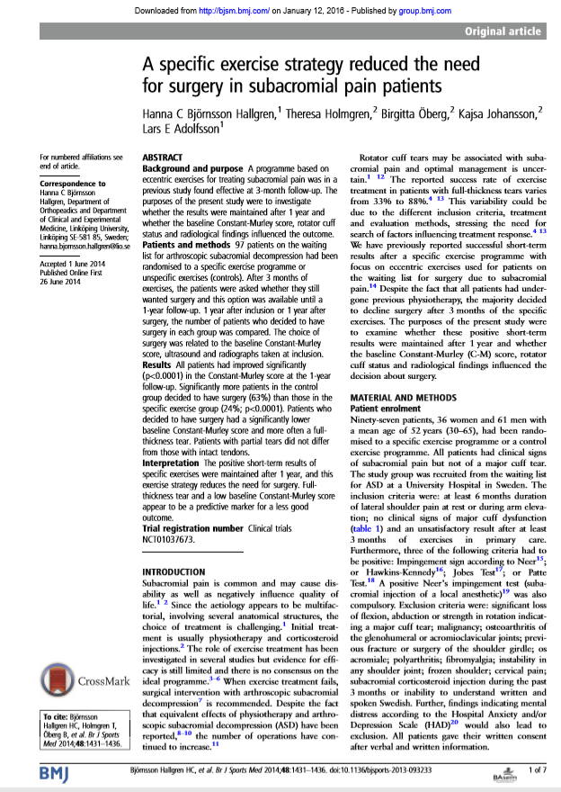
Subacromial pain ( =subacromial decompression)
Notes:
And now a key paper in Lancet 2018 Sham = SAD surgery

Slide 14

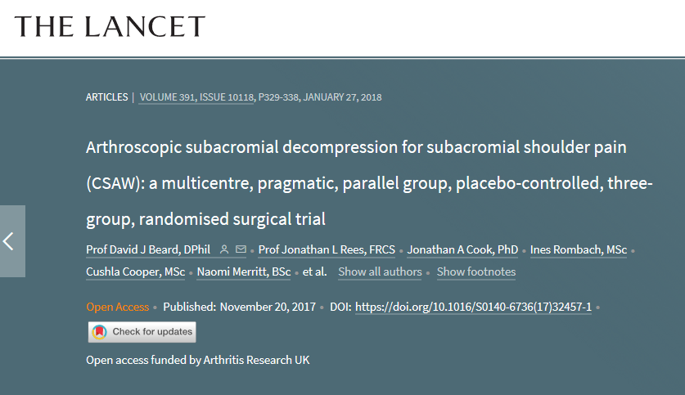
Sub-acromial decompression surgery
- Research from Oxford published Jan 2018
Interpretation
Surgical groups had better outcomes for shoulder pain and function compared with no treatment but this difference was not clinically important. Additionally, surgical decompression appeared to offer no extra benefit over arthroscopy only. The difference between the surgical groups and no treatment might be the result of, for instance, a placebo effect or postoperative physiotherapy. The findings question the value of this operation for these indications, and this should be communicated to patients during the shared treatment decision-making process.

Slide 15
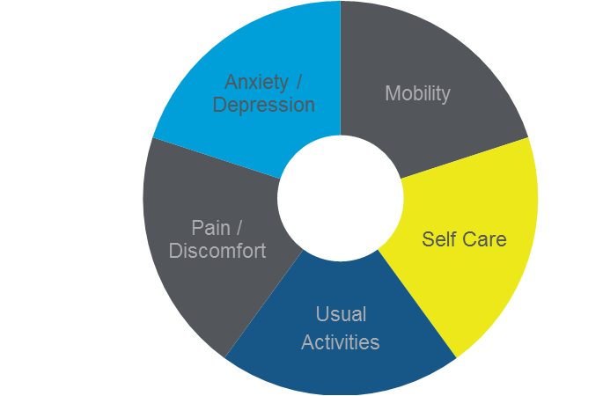
EQ5D – 5L
Health related quality of life (HRQoL)
5 questions or “domains” each with 5 options
Scoring – 0.594 (“dead”) to +1 ( full normal life)
Change in score used as PROM e.g. +0.14
minimum clinically important difference (MCID)
> 0.1 change
Very few published change for physiotherapy interventions but mean was
+0.16

Slide 16
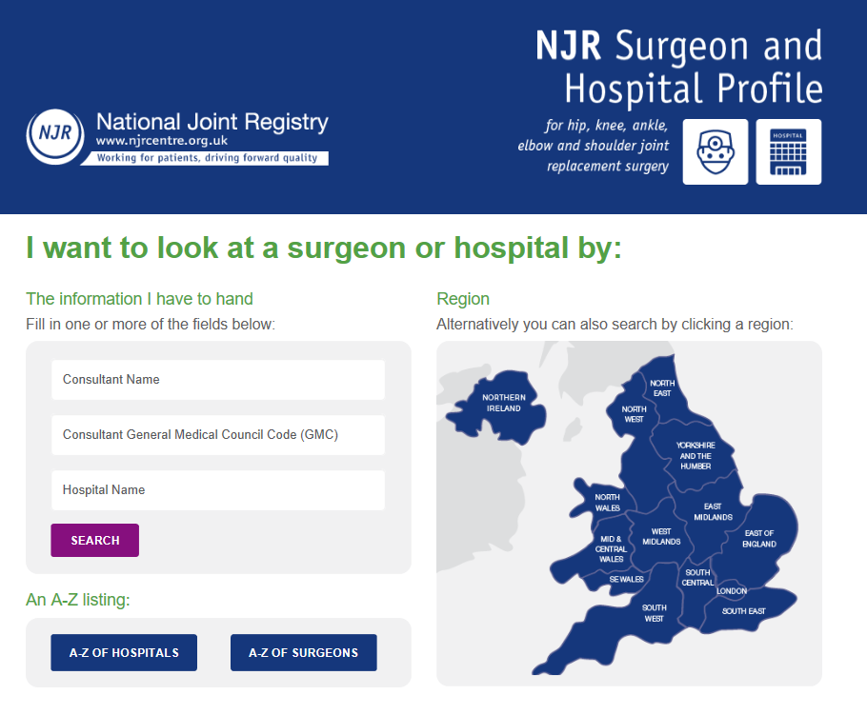
http://www.njrsurgeonhospitalprofile.org.uk/

Slide 17
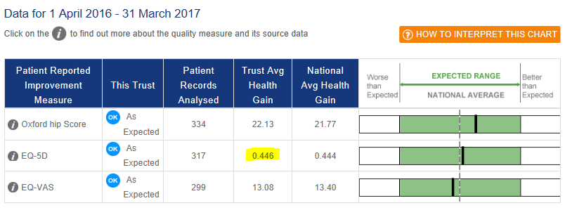
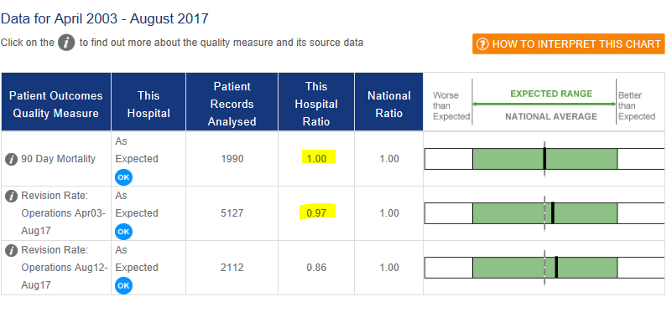
Freeman HJR

Slide 18

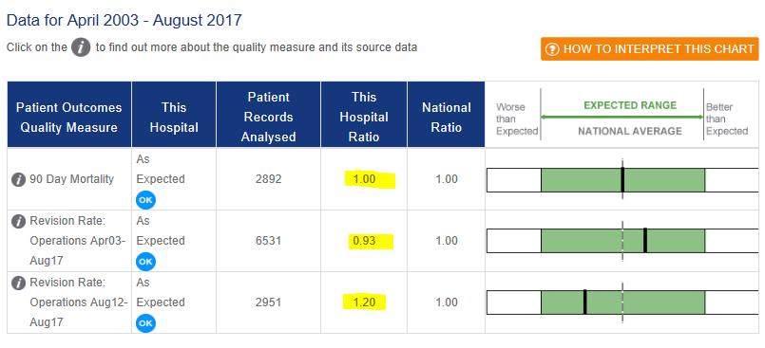
Freeman KJR

Slide 19
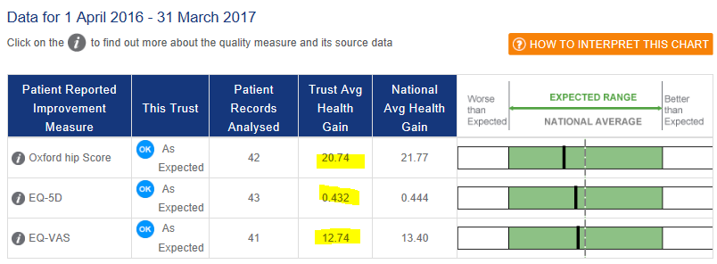

STGH Hip

Slide 20
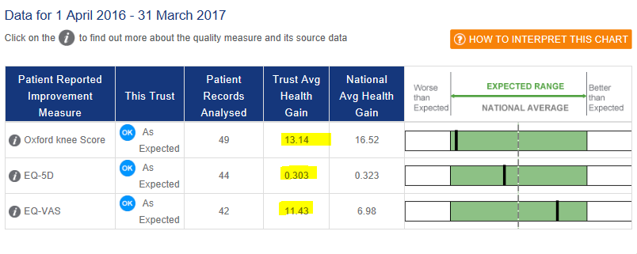
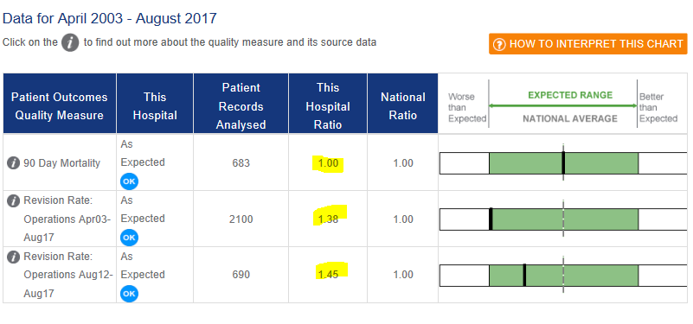
STGH - Knee

Slide 21
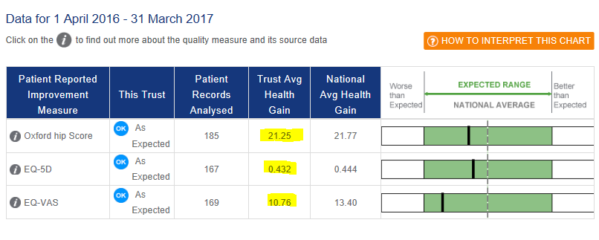
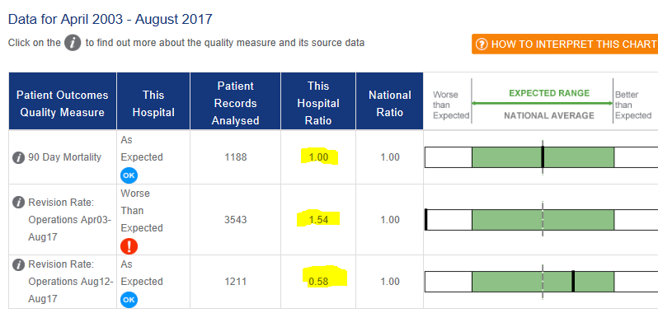
University of Hartlepool Hospital - Hip
Notes:
NEXT PHYSIO

Slide 22
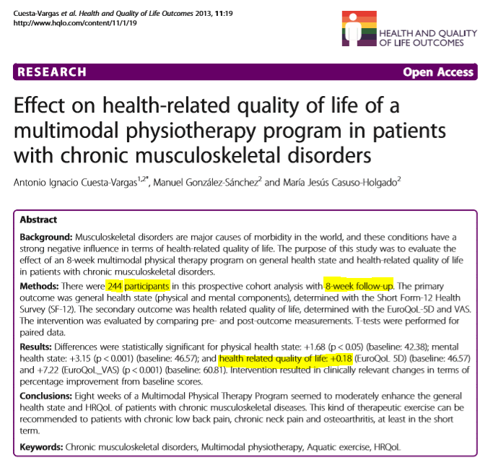

Slide 23
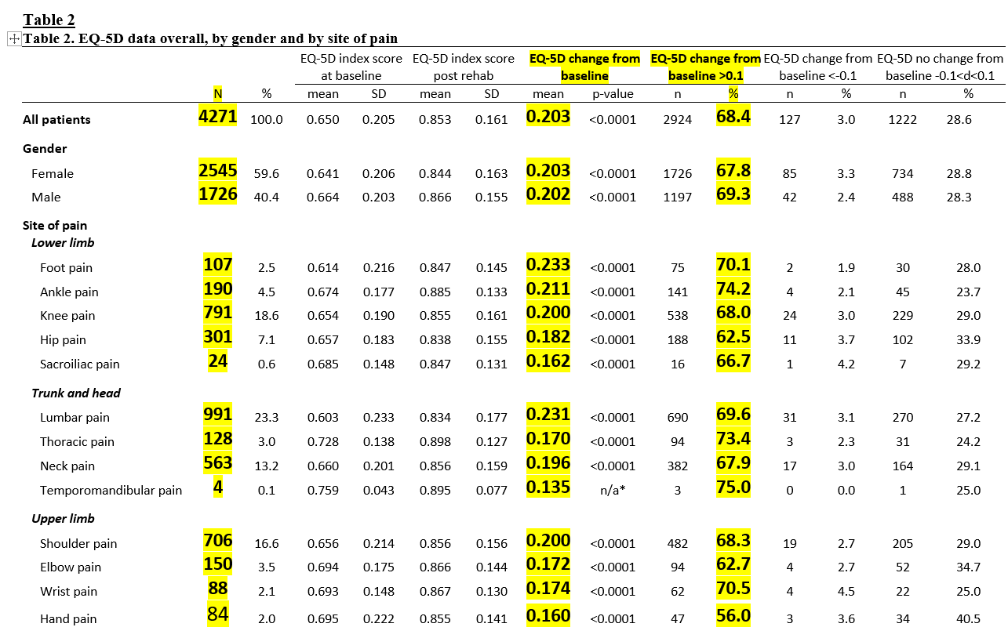
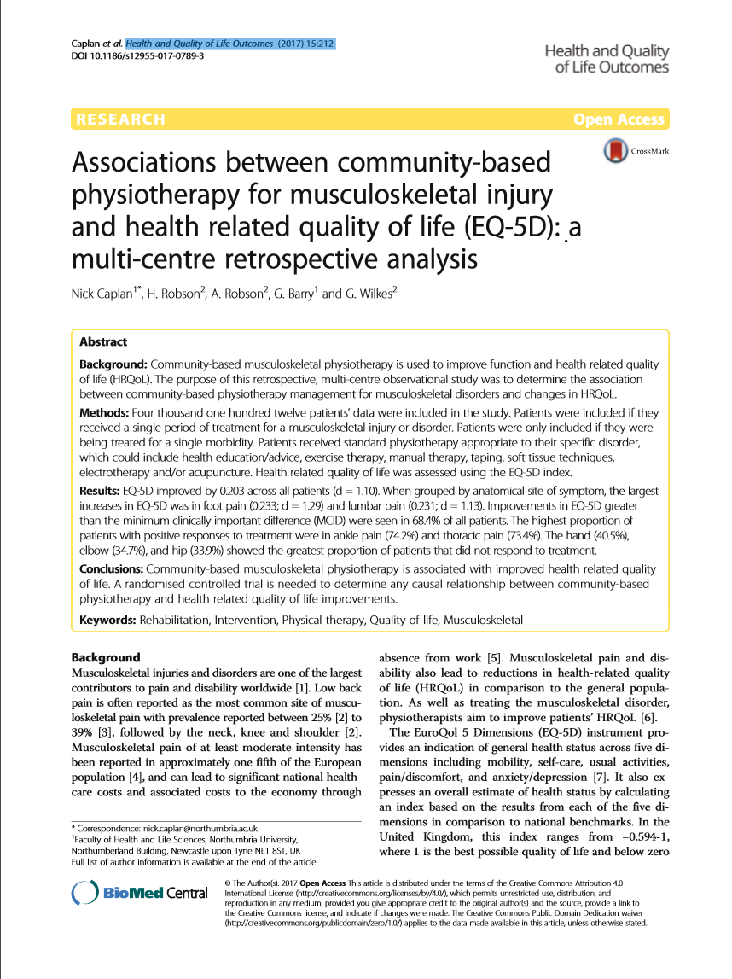

Connect Health EQ5D outcomes 2012-16
Caplan et al. Health and Quality of Life Outcomes (2017) 15:212
Notes:
Outcomes pedigree – we have published and peer reviewed showing excellent performance in terms of hard outcomes

Slide 24
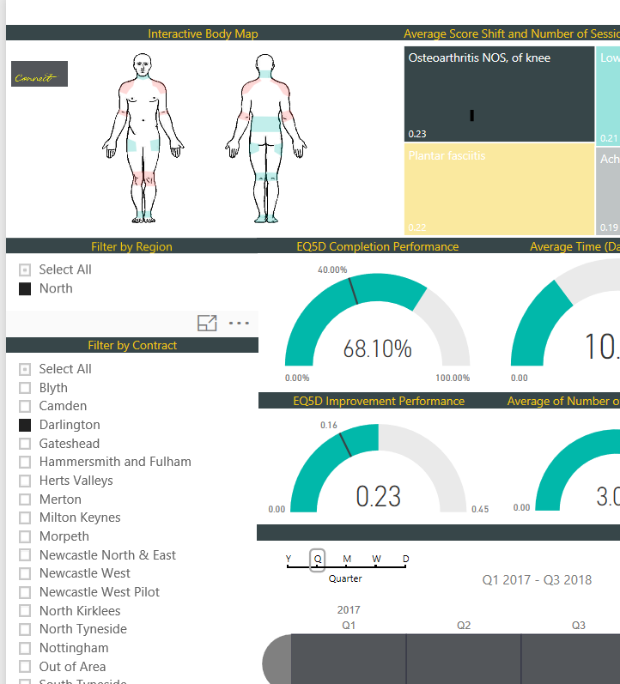
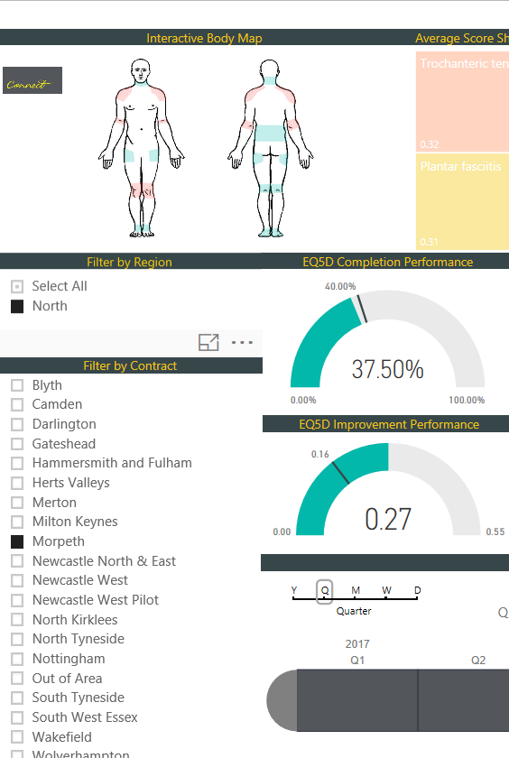
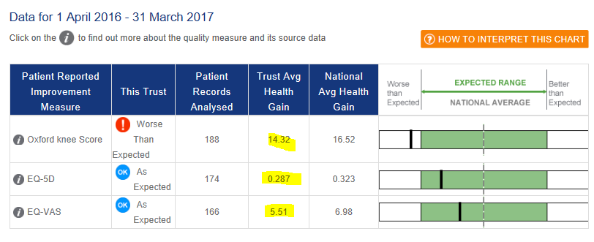
NE NHS Surgery Centre - Knee

Slide 25
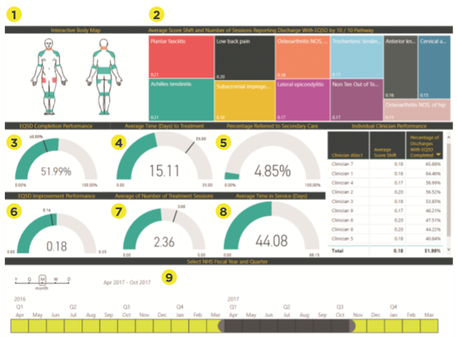

Connect Data Warehouse
 | Interactive body map
 | Average score shift of EQ5D by 10/10 clinical condition
 | EQ5D completion performance
 | % referred to secondary care
 | EQ5D improvement performance
 | Avg no. of treatment sessions
 | Avg time in service
 | Ability to filter by time period, region, contract and clinician
 | Interactive body map
1
2
3
4
5
6
7
8
9

Slide 26
Live demo

Slide 27
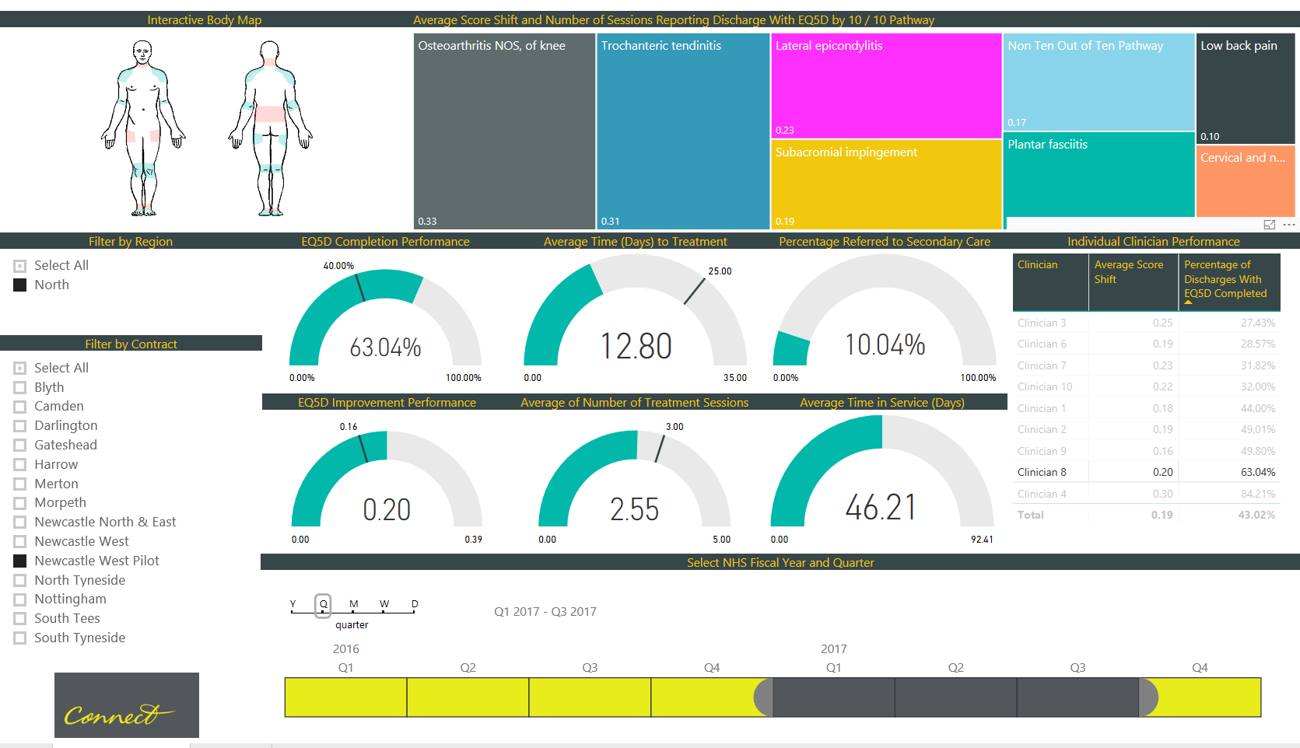
Notes:
This is one clinicians results 0.20 EQ5D 63% collection 10% secondary care note 0.33 for OA knee … better than arthroplasty !

Slide 28
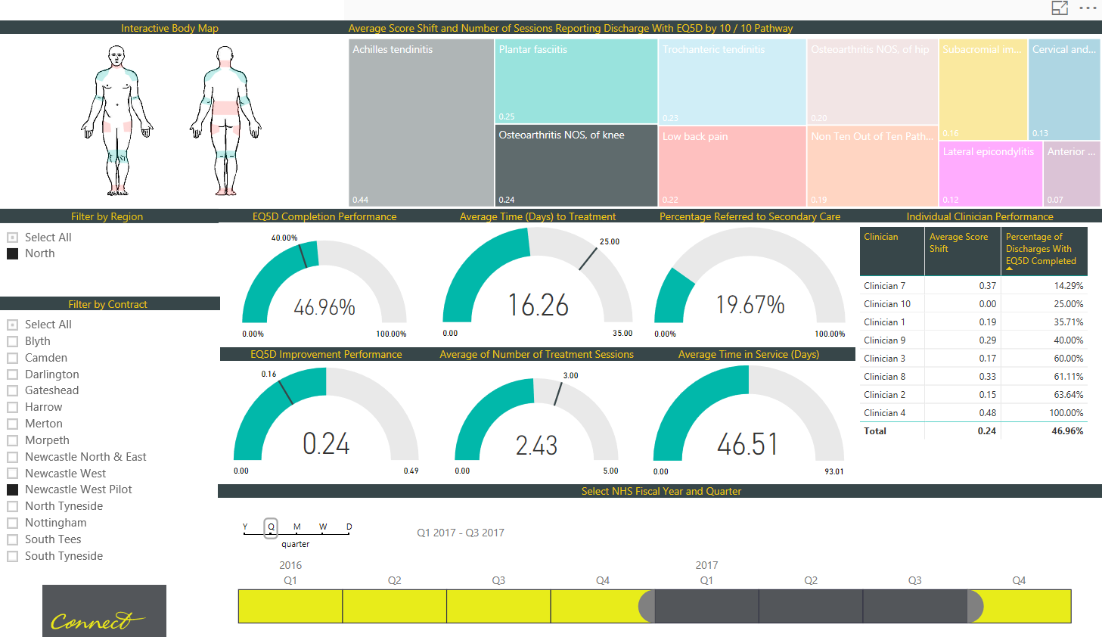

Notes:
OA of knee dashboard 0.24 ! This is one clinician in Newcastle West

Slide 29
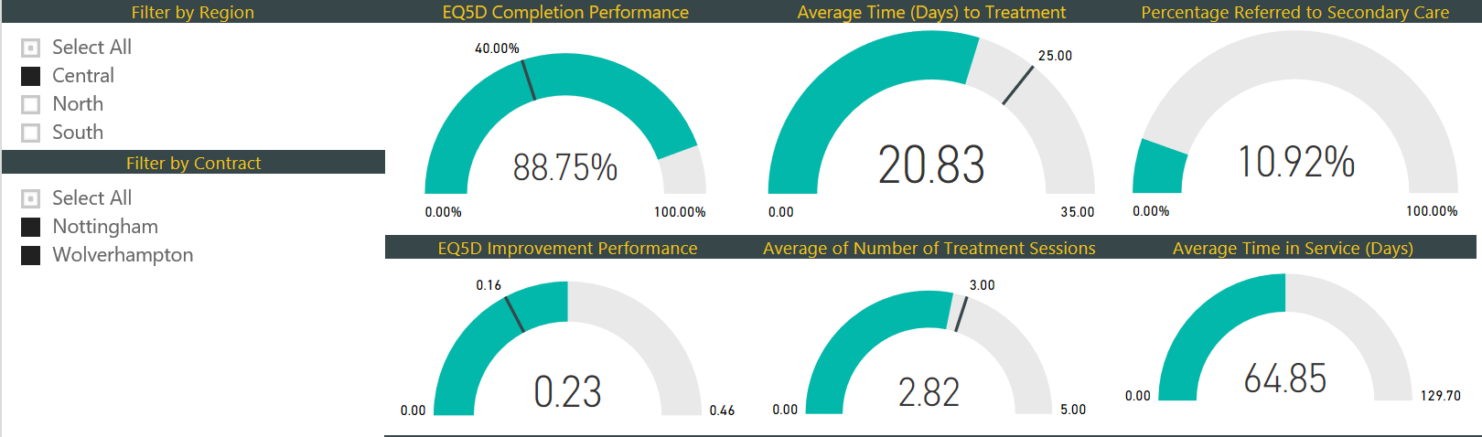
Q2 2018 July-Sept- “ Central”

Slide 30
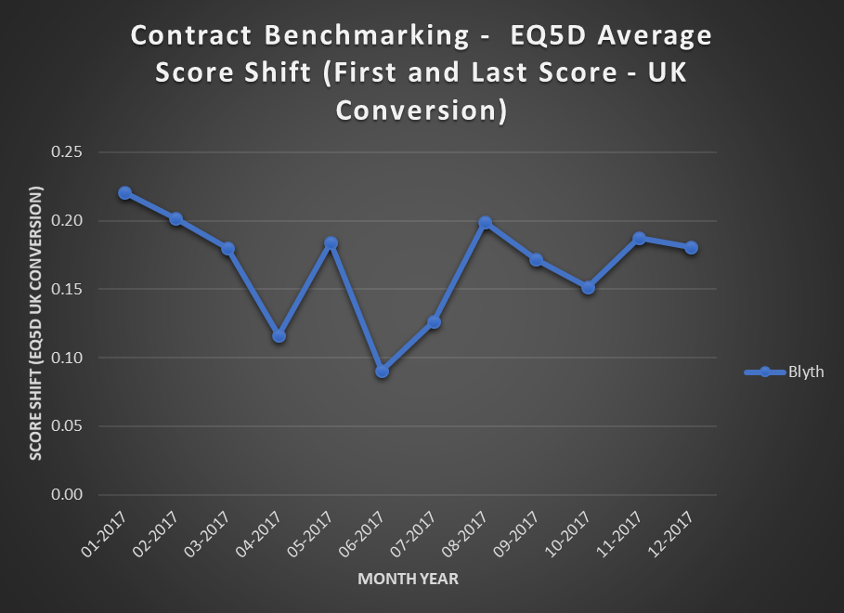
Notes:
Example of contract with low monthly - variation seen month to month so to assess this contract you need to look at a whole year of outcomes

Slide 31
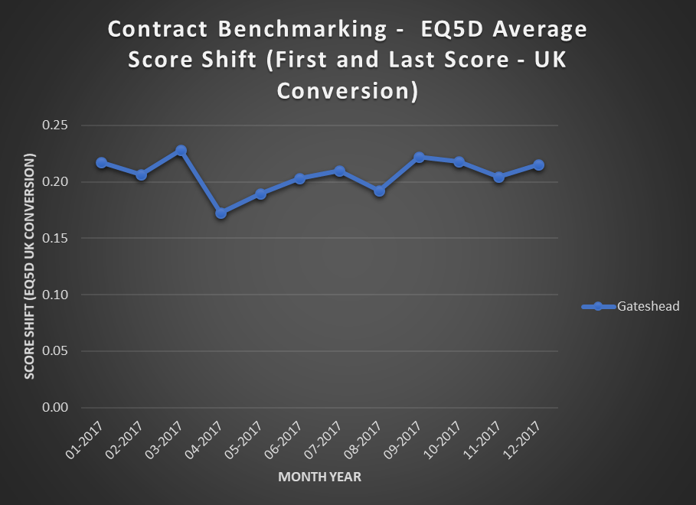
Notes:
Contrast Gateshead – large contract – 0.20 either side month to month – reliable stats

Slide 32
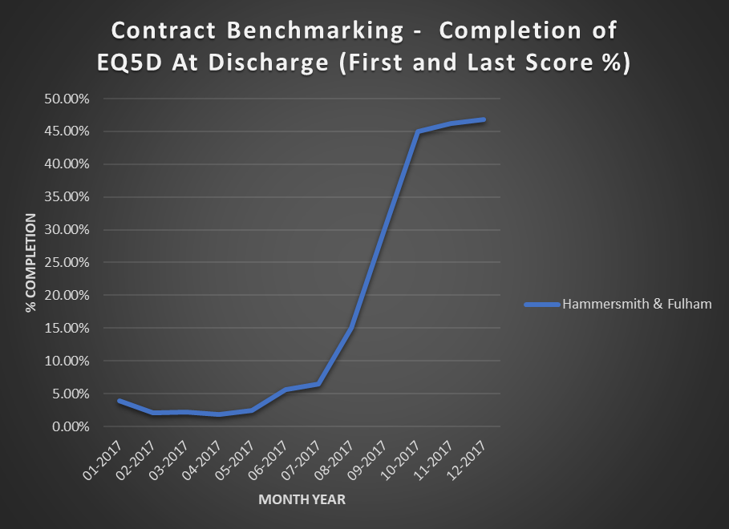
Notes:
Feedback Great example this for collection rates – 1st half 2017 –bottom of league table – MW says guys do you really want to be bottom of league table and collection in rapidly improved

Slide 33
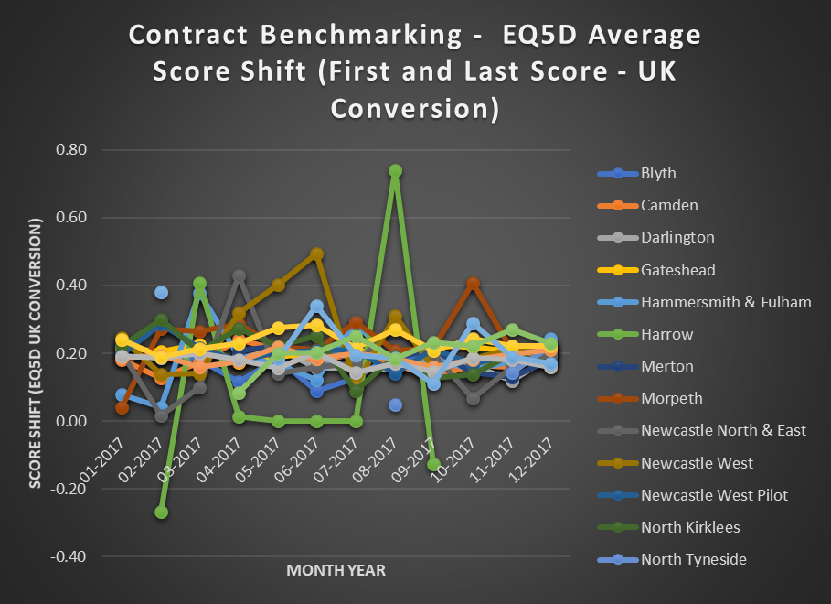
Notes:
All contracts re mean shift and so 0.20 seems to be the benchmark – variation always relates to low numbers ( <100 is inaccurate - be aware of publications or claims for low numbers!)

Slide 34
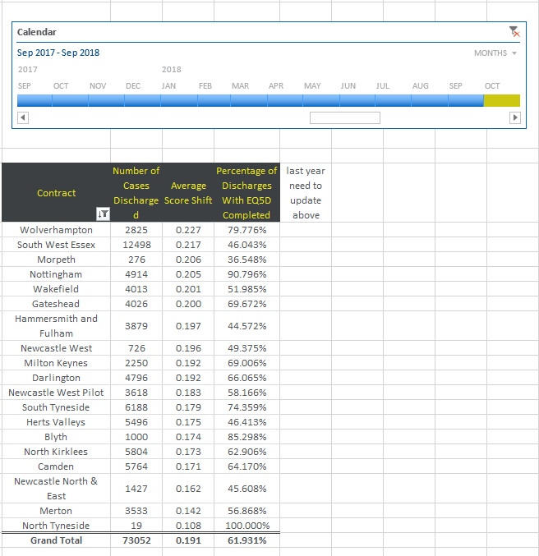
Last 12 months Connect
EQ5D outcomes

Slide 35
All-time completed Connect
EQ5D outcomes
- Nov 18
Contract | Number of Cases Discharged | Average Score Shift | Percentage of Discharges With EQ5D Completed
Blyth | 6600 | 0.183 | 33.807%
Camden | 27223 | 0.186 | 33.912%
Darlington | 7055 | 0.193 | 61.920%
Gateshead | 17479 | 0.205 | 39.680%
Hammersmith and Fulham | 11200 | 0.195 | 18.127%
Herts Valleys | 7326 | 0.174 | 47.264%
Merton | 8460 | 0.176 | 47.703%
Milton Keynes | 2754 | 0.191 | 70.127%
Morpeth | 1268 | 0.224 | 22.934%
Newcastle North & East | 3868 | 0.179 | 23.077%
Newcastle West | 2204 | 0.207 | 23.882%
Newcastle West Pilot | 15112 | 0.193 | 16.305%
North Kirklees | 9201 | 0.175 | 50.919%
North Tyneside | 4236 | 0.227 | 12.121%
Nottingham | 10971 | 0.200 | 75.939%
South Tyneside | 12342 | 0.183 | 64.652%
South West Essex | 33931 | 0.216 | 29.343%
Wakefield | 6566 | 0.201 | 40.635%
Wolverhampton | 3703 | 0.228 | 77.923%
Grand Total | 191499 | 0.195 | 39.016%

Slide 36
"In God we trust, all others bring data.“
QUESTIONS ?

