Slide 1
Innovation, Information and Impact
Technology and Data for Physiotherapy
Euan McComiskie
Health informatics Lead
@EMAHPInfo
Sue Hayward-Giles
Assistant Director Practice and Development
@suehaywardgiles

Slide 2

What is health informatics …
"The knowledge, skills and tools which enable information to be collected, managed, used and shared to support the delivery of healthcare and promote health.“
(Making Information Count: A Human Resources Strategy for Health Informatics Professionals Department of Health, October 2002)

Slide 3
2007 → 2018 …
2007
iPhone
2008
Apple App Store
2009
Spotify, GPS, Twitter (mainstream)
2010
2011
Kickstarter (crowd funding)
2012
Voice technology
Google Glass
2013
Smartwatches
2014
Amazon Echo
2015
Autonomous vehicles
2016
2017
Oculus Rift (VR headset)
2018
Machine Learning (AI)
??

Slide 4
Physiotherapy in 2018 …
Have we (and the rest of health and social care) caught up with other markets in digitalising our services?
  Do we deliver healthcare as digitally as we do our banking?
  Our shopping?
  Our entertainment?

Slide 5
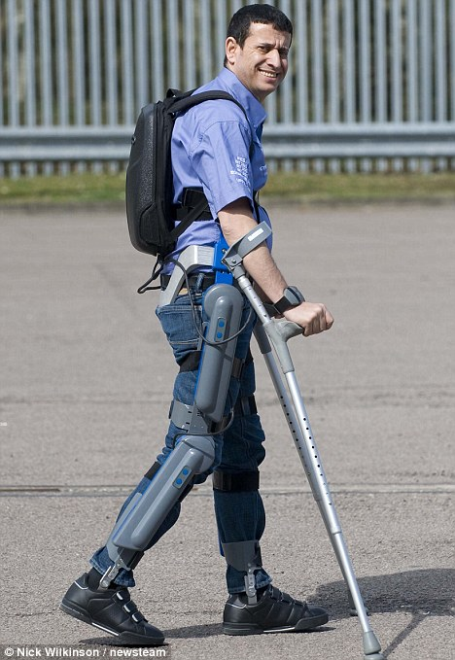
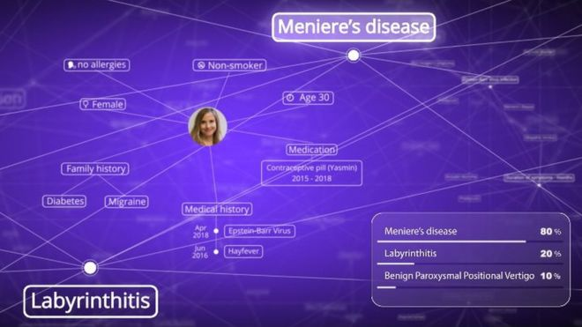

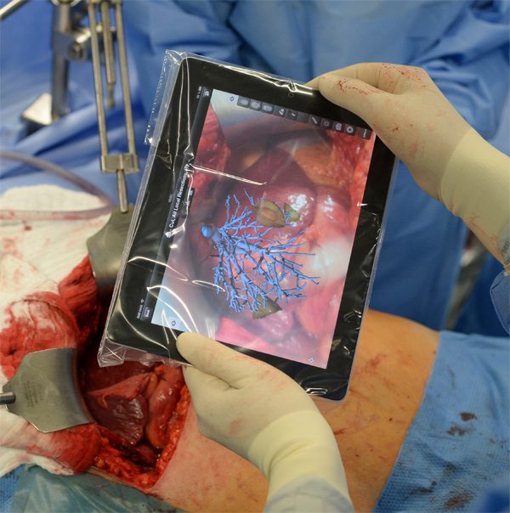
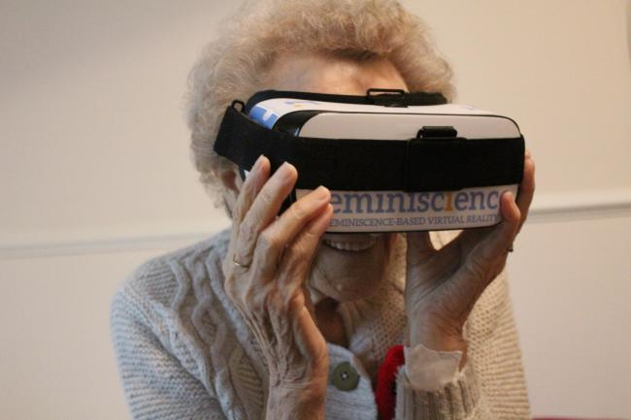
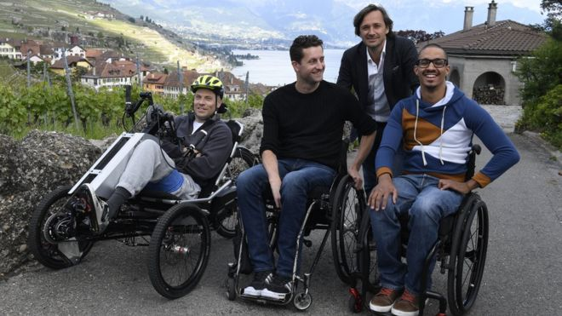
Technology in healthcare …

Slide 6
Physiotherapy in 2018 …
NO!
Have we (and the rest of health and social care) caught up with other markets in digitalising our services?
  Do we deliver healthcare as digitally as we do our banking?
  Our shopping?
  Our entertainment?
The technology is here, it’s just not well distributed yet
Why not?
Barriers and challenges

Slide 7
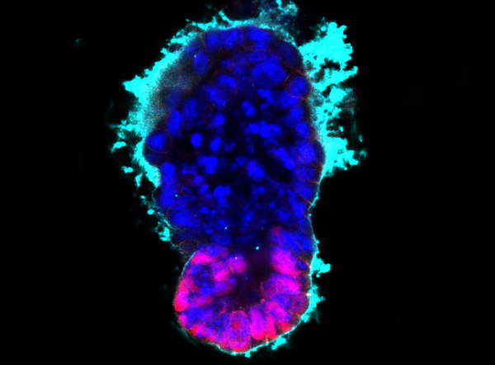
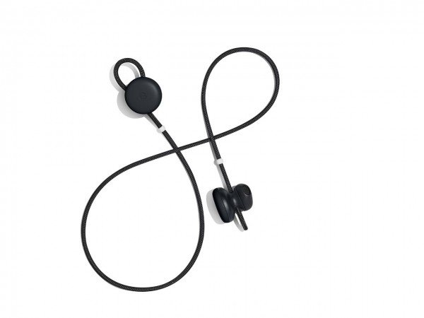
Technology …

Slide 8


IG …

Slide 9
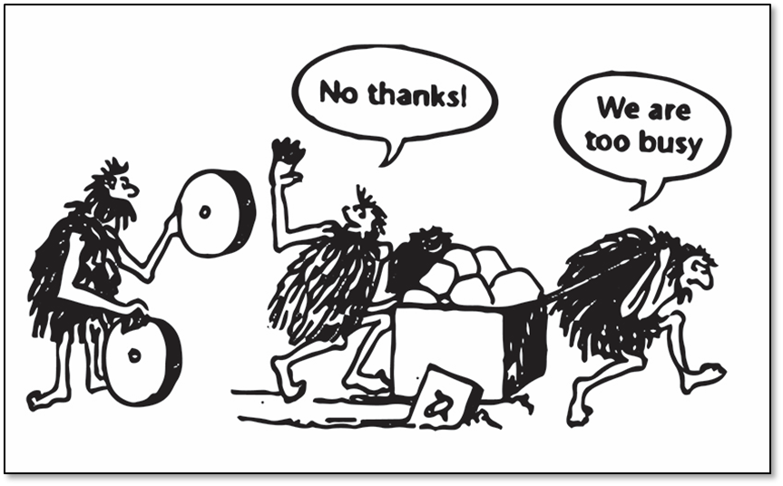
Staff culture …

Slide 10
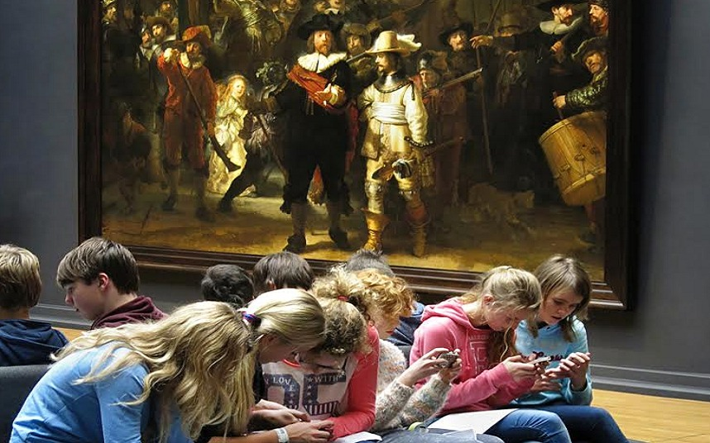
Human interaction …

Slide 11

Perceptions of public …
PhysioBot

Slide 12

Integration…
PhysioBot

Slide 13

Connectivity …

Slide 14
Cost …
 | 2008 | 2013 | 2018
iPad | Didn't exist | £699 (64GB) | £409 (128GB)
Desktop PC | $692 | $544 | $633
Smart TV | Didn't exist | $1800 | $800
Notebook | $1008 | $692 | $486
3D printer | Not commercially available | $1400 | $700
Oculus Rift system | Didn't exist | $799 | $599
FitBit | Didn't exist | $100 | $60
Echo Dot | Didn't exist | $89 | $39

Slide 15
The real currency … DATA!
Data is generated at ALL points in the
physiotherapy service user journey but do we ...
    Collect it systematically?
    Truly understand what it means?
    Consume it as much/well as we create it?
    Use it to drive improvement?
    Use it to demonstrate impact?
If you don’t count, you don’t count!

Slide 16
Physiotherapy in 2018 …
Room poll on state of data readiness … last physio standing!

Slide 17


Slide 18
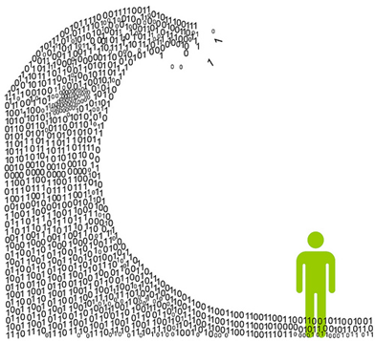



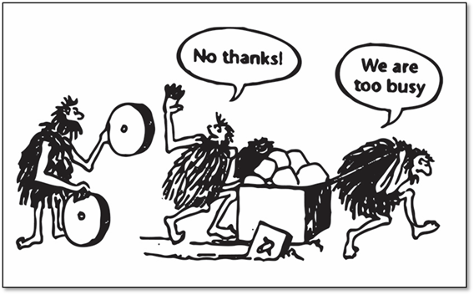
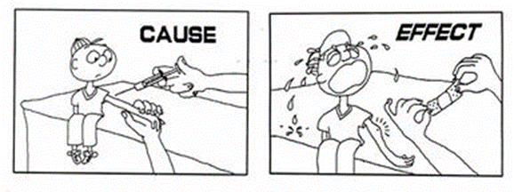

Slide 19
Data collection top tips …
  Design your answer first
  Confirm metric
  Define and limit data collection
  Use standardised data definitions
  Use clinical champions

Slide 20


Using data for impact …

Slide 21
Using data to influence …
Influence
Transactional
Output
Outcome
Experience
Impact

Slide 22
Data geeks and curious clinicians …
Where are you on the data journey?
  Dubious beginner
    I don’t really see my place in this (Euan is weird)
  Curious clinician
    I can see why we need data and would like to know more (I understand Euan)
  Fast follower
    I want to be part of improving data in physiotherapy (I want to work with Euan)
  Data geek
    I want to lead around data in physiotherapy (I want Euan’s job)

Slide 23
Data geeks and curious clinicians …
What is your first question back at base tomorrow morning?
  Investigate data collection quality in my service
  Investigate data reporting in my service
  Investigate information use by my service
  Investigate impact of service information
  Investigate national policy around data and digital
  Investigate technology use in physiotherapy

Slide 24


Use your data to tell a story …

Slide 25

Not working out …

Slide 26

Get sharing …

Slide 27

Perseverance is the hard work you do after you get tired of doing the hard work you already did.
Newt Gingrich

Slide 28
Informatics isn’t just for geeks!
Collect well, use well, share well
Challenge barriers, challenge assumptions, aspire to innovate
MccomiskieE@csp.org.uk @EMAHPInfo
Hayward-GilesS@csp.org.uk @suehaywardgiles

