Slide 1
PHYSIOTHERAPY
HEALTH AND WELLBEING
Sharon Greensill Trust Physiotherapy Professional Head
Rotherham Doncaster and South Humber NHS Foundation Trust

Slide 2
What are we aiming to do?
Getting patients to think differently about their health and wellbeing
Recognising needs
Behaviour change
Identifying goals and aspirations
Supporting change

Slide 3

All staff and teams have responsibilities for promoting healthy lifestyles and good physical health
IT IS EVERYONE’S BUSINESS
Notes:
3
Primary care
Secondary care: Mental Health
Impact of physical health on mental health and mental health on physical health. cannot separate and influence each other. Need to take a holistic approach.
Work done so far: Mapping, Gaps, inconsistencies, areas of good practice
Awareness raising
Champions workshop
Practice Development Bulletin
Innovation Scholarship visits

Slide 4
Implementing Change
At what stage is the patient
Some may have thought about making a behaviour change, but may not yet have taken steps to make that change themselves.
Others may be actively trying to change their behaviour and may have been doing so unsuccessfully for years.

Slide 5
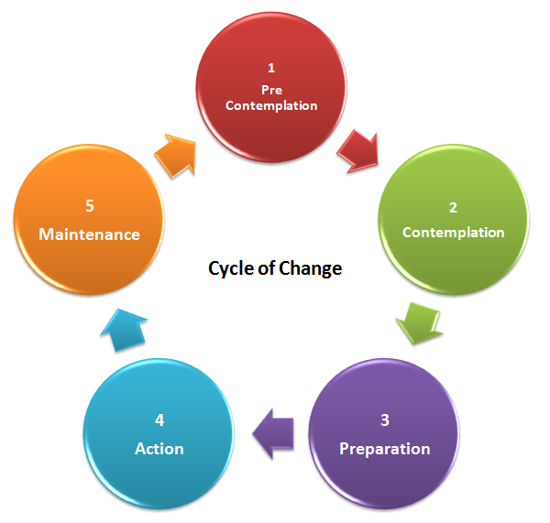
Willing to consider the possibility of having a problem
Sustained change new behaviour replaces old
Intent on taking action to address the problems
Takes action chooses to implement recovery plan

Slide 6
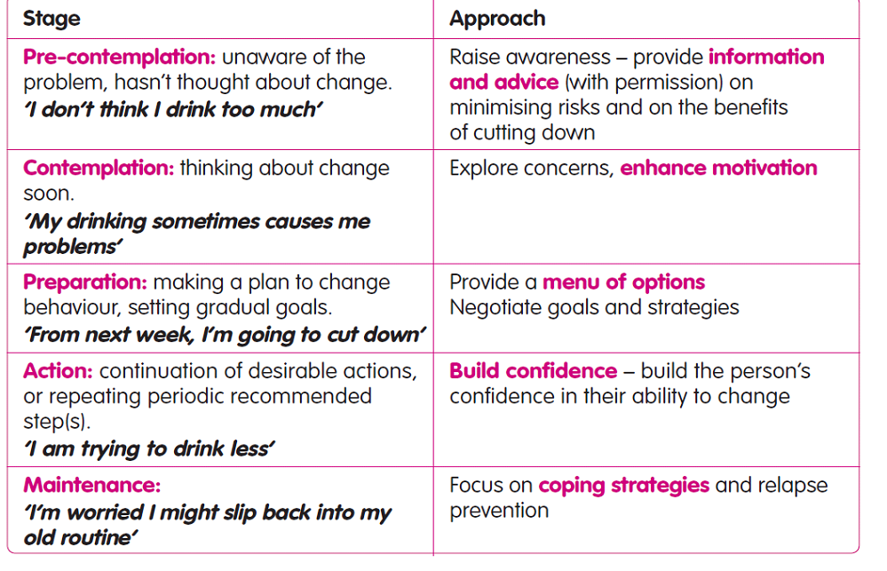

Slide 7
Motivational Interviewing
Concept evolved from experience in the treatment of problem drinkers.
Directive, client-centred counselling style for eliciting behaviour change by helping clients to explore and resolve ambivalence.
Goal-oriented
Accepts the fact that clients who need to make changes in their lives approach counselling at different levels of readiness to change their behaviour
Focus on present not past

Slide 8
Key Points for Effective Interventions
How we speak to people is likely to be just as important as what we say
Being listened to and understood is an important part of the process of change
The person who has the problem is the person who has the answer to solving it
People only change their behaviour when they feel ready - not when they are told to do so
The solutions people find for themselves are the most enduring and effective.

Slide 9
Key Skills
The ability to ask open-ended questions
The ability to provide affirmations
The capacity for reflective listening
The ability to periodically provide summary statements to the client
Non-judgmental, non-confrontational and non-adversarial
Help pts to think differently about their behaviour and consider what might be gained through change

Slide 10
Key Skills
Expressing empathy and understanding of the patient’s perspective.
Help people see the difference between how they want their lives to be and how they currently
It is the patient’s responsibility to articulate and consider solutions
Supporting self efficacy. Motivational interviewers encourage people to take responsibility for their actions

Slide 11
https://youtu.be/_KNIPGV7Xyg
https://youtu.be/bTRRNWrwRCo

Slide 12
Open-Ended Questions
Cannot be answered with a "yes" or "no
"What brings you here today?"
"Tell me about what's been happening since we last met?"
"So what makes you feel that it might be time for a change?“
How would you describe…
What choice would you have made

Slide 13
Affirmations
Build rapport and confidence
I really like the way you are approaching this problem
That must have been very difficult for you
I can see that you have doubts but I am pleased you felt able to attend
I can understand why e.g eating is a positive thing for you

Slide 14
Reflective Listening
It sounds like…
It seems as if…
What I hear you saying is..
What I am understanding is that you are not quite sure you are ready to make a change, but you are concerned that..."
Keep momentum moving forward (even if your reflections are incorrect, they create an opportunity for correction and re-articulation)

Slide 15
Summarizing
So what I have heard so far is..
So you have told me that you think in this n way, that this is difficult bit that this is an easier way. Is that right?
Reflecting back

Slide 16
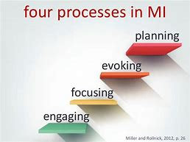
Consolidate commitment, determine readiness for action planning,
Drawing out clients real ideas and reasons for change. Re enforcing change talk
Helping choose a target area they are ambivalent about
Listening, empathy, trying to understand. OARS

Slide 17
Cognitive Behavioural Therapy
Talking therapy that can help manage problems by changing the way people think and behave.
CBT is based on the concept that thoughts, feelings, physical sensations and actions are interconnected, and that negative thoughts and feelings can trap someone in a vicious cycle.
CBT aims to help deal with problems in a more positive way by breaking them down into smaller parts.
Unlike some other talking treatments, CBT deals with current problems, rather than focusing on issues from the past.

Slide 18
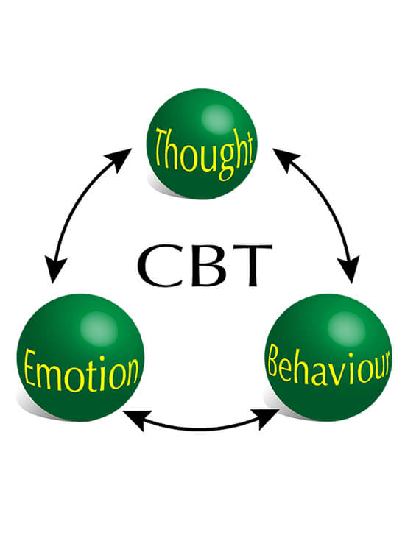

Slide 19
What is CBT
Based on the concept that thought, feelings, physical sensations and actions are interconnected, and that negative thoughts and feelings can trap someone in a vicious cycle
CBT deals with current problems, rather than focusing on issues from the past
Change negative patterns to improve the way someone feels
.

Slide 20
Changing automatic negative thoughts that can contribute to and exacerbate emotional difficulties.
Patients examine thoughts and are encouraged to look at evidence from reality that either supports or refutes these thoughts. ‘Challenging their evidence’.
Identify the problematic beliefs and how to manage these
Look at behaviour- avoidance

Slide 21
Behaviour analysis
Good things about behaviour
Not so good things about behaviour
Good things about changing the behaviour
Not so good things about changing the behaviour
Daily analysis
Activity scheduling

Slide 22
Brief intervention (BI)
Brief intervention (BI)
Brief interventions last approximately 3–20 minutes and go a step beyond brief advice. They aim to motivate and support, taking into account the individual patient’s needs, preferences and circumstances.
Benefits
Identifying how they will benefit from being more physically active.
Highlighting the benefits, as applicable to the individual. long-term condition or co-morbidity, discuss in greater depth how exercise can improve these. Disease progression may be slowed, disease severity can be lessened and medications may even be discontinued. In those without a chronic condition, the emphasis might be on the health risks of physical inactivity and the prevention of disease. Time can be spent building this understanding of the effects of sedentary behaviour.
.

Slide 23
Barriers
Identify barriers
Goal setting: Encourage the patient to identify changes to their daily routine, such as walking to work or taking the stairs more often.
‘something is better than nothing’
set achievable goals, gradually increasing their level of
physical activity over time.
Confidence building: Explore what type of activity the patient thinks they might enjoy, or have enjoyed in the past.
Involve friends or family as they seek to change their daily routine. Identify role models and sources of support.

Slide 24
Barriers to Exercising
Never done it before
Wasn’t good at sports at school
Would feel silly
Too tired
No motivation
Don’t know where, when or how to start.
Don’t feel confident enough, couldn’t go to a class or
leisure centre alone
Don’t know anybody to exercise with
Don’t have the right clothes
Can’t afford it
No time

Slide 25
Benefits of Stopping
Health – less shortness of breath, better fitness
Reduced risk of diseases caused by smoking
Reduction of symptoms e.g. cough and phlegm production
Lower risk of chest infections, less frequent colds
Better nutrition
Less stress
Smell better: hair, skin, clothes, mouth
Less staining: fingers, nails, teeth
More money: 27.4% of monthly budget is spent on cigarettes by people with schizophrenia
More control
Increased self esteem
Decreased risk from second hand smoke

Slide 28
ANY QUESTIONS?

Slide 29
MI is based on these assumptions:
how we speak to people is likely to be just as important as what we say
being listened to and understood is an important part of the process of change
the person who has the problem is the person who has the answer to solving it
people only change their behaviour when they feel ready - not when they are told to do so
the solutions people find for themselves are the most enduring and effective.
There are four general principles of motivational interviewing:
R - resist the urge to change the individual’s course of action through didactic means
U - understand it’s the individual’s reasons for change, not those of the practitioner, that will elicit a change in behaviour
L - listening is important; the solutions lie within the individual, not the practitioner
E - empower the individual to understand that they have the ability to change their behaviour. (Rollnick et al 2008)
What makes MI different from other, confrontational approaches?
MI does differ substantially from more aggressive styles of confrontation. It is not:
arguing with the client who has a problem and needs to change
offering direct advice or prescribing solutions to the problem without the person’s permission or without actively encouraging the person to make their own choices
using an authoritative/expert stance that leaves the client in a passive role
where the health care professional does most of the talking, or only gives information
imposing a diagnostic label
behaving in a coercive manner.
What is the evidence that MI works?
Clinical trials have shown that patients exposed to MI (versus treatment as usual) are more likely to enter, stay in and complete treatment, participate in follow-up visits, decrease alcohol and illicit drug use and quit smoking.
Why should I change the way I do things?
It isn't a matter of changing what you have learnt, rather adjusting your skills to be better equipped to deal with your clients. Techniques taken from the motivational interviewing approach can be integrated into your consultation with your clients and this resource provides you with an overview of some of these.

Slide 30
Why Quit Rates are Low
Many people would like to quit
Smoking can be seen as part of someone's culture
In mental health settings staff and service users / patients believe nicotine helps people cope with the symptoms of their illness or with medication side effects
Smoking is treated as a social activity
Smoking is used to fill time or cope with loneliness
People may find it hard to access stop smoking clinics as they are generally not directed there by health care professionals
Notes:
RESEARCH - NICOTINE AND POLYCYCLIC HYDROCARBONS IN CIGARETTES HAVE SIGNIFICANT IMPLICATIONS FOR PEOPLE WITH SCHIZOPHRENIA TAKING ANTIPSYCHOTIC MEDICATION AND THE EFFECTS ON NEGATIVE SYMPTOMS ASSOCIATED WITH THIS. Smoking alters the metabolism of psychotropic drugs , a factor clinicians need to consider.

Slide 31
Effects of smoking on physical health
Biggest single cause of early death
Smokers in the general population die on average 10 years
earlier than non-smokers
50% higher risk of heart attack and stroke
One in five deaths in the UK are attributed to smoking:
Respiratory disease
Circulatory disease
Stroke
Several cancers
Smokers who smoke at least 20 cigarettes a day also have a 61% increased risk of type two diabetes compared with non smokers

Slide 32
Motivation to quit?
How do you feel about your smoking?
What do you most enjoy about smoking? Is there anything you don’t enjoy?
Have you ever thought about stopping smoking?
How important is it for you to stop smoking? Why?
Have you any concerns about how you might feel when you stop smoking?
Have you ever tried to stop smoking before? What happened?
What benefits did you notice when you weren’t smoking?
Did you know there is help available and that you are 4 times more likely to stop with support?
Would you like some information on Stop Smoking Services?

Slide 33
Healthy Eating, Nutrition and Hydration
Why do people find healthy eating difficult and difficult to make changes?
Worried that a healthy diet will cost more
Eating because of boredom
Enjoying foods that are less healthy
Medication can affect peoples appetite, some people feel hungrier whilst others lose their appetite
Changing meals can affect the whole family
Eating alone, loneliness
Physical disability
Isolation and access to shops
Notes:
ask
Why do we think this may be so ?
Confusion over labelling and packaging, convenience foods

Slide 34
Barriers to exercising
Never done it before
Wasn’t good at sports at school
Would feel silly
Too tired
No motivation
Don’t know where, when or how to start.
Don’t feel confident enough, couldn’t go to a class or
leisure centre alone
Don’t know anybody to exercise with
Don’t have the right clothes
Can’t afford it
No time

