Slide 1
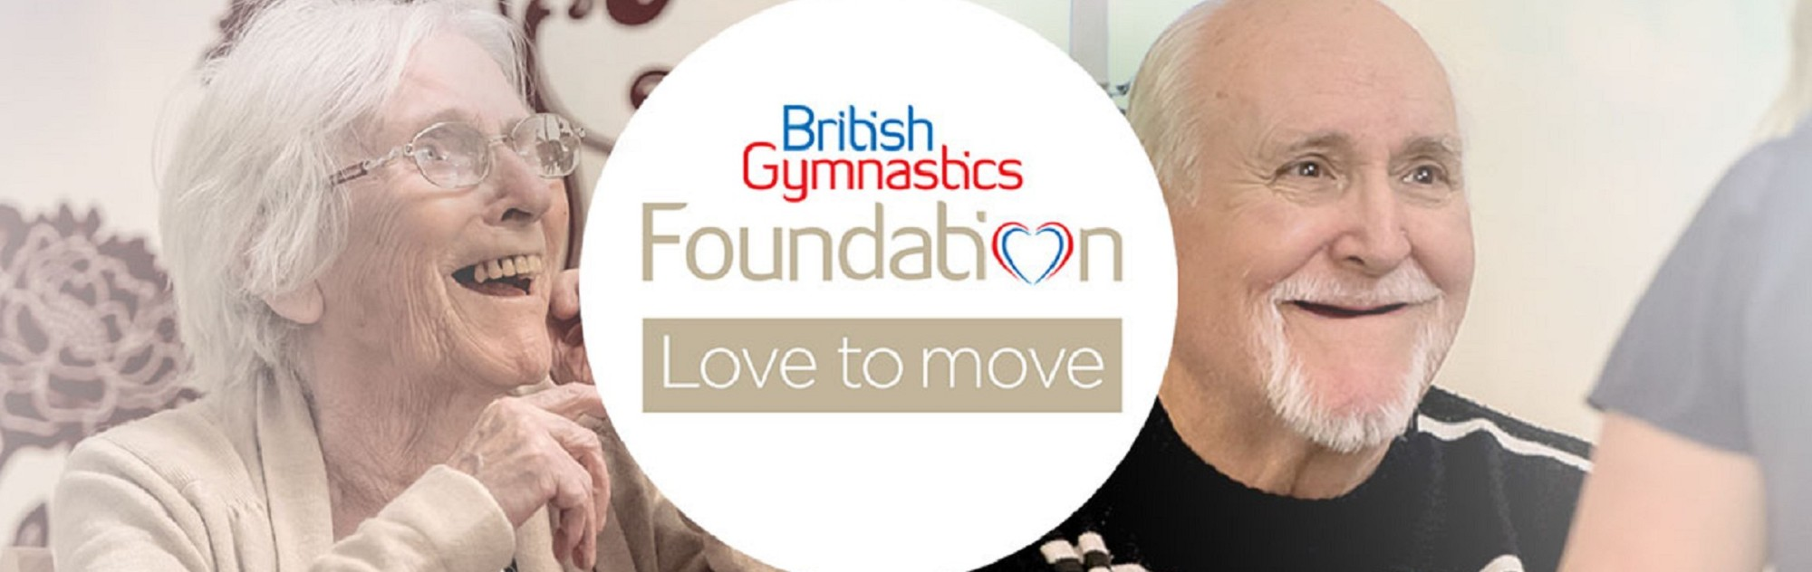

Slide 2
Love to Move
Age and dementia friendly seated gymnastics programme
Designed to get older people moving and functioning better.
Integrating the use of gymnastic foundation skills, cognitive stimulation therapy and social interaction activities.

Slide 3
Based on bilaterally asymmetrical movement patterns.
Understood to benefit older people and those with dementia and mild cognitive impairment, by enabling the left side and right side of the brain to process information independently; thus improving cognitive function, coordination and the ability to carry out activities of daily living more independently

Slide 4
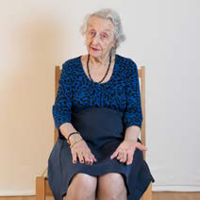
Place your hands on your knees. Turn one palm to face upwards and one palm to face
Downwards. Alternate the palm which
faces upwards.
Try this
action 20 times

Slide 5
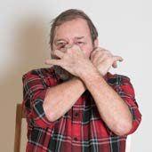
Grab your nose with your left hand whilst grabbing your left earlobe with your right hand.
Make sure to grab your ear and nose with a light touch using your index finger and thumb
Clap your hands.
Repeat but this time
grab your nose with your
right
hand and your right
earlobe with
your left hand

Slide 6
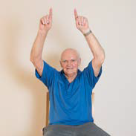
Practice drawing a stick with both hands. Starting at the top, use your hands or index
fingers to draw a stick vertically downwards.
Practice this action several times with your left
hand mirroring the actions of your right hand

Slide 7

Practice drawing triangles with both hands
• Starting at the top, use your hands or index
fingers to draw right angle triangles. Then return to the starting position at the top.

Slide 8
Once you’ve mastered mirroring each side of your body with your stick and triangle drawing, it is time to try and do some bilaterally asymmetrical actions:
For a count of six, starting with both hands at the top, draw three sticks with one hand and two triangles with the opposite hand.
On the 6th count, both hands should return to the starting position at the top!

