Slide 1
Physical activity, public health and ageing filling in the gaps between research and practice
Bob Laventure
Consultant in physical activity and ageing, Director Later Life Training
CSP - York September 2018

Slide 2
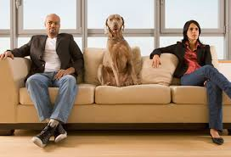


Translating evidence into practice
???
Researcher
Practitioner

Slide 3
Physical activity, ageing and public health
Demography supports the need
Explosion of research in last 20 years
Increase in evidence informed guidance
Multiple players and stakeholders involved
But …….
Participation rates shows little sign of increasing
Life expectancy is increasing but so is disease prevalence
We’re not getting it right yet are we?

Slide 4
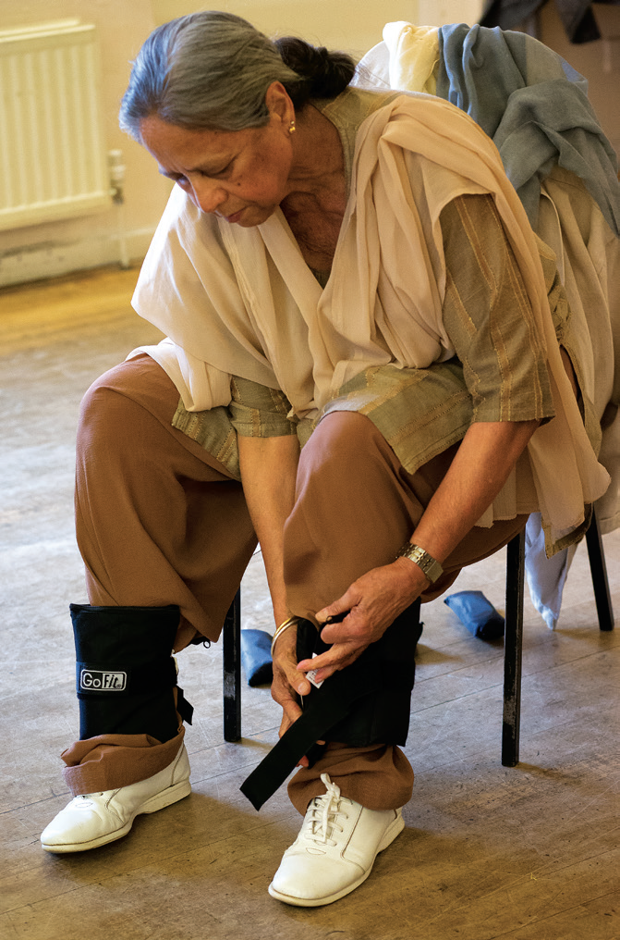
Filling the gaps between research and practice
Physical activity – our beginnings
Where are we now?
Why “filling the gaps” and what might we do?

Slide 5
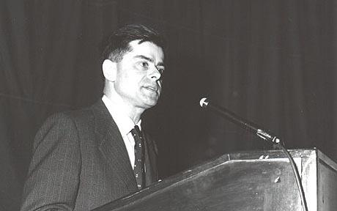
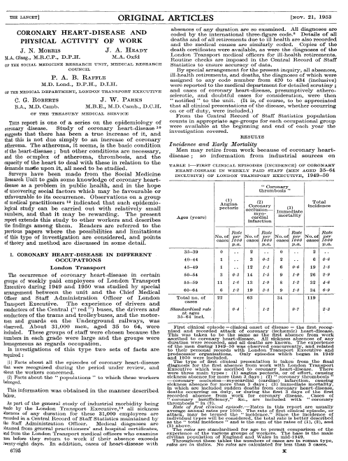
Benefits of physical activity and exercise
Scientific breakthrough
Professor Jerry Morris
(1910 – 2009)
The “Father” of physical activity and exercise science
Landmark study
The 1948 – 52 London Bus driver/conductor study looking into CHD
(Lancet 1953)

Slide 6


Explosion of evidence - 1 - benefits
High Impact research
London bus drivers and conductors (Morris 1949 - 53)
Harvard Alumni Study (Paffenbarger 1978)
Blair et al (1993)
High Impact policy
US Surgeon General (1996)
ACSM Position Stand (1998)
HEPA Europe (1999, 2016)
World Health Organisation (2008, 2015, 2018)

Slide 7
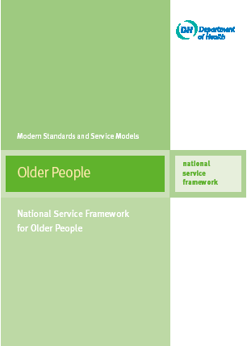
Starting point - National Service Framework
Standard 6 Falls
The NHS, working in partnership with councils, takes action to prevent falls and reduce resultant fractures/other injuries in their populations of older people.
Older people who have fallen receive effective treatment
(1) Prevention.
(2) Diagnosis & management.
(3) Rehabilitation and longer term care.
Standard 8
  the promotion of health and active life for older people
(DH 2001)

Slide 8
Physical activity – effects of physiology of ageing
CHRONIC DISEASE PREVENTION AND RISK REDUCTION
Reduced all-cause mortality*
Coronary Heart Disease*
Diabetes prevention*
Stroke*; peripheral vasc dis
Colon and breast cancer*
Musculoskeletal symptoms
Hip fractures, reduced falls*
Weight, blood pressure, lipids
PSYCHOLOGICAL AND WELL BEING
  Immediate outcomes:
  Reduce anxiety
  Reduce depression
  Reduce stress
  Long term wellbeing:
  Life satisfaction
  Self concept, esteem
  Improved sleep
SOCIAL OUTCOMES
  Involvement
  Social networks, social supports and integrational PA
FUNCTIONAL STATUS OUTCOMES
Maintain muscle strength*
Quality of life (QoL)
Physical functioning, daily living (ADL)
Congnitive function*
* Reported as “strong” epidemiological evidence, U.S. Department of Health and Human Services (HHS), 2008 Physical Activity Guidelines Advisory Report.
http://www.health.gov/paguidelines/guidelines
Baumann et al Gerontologist (2016)

Slide 9
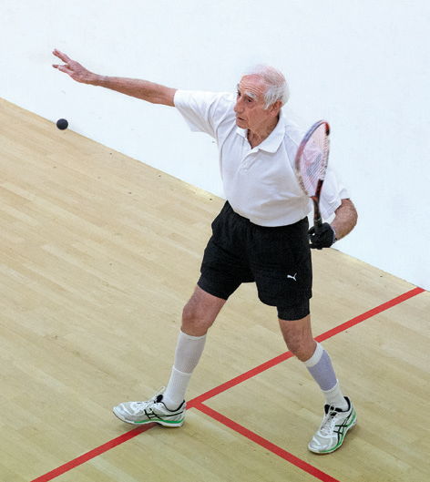
2. Where are we now?
Evidence based guidelines and recommendations
Understanding what helps and hinders participation
Healthy and active settings/environments
Multiple interventions

Slide 10
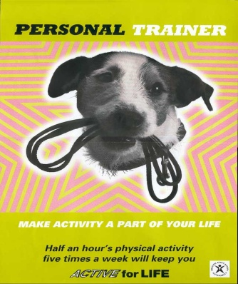
Evidence based guidelines – 1 (1995)
The move from
Vigorous to moderate intensity
Planned to routine participation
Fitness to health
Single to multiple benefits
But
For adults only and supported by evidence and policy
Health as principal stakeholder
“Physical activity is defined as any bodily movement produced by skeletal muscles that results in energy expenditure”
(Casperson 1985)
‘Half an hour on five days of the week or more - 2 x 15 minutes is a good way to begin”

Slide 11
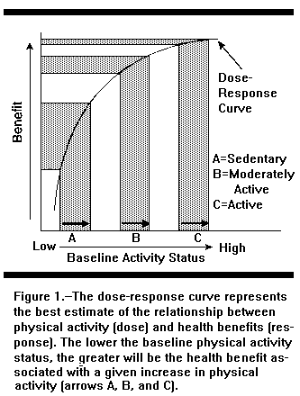
A simple message?
Dose response curve
The lower the baseline level of physical activity, the greater the health benefit associated with an increase in physical activity. Exercise can be adapted for any medical condition
(Haskell 1994)
JB Wolfee Memorial Lecture 1994

Slide 12
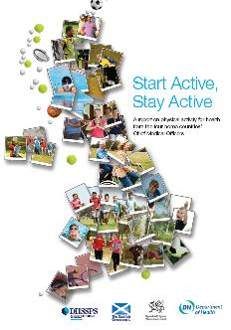
Evidence based guidelines – 2 (2011)
Evidence based messages to underpin physical activity promotion
How much and what sort of physical activity is good for our health?
Refinement over 15 years
Specific to population groups across the lifespan (Early years, school aged children, adults, older adults 65+)

Slide 13
Physical activity guidelines - older adults 65+
Older adults (65+) should aim to be active daily, any activity will make a difference
Over a week, activity should add up to at least 150 minutes (2 ½ hrs) of moderate intensity activity in bouts of 10 minutes or more.
For those who are already active……… 75 mins vigorous physical activity
“The Moving Message?”
(DH 2011)

Slide 14
Physical activity guidelines - older adults 65+
All Older adults (65+) should minimise the amount of time spent being sedentary (sitting) for extended periods.
Older adults should also undertake physical activity to improve muscle strength on at least two days a week.
Older adults at risk of falls should incorporate physical activity to improve balance and co-ordination on at least two days a week.
“The new stuff”
(DH 2011)

Slide 15
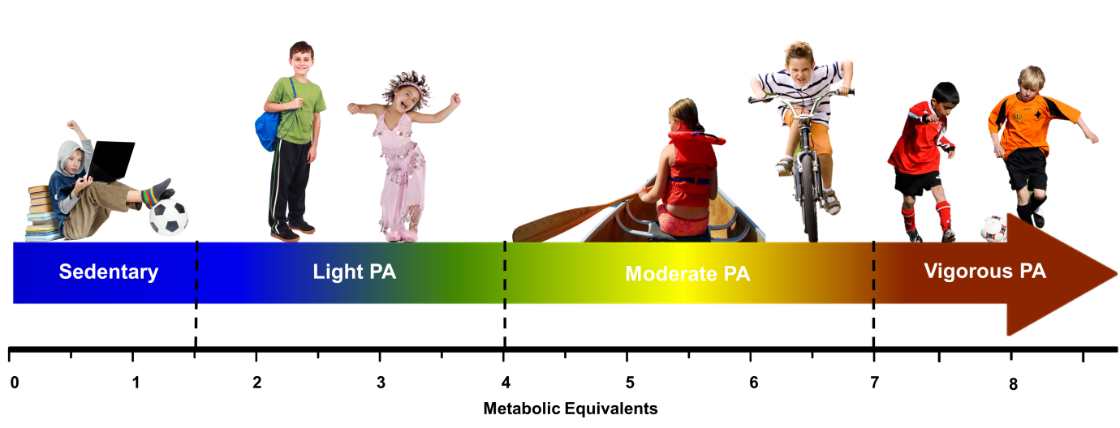
What is sedentary behaviour?
Any waking activity characterized by an energy expenditure ≤ 1.5 METs, and a sitting or reclining posture.
Notes:
Try to find where this was made so I can add animations
15

Slide 16
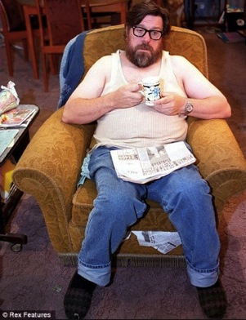

Sedentary behaviour health risks
In older adults (>60 years old), sedentary behaviour is significantly associated with:
Sedentary behaviour is also linked to musculoskeletal pain and can affect quality of life, social inclusion and engagement
Higher plasma glucose
Higher BMI and waist/hip ratio
Higher cholesterol
Reduced muscle strength
Reduced bone density
Reduced cognition
Increased depression
Gennuso et al (2013) Med Sci Sports Exerc.; Skelton (2001) Age Ageing; Chastin et al (2014) Bone.; WHO (2010) Global Recommendations on Physical Activity for Health
Notes:
Plasma glucose and BMI (Gennuso et al)
Muscle strength and bone density (Skelton et al; Chastin et al)
Pain (WHO)

Slide 17
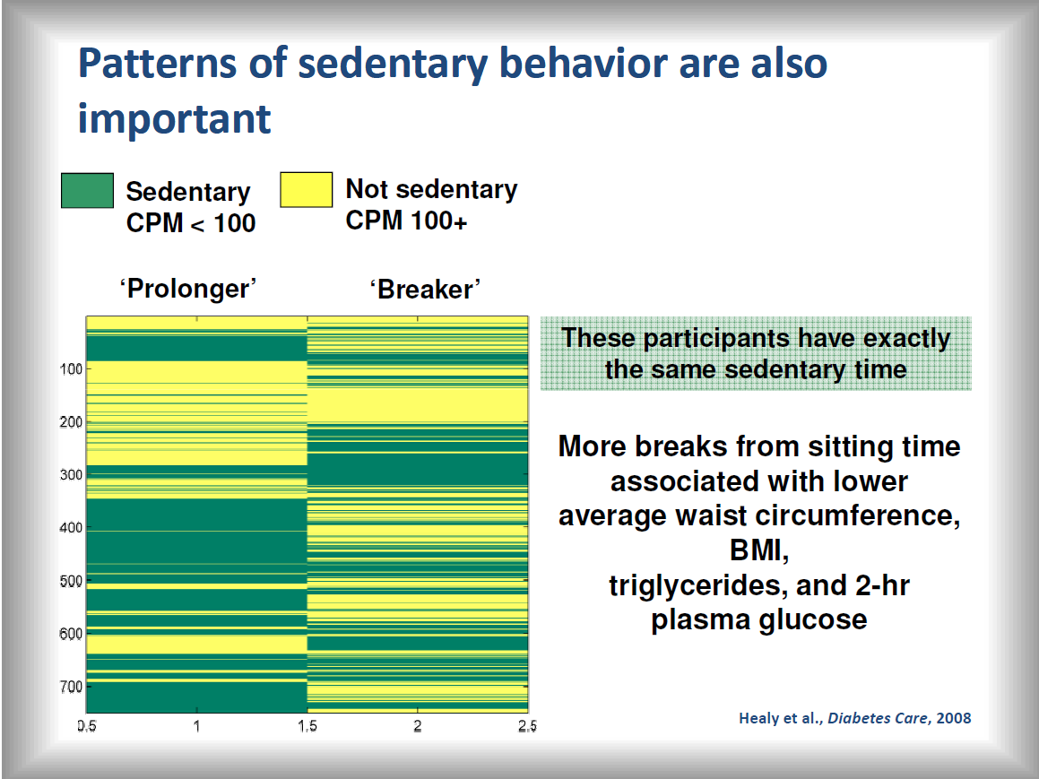

Slide 18
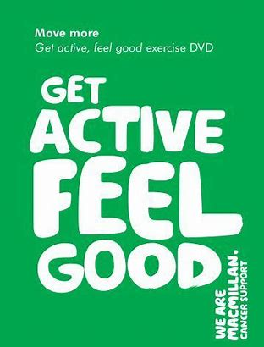

At the same time – exercise guidelines
To support the treatment of diseases, Long Term Conditions and rehabilitation eg,
Cardiovascular Disease
Stroke
Diabetes
Mental Health
Arthritis
Cancers
Parkinsons’ Disease
Osteoporosis
Falls prevention
Adaptation of exercise for medical conditions
Specificity of exercise for treatment and rehabilitation
“Living Well With”

Slide 19
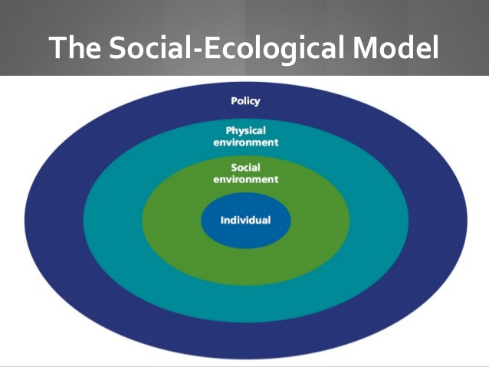
2. What helps/hinders (our attempts to be active)?
Motives, influences and environments
Individual - Our values, goals and beliefs, what is important to us,
Social - Support from “significant others”, family, friends, peers and professionals
Environmental - physical – Where we live our lives
Sallis et al (2010)

Slide 20
Individual
Intrinsic …. V …. extrinsic motivation
Intrinsic motivators (beliefs attitudes)
It is important to me
It will make a difference to me
It’s part of who I am
Self-efficacy and achievement
Perception of ability
Extrinsic motivators (professionally driven?)
Health (live longer)
Improve your condition
Government guidelines
Physician guidance

Slide 21
Social environment
Supported by “significant others?”
Spouse, partner
Family or friends
Peers “people like us!”
Professionals (who is best positioned?)

Slide 22
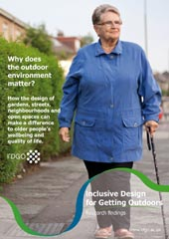
Physical environment
Where we live our lives
An accessible neighbourhood
Perceptions of safety
  Absence of crime, graffiti, rubbish
  Safe and accessible pathways (fear of falling)
  Street lighting
(Inclusive design for getting outdoors 2009)

Slide 23
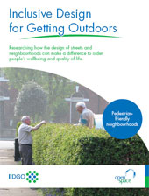
Physical environment
Where we live our lives
An accessible neighbourhood
But ……..“Purposeful and somewhere good to go”
  Interest, views, events
  Green space (sitting spaces)
  Facilities and amenities (toilets)
(Inclusive design for getting outdoors 2009)

Slide 24
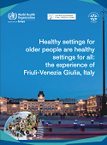

Healthy and active settings (WHO 2008)
Whole environments
Schools
Universities
Workplace
Hospitals
Homes
Prisons
"Health is created and lived by people within the settings of their everyday life; where they learn, work, play, and love."
The Ottawa Charter (1986)
Becoming Active Settings
Active Schools
Active Communities
Active Work Places

Slide 25

Active Residential Care Homes - Scotland
CAPA - Individual approaches
Moving More Often
Planned opportunities to “Have a Good Conversation”
Enabling the person experiencing care to make a decision

Slide 26
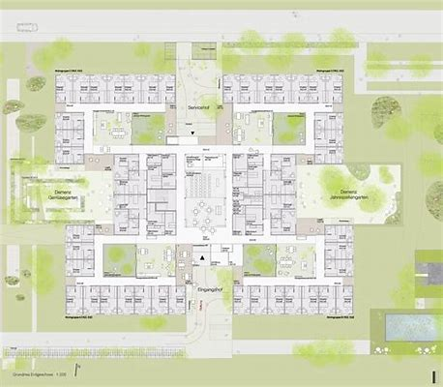
Adapting the care environment
Residential care settings, architecture and built environment
Interconnectedness
Traversability
Diversity
Aesthetics
Legibility
To improve well-being
Landmarks, views, junctions, through ways
McIntyre, L.J and Harrison I.R. (2017)

Slide 27


Increased programming
National programmes
Physical activity and ageing has lagged behind (determined by PA/sport policy priority)
Enthusiasts and front runners but not sustained
Sport England investment of £10,000,000 in Active Ageing (20 projects)
Increase in adaptation and access for older people

Slide 28
The later life continuum
Target older population | Policy focus and outcomes | Stakeholders and partners
The Actives - entering old age Goal – build and maintain capacity | maintaining and increasing physical activity levels to Improve health | Primary care, physical activity, sport, recreation providers and services
Those in transition Goal - reverse, stop or slow the loss of capacity | Initiating and maintaining physical activity to improve/maintain health, function and independence | Primary care and adult, health/social/care services, voluntary sector, housing and support services
Frailer, older people Goal – compensate for loss of capacity | Physical activity to maintain Quality of Life Activities of Daily Living | Residential care providers, home support services
(WHO 1996/2015, DH 2001/11 BHF NC 2003/8/11)

Slide 29
But Active Ageing …. all things to all people?
Active Ageing (WHO)
  Health
  Participation
  Security
Physical activity (PHE)
  Activity
  Moving
  Exercise
  Sport and recreation
Health
  Physical
  Psychological
  Cognitive
Healthy Ageing
  developing and maintaining the functional ability that enables well-being in later life
Successful ageing
  Participating
  Volunteering
  Contributing to society
Well-being models
  SCIE
  5 ways to Wellbeing … NEF
  ICAA …. 9 Pillars of ….

Slide 30
Update on UK CMO evidence
Review of UK CMO Guidelines
Started 2017 and ongoing
Following US and Canada
All ages cohorts
Potential launch early 2019
Including messaging and communication channels

Slide 31
Strength and Balance - Expert Panel Review
Centre for Ageing Better - 5 key papers
Enablers and barriers to older people’s participation in strength and balance activities: A review of reviews
What types of physical activities are effective in developing muscle and bone strength and balance?
Which strength and balance activities are safe and efficacious for individuals with specific challenges (Osteoporosis, Vertebral Fractures, Frailty, Dementia)? : A Narrative Review.
A review of global surveillance on the muscle strengthening and balance elements of physical activity recommendations
What are the health benefits of muscle and bone strengthening and balance activities across life stages and specific health outcomes?
Public Health England and Centre for Ageing Better (2018)

Slide 32
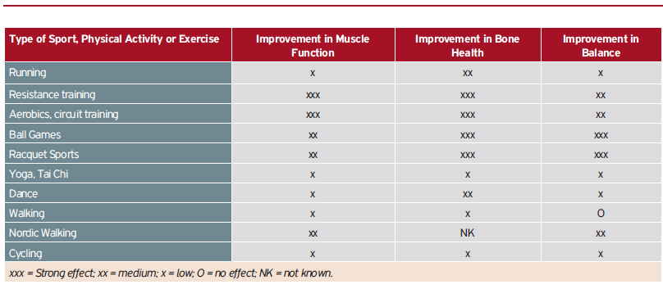
What types of activities will develop strength and balance activities?
(Adapted from Heionien & Kujala, in Kokko et al 2011)

Slide 33

Extending the moving message?
Use of language and meanings
Interpretation and exemplification of intensity
Sedentary – light – moderate – vigorous – high intensity (HITT)

Slide 34
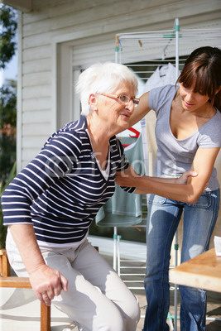
“Trigger” opportunities for strength and balance?
Key life stages when engagement with strength and balance activity become (more) important
“Triggers”
For women, pregnancy and post menopause
Diagnosis of disease or following “events”
On retirement
Becoming a carer
Following hospitalisation
(Skelton DA, Mavroeidi A (2018)

Slide 35
3. Filling in the gaps
Resistance to replication using evidence
Key messages (guidelines) still unknown
Recognising priorities for older people
Approaches to environments and support

Slide 36
The implementation challenge – “using what works”
The implementation challenge
What can we learn to improve adoption and implementation of effective adapted physical activity programmes?
(Hopman Rock M.R. 2009)

Slide 37
Resistance to replication?
Programme fidelity– delivered as intended? Eg REAIM (Green & Glasgow 2006)
“Cherry pick” components?
Skills set required to replicate
Transfer/acceptable to participants – would this work in Cardiff, Dudley of York?
The way research is funded and evidence is written and disseminated
What did they do and how?
Resource limitations

Slide 38
Resistance to replication?
Robust evidence for implementation (planning and outcomes) not required by some stakeholders
Difference evidence required
Resistance to top down models without resources?
Demise of public sector (especially Local Govt., and changes in delivery infrastructures
New stakeholders, funders and providers eg, increase in voluntary sector, private sector, SMEs, NGBs of Sport

Slide 39
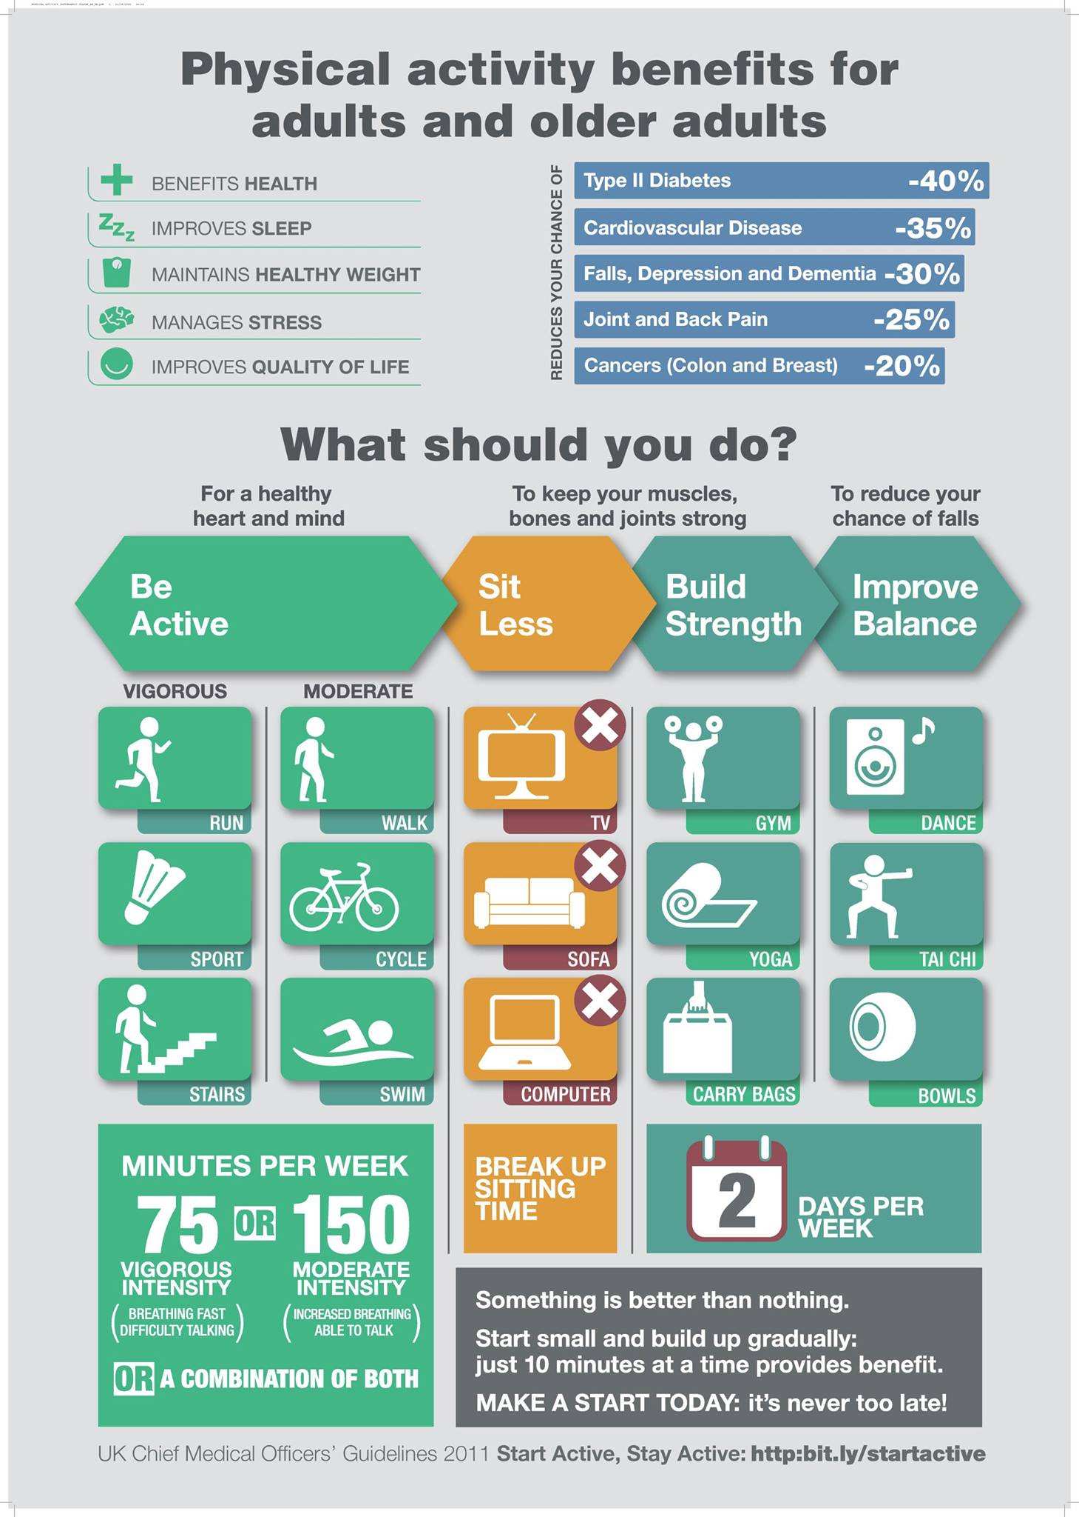
Key messages still unknown
“Our five a day” – who knows?
16% of physios (Lowe et al 2017)
20% of GPs (Lowe et al 2017)
UK 18% (Knox et al 2015)
8% (NI) (PARC 2015)
“The “Forgotten Guidelines”
(Strain et al 2018)
(PHE 2016)

Slide 40
Guidelines into practice
How we translate and disseminate messages
Guidance (Strength and balance 2 x pw)
Interpretation (what does that mean?) Overload, rest and recover, progression)
Communication with the public (education, understanding and language)

Slide 41
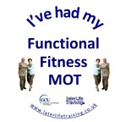
Interpretation - strength and balance
Muscle strength activities
Will make the muscles feel more tension than normal.
The day after strength activities, there will be mild muscle stiffness, indicating that the activity has had a training effect.
Balance activities
Standing or moving about whilst standing and …..
Reduced base of support
Movement of centre of mass
Reduced holding

Slide 42

Messages about strength and balance
What does it look and feel like?
Strength?
Shaking and warm
Balance?
Wobble and challenge
Meaningful message?
CSP 2016

Slide 43
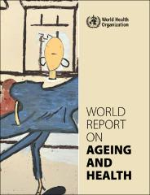
Strength and balance
How Important are they?
“…… it is logical and possibly safer to suggest that older adults whose mobility is compromised start by increasing their strength and improving their balance before embarking on aerobic training”.
WHO World Report on Ageing and Health (Oct 2015)
(Sherrington et al 2011)

Slide 44
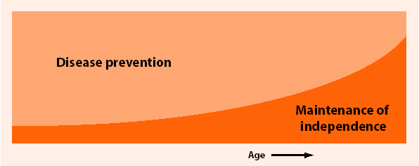
Shift in policy as we age
beyond policies focusing on NCD prevention alone, to areas of preserving functional capacity, neuromotor abilities, balance, co-ordination, reaction time, and neurological or cognitive health.
(Bauman et al 2016)

Slide 45
Independence – older people’s priority
Commonly understood as the ability to perform functions related to daily living – i.e. the capacity of living independently in the community with no and/or little help from others.
What’s important to people as they age? Significant mis-match between what is being done and what older people want?
(Phoenix et al 2016)

Slide 46
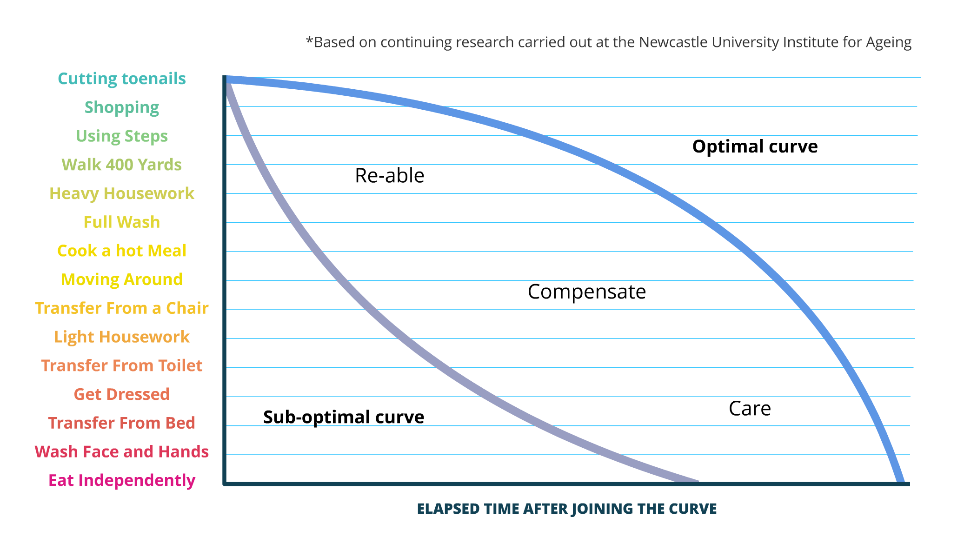
Life Curve ™ Newcastle
Research and practice into Functional activities, decline in ADLs and a sequence from independence to dependence

Slide 47
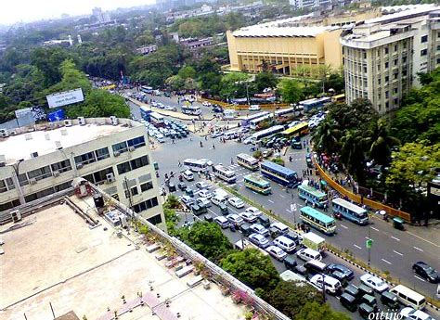
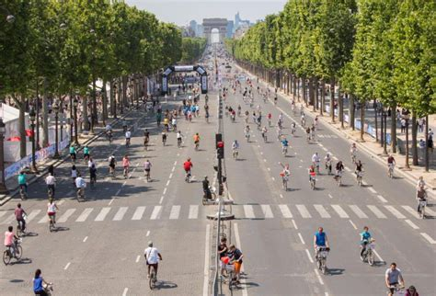
Adapting our environment
Age friendly built environments (traffic free cities, spaces, and communities)
Increasing pedestrian and wheeled access
Community spaces and places to play
Manchester, Amsterdam, Vienna, Hamburg

Slide 48
Socially supportive environments
Individual ✖ ✖ ✖ Physical Environment
“Older individuals are less affected by their local physical environment and more by social environmental factors, reflecting both the functional heterogeneity of this age group and the varying nature of their activity spaces.”
(Hawkesworth et al 2018)

Slide 49
Personalisation and support
Variety of BCTs have identified support strategies known to be effective but ………..
“Self-regulation techniques effective for younger adults may not be for older adults”
Eg self-regulatory BCTs are too complex for declining executive functioning or otherwise do not appeal. (French et al 2014)
Difference between participants and practitioners in what support is valued (Stewart et at 2001)

Slide 50
CHAMPS - participant views on support
Mean ratings of helpfulness from participants
Personal attention and encouragement from staff (3.9)
Information meeting * (3.87)
Telephone calls from staff (3.84)
PA planning session * (3.82)
Monthly newsletters (3.62)
Programme handouts (3.60)
Exercise booklets (3.39)
Functional fitness evaluations (3.30)
Activity Logs (3.22)
Feelings of belonging to a group (2.96)
Goals setting/contracts (2.84)
(Stewart et al JAPA 2001)

Slide 51
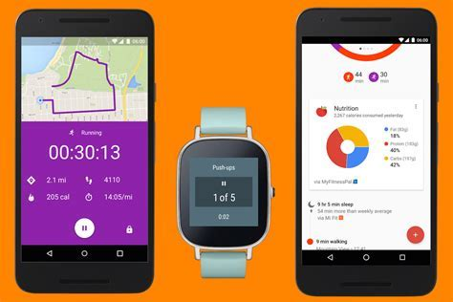
Support from technology
Online information on accessible activities
Apps as behaviour support tools and motivation for the individual – prompting, effective feedback for self-monitoring
GPS - Monitoring and surveillance – individuals and populations - potential for big data

Slide 52

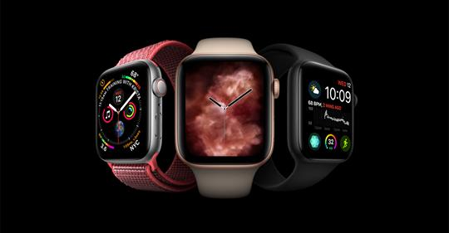
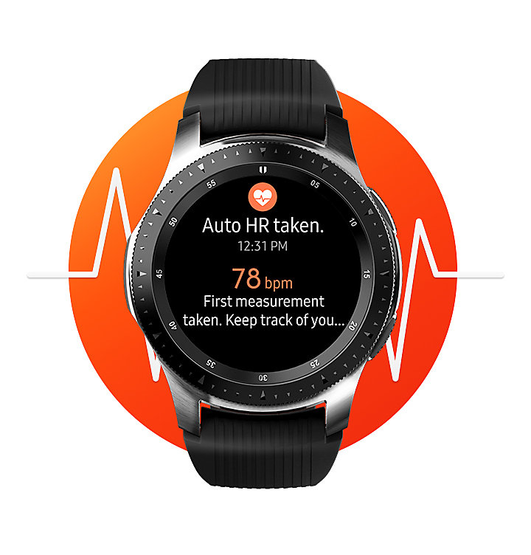
Mhealth - smart technology
Apple Watch series 4
Monitoring Falls
Motivation on functioning, activity patterns, intensity, (Helbostad et al 2017)
Samsung watch
“Personal trainer on your wrist” the Smarter Way to Wellness

Slide 53
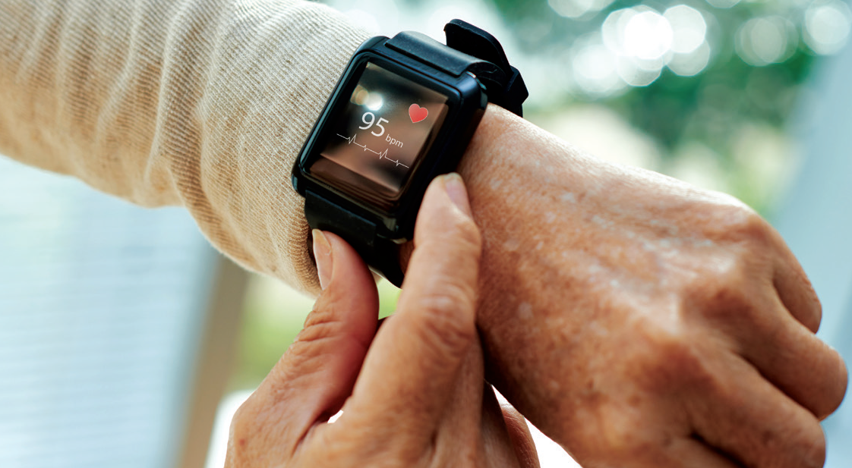
Personalisation and support
Variation in cognition, vision and manipulative skills
Known digital divide (those that can and can’t)
Inequalities persist
Tailoring is more than an exercise prescription and progression.
Negotiation of BCTs, what would work for you?

Slide 54
Physical activity, ageing and public health
Multiple benefits, messages, modes, prescriptions, outcomes, needs
We know so much more, but how is that helpful?
Maintaining evidence led approaches and interventions
Messaging remains a huge challenge

Slide 55
Thank you for listening and happy to hear from you !
Bob Laventure –
Bob.laventure@laterlifetraining.co.uk
www.laterlifetraining.co.uk
Physical activity – you don’t have to do it seriously, only regularly!

