Slide 1

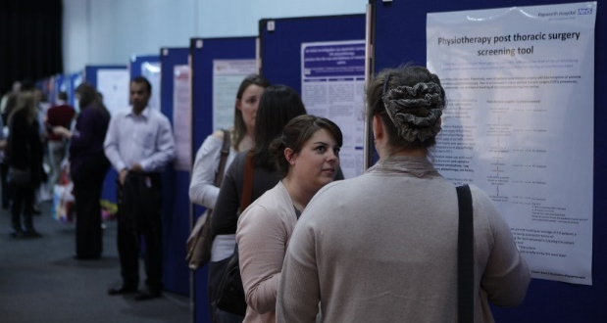
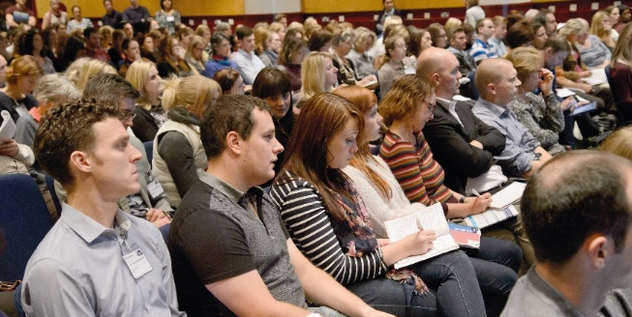

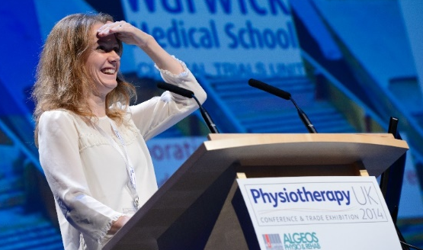

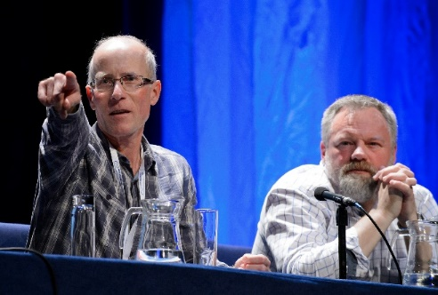
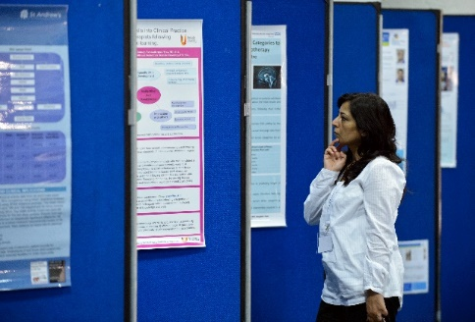
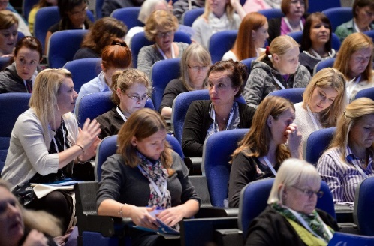
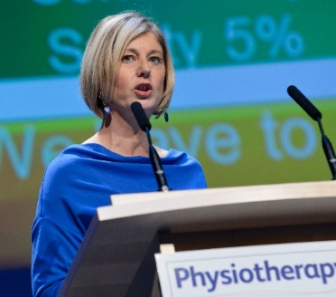
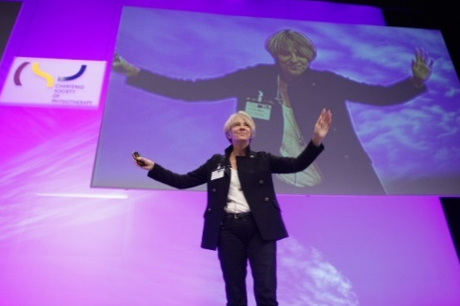





Only
£99
before 31 July
2 days of world-class CPD
in partnership with
#Physio18
www.physiotherapyuk.org.uk

Slide 2
Welcome!
CSP Network and Board
Think Physio, Act Local Development Day
#thinkphysio2019

Slide 3
A whistle-stop tour of GDPR - the do’s and don’t’s
Rob Yeldham
Director
Strategy, Policy and Engagement Directorate
Notes:
This is a light hearted warm up task to do with others on your table. You will find one answer sheet per table. There will be a small prize for the winning table. Results will be announced after lunch.
Before we go through the quiz questions I have a few GDPR updates to announce.
ERN Chair email addresses
For those of you representing English regions we can confirm that you will soon receive Chair email addresses that can be managed via Office 365. This replace the outmoded set up where emails to Chair’s addresses are forwarded to personal email accounts. Rob L 7 Rob Y to confirm more details on this.
Advice sheet
A GDPR advice sheet is available for everyone today. Please pick one up before you leave today.
Data Protection Training
We are soon going to be able to offer this to CSP volunteers. Rob L to confirm more details on this.

Slide 4
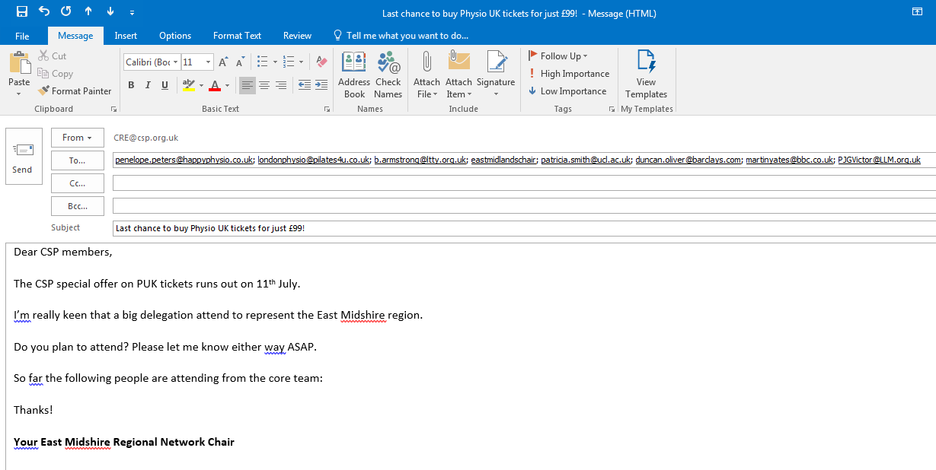
1) Spot the mistake. What’s wrong with this email?

Slide 5
2) You want to promote an event and encourage members to sign-up to attend. Choose three of the best GDPR compliant ways to do this (1 point per correct answer):
A. An Eventbrite account you have created under your name or that of your network’s
B. The CRE Eventbrite account
C. Your network’s Facebook page
D. Email using a list of members who came to your last event that you store in your Outlook account
E. iCSP broadcast message to all the members in your region.

Slide 6
3) How long can personal data be retained for?
Three months maximum
As long as you like!
It must not be kept for longer than is necessary for the purpose it was processed

Slide 7
4) Notification of a data breach must be made within how many hours?
Within 24 hours
Within 72 hours
Within 1 week

Slide 8
5) A volunteer team leader collects the contact details of another CSP member who wants to join the core team of volunteers. What else should they do?
Get them to give consent for their data to be shared with other core team members
Get them to supply their date of birth
Get them to supply their marital status

Slide 9
6) Which method of communicating with a group of CSP members is GDPR compliant?
Facebook group
Tweet chat
iCSP broadcast
All of the above three

Slide 10
7) What is the maximum penalty for non-compliance?
Up to 20mil Euros or up to 4% of total global revenue for the preceding year, whichever is greater
Up to £5mil or up to 2% of total global revenue of the preceding year, whichever is greater
5,000 Euros per infraction
10,000 Euros fine for private companies only

Slide 11
Alex Mackenzie
Chair of CSP Council

Slide 12
New Governance structures
Council
12 members representing the whole of the profession
3 committees:
Employment Committee
Finance, Risk and Audit Committee
Professional Committee

Slide 13
From the AGM
Engaging with members
Council members will network with a range of members to stay in touch with their views and concerns. They will attend local and national events, including English Regional Network and Country Board meetings to get an understanding of the different environments CSP members work in. Council members no longer represent particular groups and so have more breadth to develop a wider understanding of the profession and how members work.

Slide 14
New ways of working
Focus groups
SLWG
Webinars
Council members going out to member meetings
Any other ideas?

Slide 15
Only
£99
before 31 July
2 days of world-class CPD
in partnership with
#Physio18
www.physiotherapyuk.org.uk

Slide 16
Best practice member engagement –
what works across the UK
#thinkphysio2019

Slide 17
Only
£99
before 31 July
2 days of world-class CPD
in partnership with
#Physio18
www.physiotherapyuk.org.uk

Slide 18
Improvement and Transformation
Helen Baxter
Head of Improvement and Transformation
Twitter @helenbaxter57

Slide 19
The challenges we face – Five Year Forward View
Health and wellbeing gap
Care and quality gap
Funding gap
Radical upgrade in prevention
Efficiency and investment
New care models

Slide 20
Quadruple Aim
Patient Experience
Satisfaction
Quality
Trust
Costs
Lower costs
Appropriate spending
Staff Experience
Professionalism
Joy at Work
Recruitment & Retention
Outcomes
Effective interventions
Less preventable illness
Less variance

Slide 21
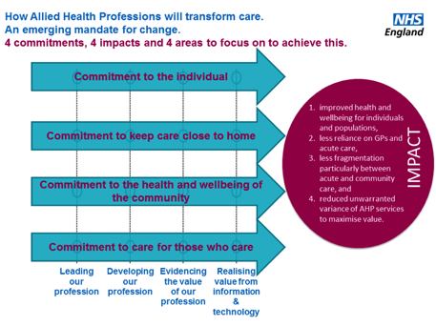
Chief AHP Officer, 2016

Slide 22
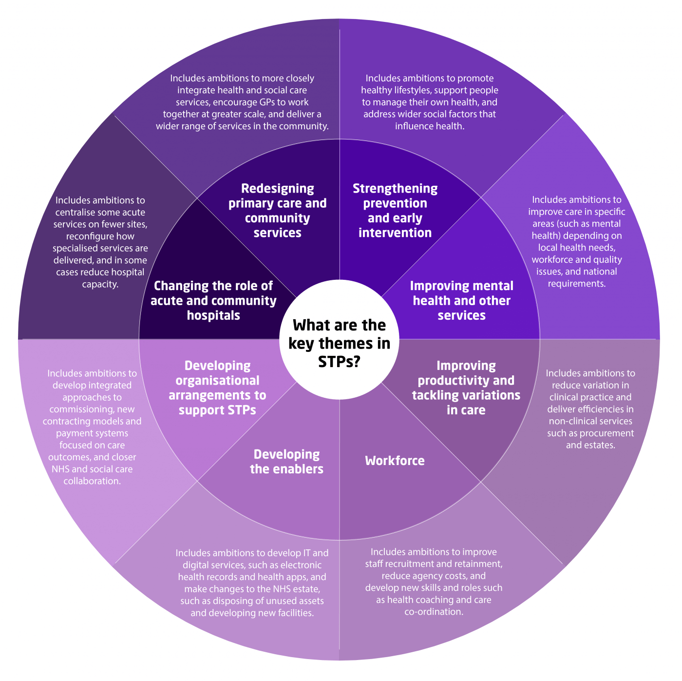

Slide 23
Opportunities
Reduce inappropriate hospital admissions
Reduce unnecessary care costs
Faster diagnosis and earlier intervention- eg direct access
HWB -Prevention , Self care and management and health screening
New models of care
Extended skills
Integration
Delivery of services closer to home
Faster diagnosis and early intervention
Parity between physical and mental health
Care co ordination- seamless services
Research evidenced based outcomes

Slide 24
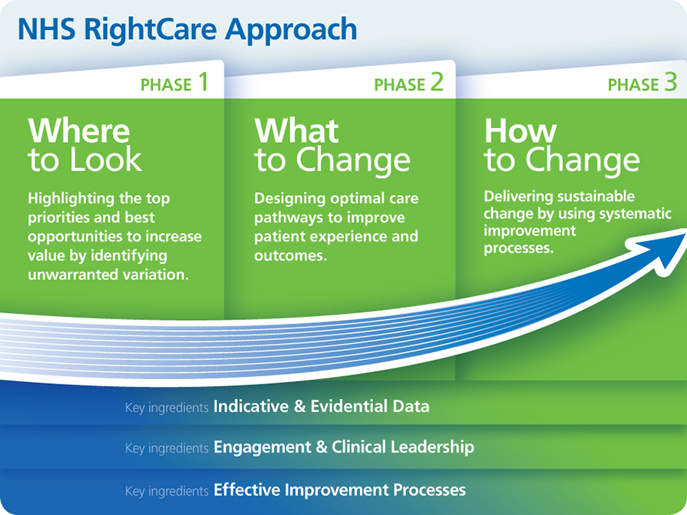

Slide 25
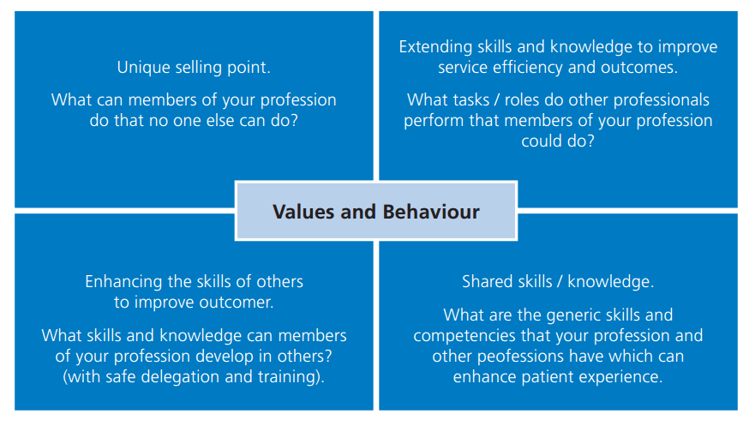
Readiness for future care
www.england.nhs.uk/ahp

Slide 26
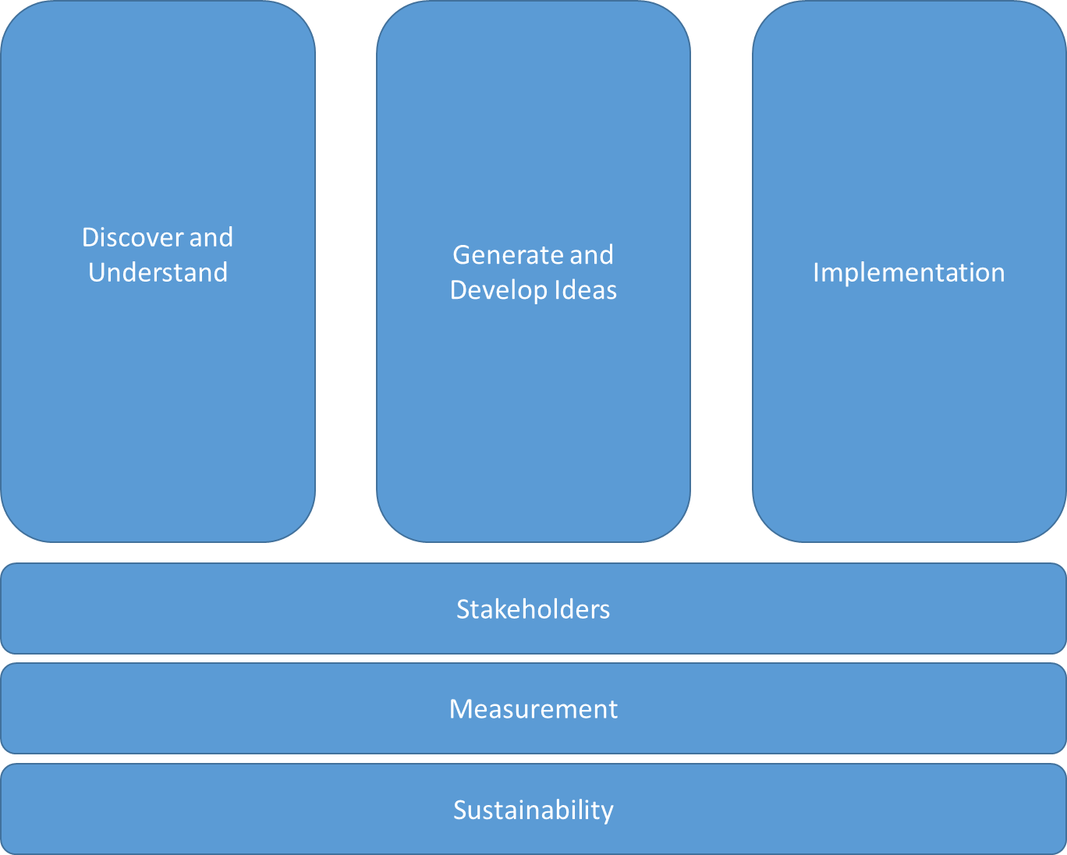
Transformation Approach
Notes:
Overview of the Improvement and Transformation Framework with brief explanation
Each section then has more detail behind with regards to principles and tools available
Key questions …

Slide 27
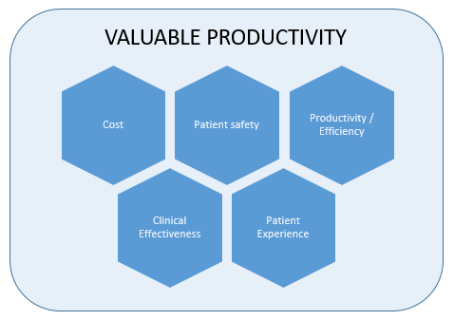
Valuable Productivity
Cost effective and sustainable optimal quality in health and care.
aims to make use of value and productivity as service evaluation and contribute to sustainable, high quality services.
provides an opportunity to support physiotherapists to engage with the health economic context of services, make high quality sustainable service decisions and strategically influence.
Notes:
“Valuable productivity is defined as cost effective and sustainable optimal quality in health and care”
Valuable productivity aims to make use of value and productivity as service evaluation domains to provide language commonality, reduce stakeholder bias (budget providers versus budget spenders) and contribute to sustainable, high quality services. The framework also provides an opportunity to support physiotherapists to engage with the health economic context of their services, make high quality sustainable service decisions and strategically influence.
Value is defined as cost in relation to quality [outcomes]¹. Quality has a variety of available definitions but the NHS definition of high quality is agreed to be ‘patient safety’, ‘clinical effectiveness’ and ‘patient experience’³. Added to ‘cost’, these are the domains in a value concept model for service evaluation.
The NHS has a current focus on operational efficiencies and describes several potential metrics for productivity⁴. These metrics do not recognise education, clinical supervision or research as ‘productive’ workforce activity. This has the potential to lead to safety and clinical effectiveness issues by promoting unsafe or quality impeding productivity incentives, e.g. by benchmarking metrics absent of quality domains. Productivity should not be an unpalatable concept for clinicians and is essential to achieve sustainability of universal healthcare, but there is a need for it to relate to value domains.
Therefore, a “valuable productivity” improvement framework is proposed, inclusive of the five domains shown above.

Slide 28
Practice and Development knowledge and skill support
Individual advice or consultancy provided remotely (e.g. telephone, email)
CSP webpages, media resources and virtual learning environment
Deployed consultancy support
Face to face education and network engagement
Interoperable levels
Notes:
Considering size of UK wide task versus resourcing, realistic structure for valuable productivity support, advice, consultancy and education. Structure available across four countries, sectors and settings.
Pyramid represents realistic deployment of resources allowing maximum access to expertise in realtime by members working across the UK. However, model shows face to face activity cumulatively not a minority activity.
This is an iterative and interoperable approach, matched to the needs of the scenario, project or individual member requirement. It is likely, an individual member could benefit from each level for a particular system issue.

Slide 29
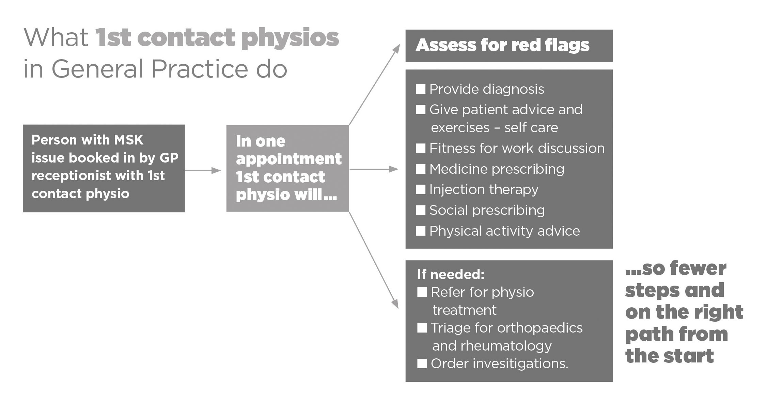

Slide 30
Benefits of the FCP model in General Practice
Patients | GPs | Local health economy
Quick access to expert assessment, diagnosis, treatment & advice Prevention of long-term conditions Improved patient experience A shorter, simpler pathway Lifestyle/physical activity advice Longer appointment times Quicker support to aid return to work Moving FCP expertise to the front end of the pathway puts people on the right pathway from the start | Release of GP time Reduced prescription costs In-house MSK expertise Increased clinical leadership and service development capacity Generate income through moving volume of injections to primary care Physiotherapists may soon issue Fit Notes Help in meeting GPFV workforce targets | Reduced number of MSK referrals into secondary care Improved use of imaging Improved conversion rate to surgery Improved links with local voluntary sector and patient groups Reduced levels of disability and social care need Reduced demand on community/outpatient MSK services –some areas allowing staff time to be redeployed into General Practice
Notes:
Referrals to consultants – advanced practice interface services – successful but GPs bypass services e.g. NHS Norfolk where 52% of outpatient attendance were still GP referred in spite of 91 % Trusts having some form of interface services providing triage

Slide 31
FCP
Primary Care Transformation Network
NHS England High Impact Interventions
Health Education England MSK Capabilities Framework
Supporting implementation – at STP and country/board level

Slide 32
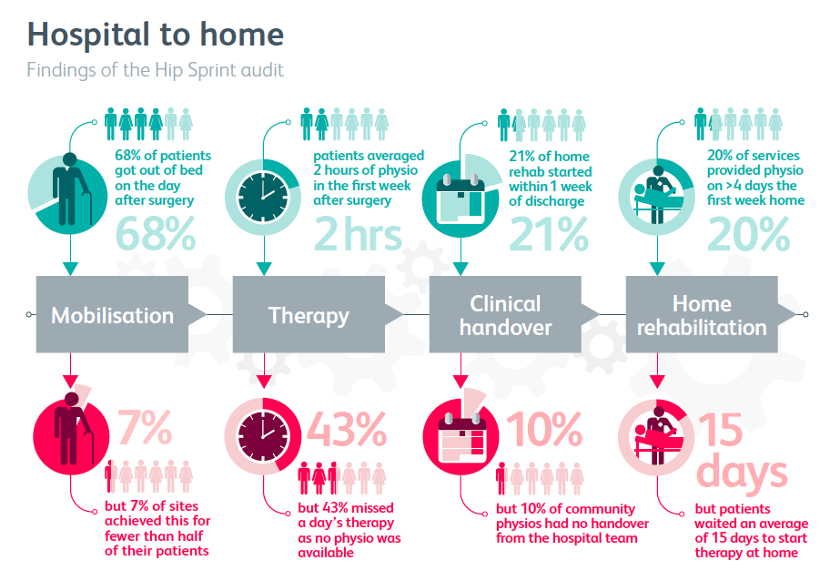
Hip Sprint

Slide 33
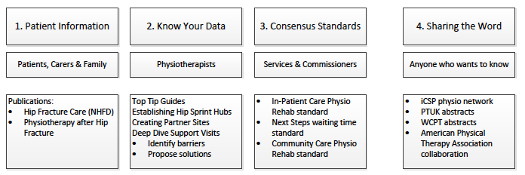
Hip Sprint 2
Implementation Phase
http://www.csp.org.uk/professional-union/practice/consultations-your-views-needed/csp-hipsprint-audit-project

Slide 34
CSP Standards for hip fracture rehabilitation 2018
Early Mobilisation
2. Intensive Rehabilitation
3. Continuity of Care
4. Team Working
5. Clear Communication

Slide 35
Community Rehabilitation
Understand what is actually happening – build on the data from hip sprint
Develop Insights from Community rehabilitation services
Identify what are key factors for successful services

Slide 36
At this critical moment, health care needs leaders with the courage to develop, design, and test new models of innovation, collaboration, and governance that can take health care beyond its traditional limits.
Institute for Healthcare Improvement Leadership Alliance, 2016

Slide 37
Thank you
Helen Baxter
Contact: transformation@csp.org.uk

Slide 38
Financing your ideas
John Catley
CSP Head of Finance

Slide 39
Financing your ideas
CSP & Regional Networks – One CSP
John Catley
CSP Financial Accounts Officer

Slide 40
What can we do?
Ease your administrative burden
Free up time for you to engage
Work with you

Slide 41
How?
Access to CSP products and services
  The trainline online booking tool
  CTM for air and hotel bookings
  Liaise with the CRE team to support conference bookings
  Make payments directly
  Pay all member expenses

Slide 42
Barriers?
There is no conspiracy!
The Society has to account for your funds in our year-end accounts, a shift to ‘in-house accounting’ makes this process simple
Your funds are ring fenced, subject to the Society’s usual governance and T’s & C’s you can spend as you need to
We will prepare your year-end accounts – you can have sight of your current position at any point during the year

Slide 43
Who’s on board already?
1. North East Region
2. North West Region
3. East Midlands Region
4. Yorkshire & Humber Region
5. SE Coast Region
6. Yorkshire & Humber Region
7. Northern Ireland Board

Slide 44
Tempted?
Close your bank account/s – no more worries about bank mandates! Return funds to the Society – details provided as necessary Send in a set of accounts to reconcile to the closing bank balance Engage locally and leave the admin to us!

Slide 45
The Goal
CSP & Regional Networks One CSP

Slide 46
THANK YOU!
Please feel free to contact me directly on
020 7306 6648 or catleyj@csp.org.uk

Slide 47
Promoting events and activities with help from the CSP design team
Tris Reignier
CSP Creative Team

Slide 48
Ideas shopping workshop
#thinkphysio2019

Slide 49
Share your feedback
Visit www.menti.com
and insert code
70 53 22

Slide 50
Thank you for coming!

