Slide 1
CSP Pulmonary Rehabilitation Impact Model on Exacerbations (PRIME) tool
How to calculate impact of PR provision to all the eligible COPD patients across England using the CSP PRIME Tool *
*use the PowerPoint file in presentation mode to follow the instructions

Slide 2
Background
The PRIME tool was commissioned by the CSP through the Physiotherapy Works programme. The work was undertaken by Imperial College London, with input from an expert steering group, and the model was launched in November 2017.
Aim
The PRIME tool aims to use available evidence and data to model the impact of pulmonary rehabilitation (PR) on exacerbations of chronic obstructive pulmonary disease (COPD).
Format
The PRIME tool is an excel spreadsheet embedded in the CSP website.
Assumption
The key assumption is that exacerbations are reduced by 36.4% when PR is completed by eligible patients with COPD.
It is freely available to anyone, members and non-members alike.

Slide 3
Instructions
Please follow the steps through the next set of slides to calculate impact of PR provision to all the eligible COPD patients across England from PRIME Tool ( England )*
Launch the tool
Start at the Results sheet
* Based on the data as used in the development of tool ( see tool for further details)

Slide 4
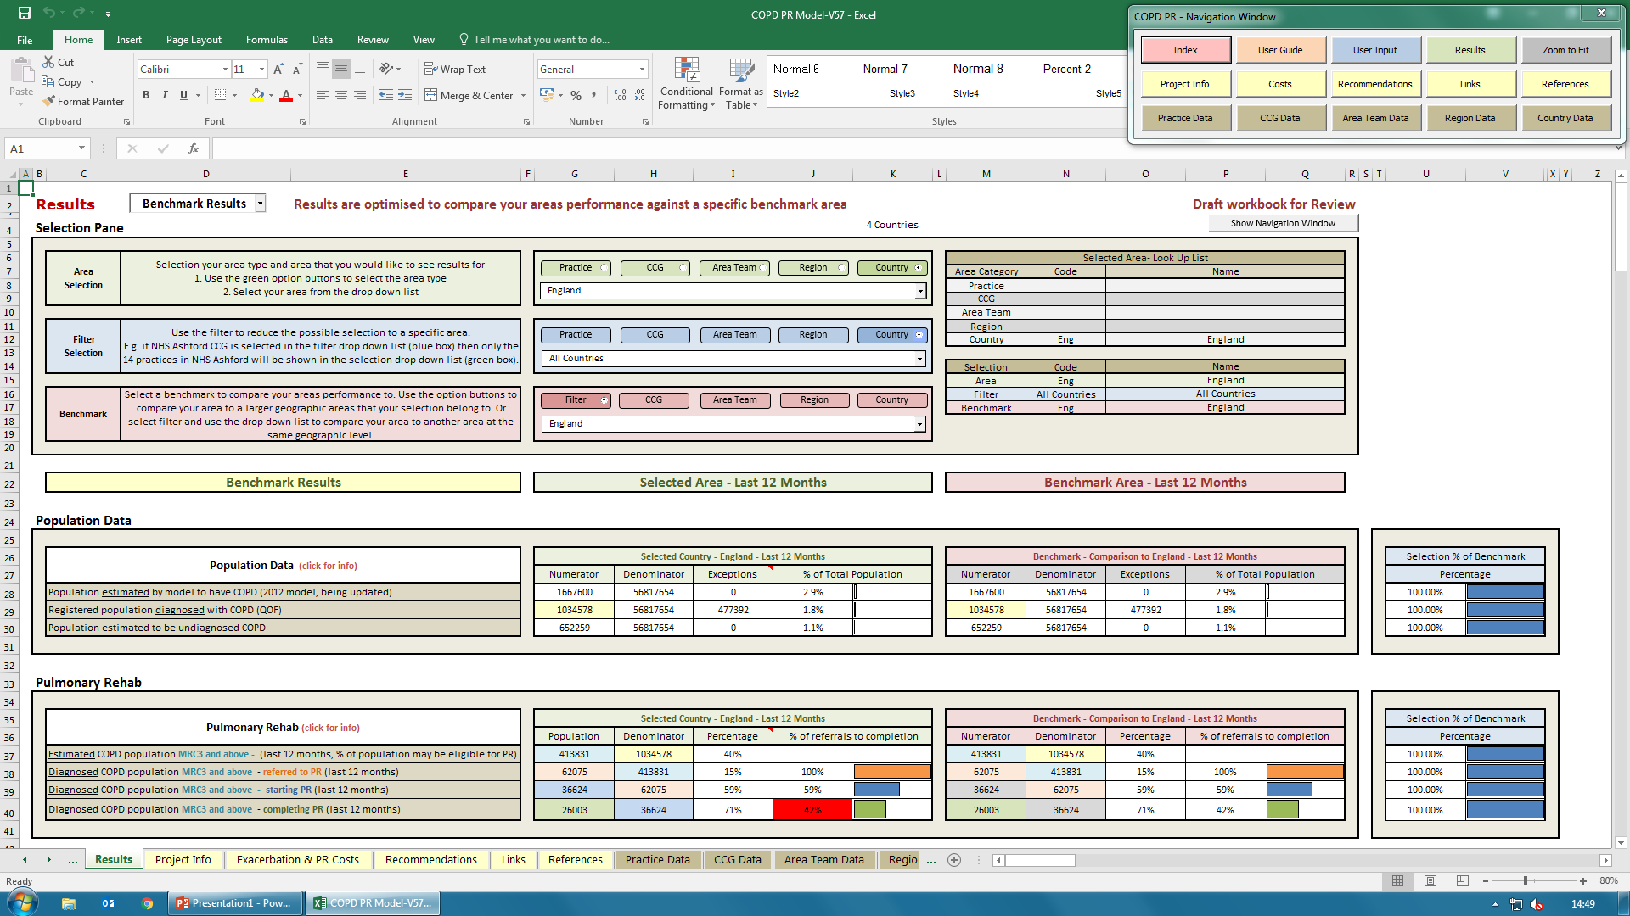
Select country
Start here

Slide 5
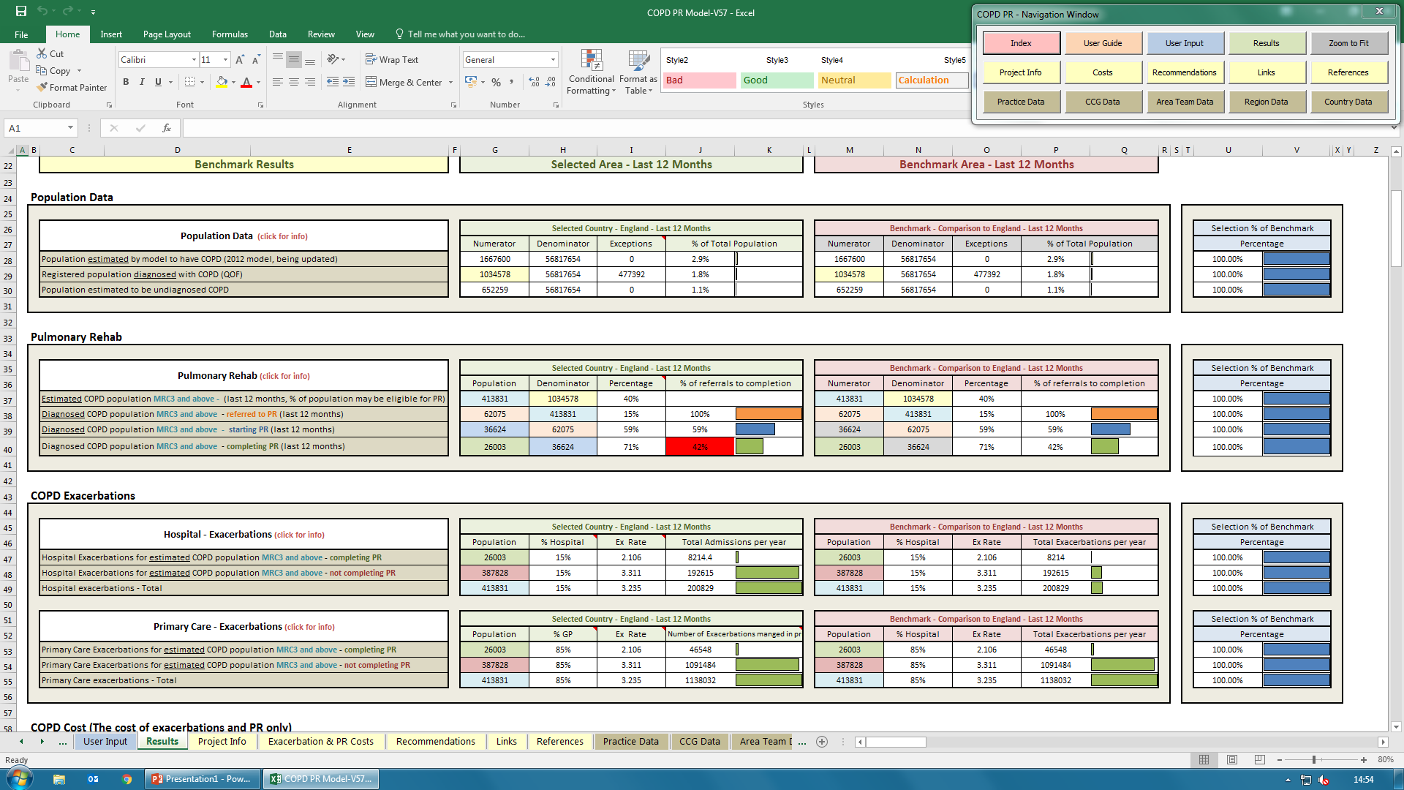
Numbers if Pulmonary rehab is offered to only 15% of eligible population ( current scenario)
Scroll
down
Number of hospital admissions
Number of exacerbations managed in primary care

Slide 6
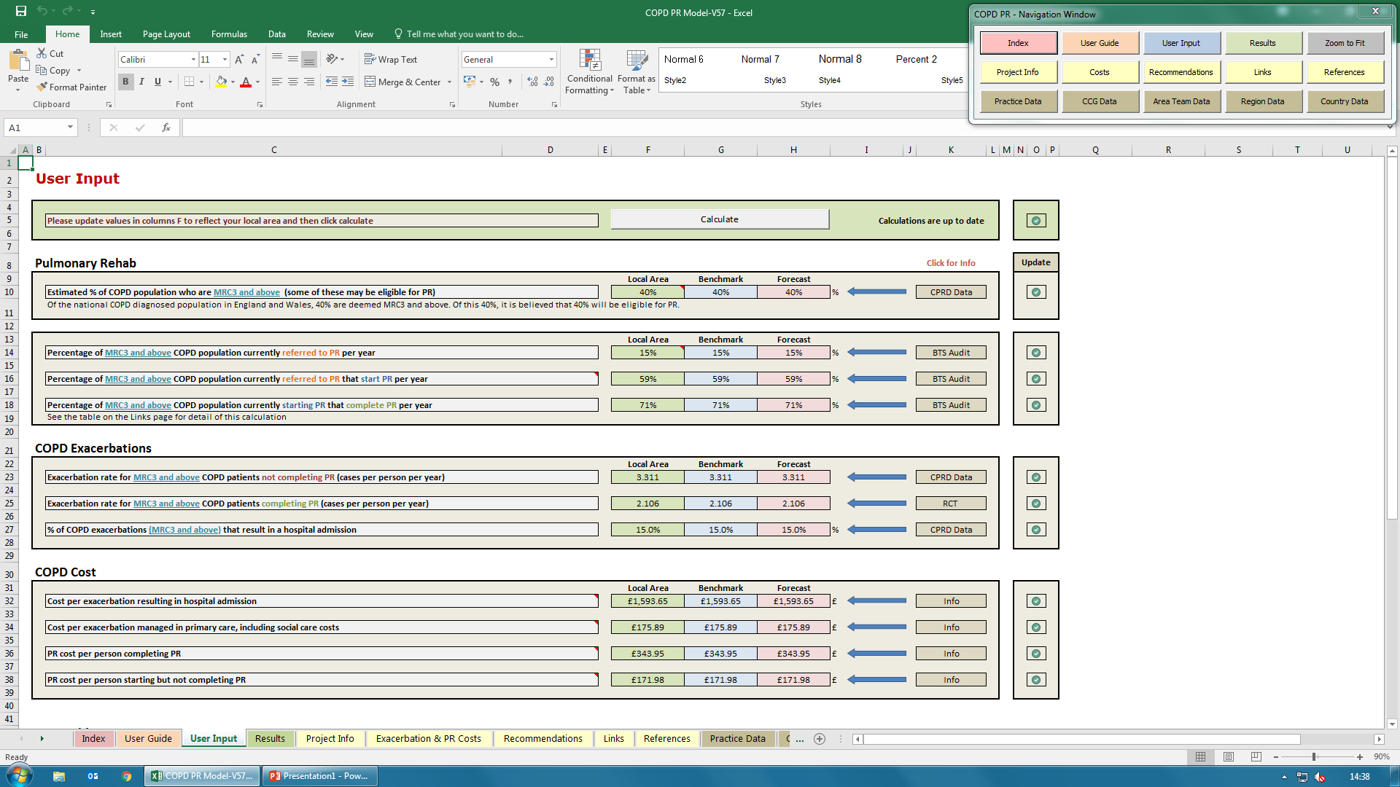
How to calculate Impact if Pulmonary rehab is offered to 100% of eligible population (proposed)
Click calculate
Change to 100
Select user input
Select results

Slide 7
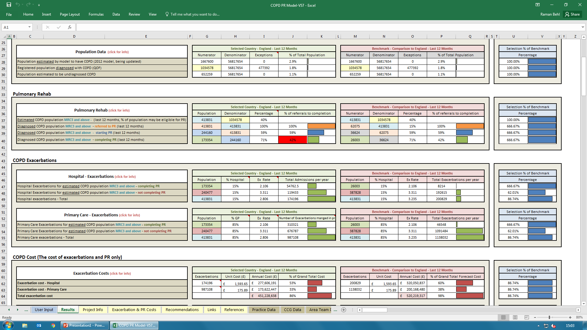
Impact if Pulmonary rehab is offered to 100% of eligible population (proposed)
Scroll
down
Note Reduction in Number of hospital admissions
Note Reduction in number of exacerbations managed in primary care

Slide 8
Impact of PR if offered to 100% of eligible COPD population (note these numbers have been calculated by deducting figures from 15% referral scenarios and 100% referral scenario )
The model proposes the following:
If every eligible COPD patient in England is referred to Physiotherapy-led pulmonary rehabilitation programme (the national benchmark for this is currently only 15%), annually patients and services will experience the following benefits:
A reduction of 1/3 exacerbations
A reduction of 150,924 exacerbations in this patient population, freeing up this number of appointments in primary care
26,633 avoided hospital admissions
106,532 hospital bed days saved (based on BTS/RCP National Clinical Audit Report 2015, average length of stay per COPD exacerbation admission = 4 days)

